Slide 1
Interactive maps pz.tt/ahg17-map

Slide 3
Dyslexia
Moderate vision impairment
Severe vision impairment
Epilepsy
Migraines
Physical impairment
Fibromyalgia
Multiple Sclerosis
Crohns Disease
PTSD
Aspergers

Slide 4
It’s not just about vision impairments

Slide 5
Our Services
Audits
Mobile testing
Building web sites
CMS testing
Accessible design
Video accessibility
User testing
OS / browser testing
Consultation
Accessible documents

Slide 6
Our Products
OzPlayer
OzART
OzWiki
A11yVoices.com
A11y Factsheets
More information:
www.accessibilityoz.com

Slide 7
OzWiki Interactive maps factsheet
A11yoz.com/fs-map

Slide 8
Impact on the end user

Slide 9
Impacts: Lack of description
Some maps do not have any text description:
    There are some people with disabilities that will not be able to see or interact with the map at all – they need a text description

Slide 10
Impacts: Lack of screen reader accessibility
“Maps are very important source of information for blind users. Maps designers should never assume the data they prepare won't ever be used by people with visual impairment.
Parking areas for instance are quite often places of meeting with one's befriended driver. One must know the area to be sure that the place of meeting is not a large three-story building where finding your friend's car and not being killed by other cars is a real possibility. “

Slide 11
Impacts: Keyboard inaccessibility
Some maps cannot be operated with the keyboard or do not have a highly visible keyboard focus indicator
    This limits the map use to mouse users only
    Many assistive technologies mimic the keyboard – they will not be able to interact with the map either

Slide 12
Impact: Use of colour
Some maps rely on colour to convey information, or colour contrast is not sufficient
    People who are colorblind may not be able to understand features of the map

Slide 13
Impact: Increase text size
Some map text content cannot be increased
    People who have mild vision impairments may not be able to read the content on the map

Slide 14
So how do you create an accessible interactive map?

Slide 15
Accessible interactive maps
Provide a long description in text
Make the map keyboard (and mouse and touch!) accessible
Meet colour contrast requirements
Use icons in addition to colour
Ensure users can increase text size

Slide 16
Step One
Long description

Slide 17
Long description
Providing an ALT attribute for image-based maps.
Ensure client-side image maps have accurate ALT attributes to indicate areas of a map or important markers
Provide a text version in a table of the important locations

Slide 18
Long description
Describe only those aspects of the map that are relevant, e.g. the most important point or the most common feature of the map
Describe the distance (in kilometres or metres) from important points.
If the map will be used for transport, give directions for car, public transport and/or walking.

Slide 19
Long description
If the map is time-sensitive, mark the times in the long description.
If the map is a transport map, organise the map by train, bus or train line and describe the locations and distances travelled.
If the map is a topographical map, mark the height at which important points occur.

Slide 20
Step Two
Screen reader accessibility

Slide 21
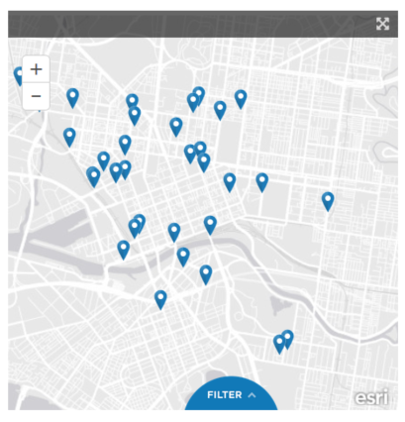
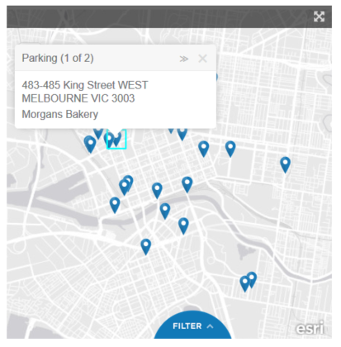
Partially screen reader accessible map

Slide 22
Screen reader accessibility
“Icons representing parking areas on the map could only be selected randomly.”
“All icons have the same label "graphic, MapMarkerIcons/blue_pin" (JAWS) or "graphic [number]" (NVDA) . Only after I selected the parking area I could read its name and address.”
“I could select the area the same way as parkings: randomly, on Firefox with JAWS and NVDA. Without labels (for instance names of districts) such selection makes no sense. I've never learnt what area I actually selected.”

Slide 23
Screen reader accessibility
“I could access parking areas only on Firefox with JAWS or NVDA. No access with other browsers or with WindowEyes.”
“Buttons for filtering are labelled as "filter btn on" and "filter filter btn off". You are not sure if the filtering category is selected or not, or what it does.”
“Links for sharing options (Facebook etc.) are not labelled (when you open e.g. "Parking locations" and go to "Share" there are four unlabelled links - one of them is Facebook).”

Slide 24
Screen reader requirements
Add the map at the current place in the DOM
Add hidden skip links so screen reader users can skip the map
Where possible, use links for the active regions of an interactive map
If you have to use something else make sure it has a text alternative!
Anything hidden with display:none, visibility:hidden, role=presentation or aria-hidden=true will be hidden from screen readers too!

Slide 25
Step Three
Keyboard and touch accessibility

Slide 26
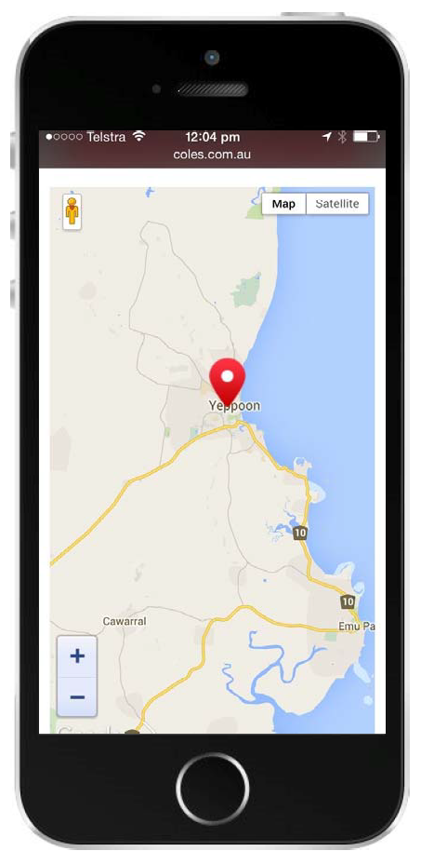
Not touch accessible
‘The zoom of doom’
û

Slide 27
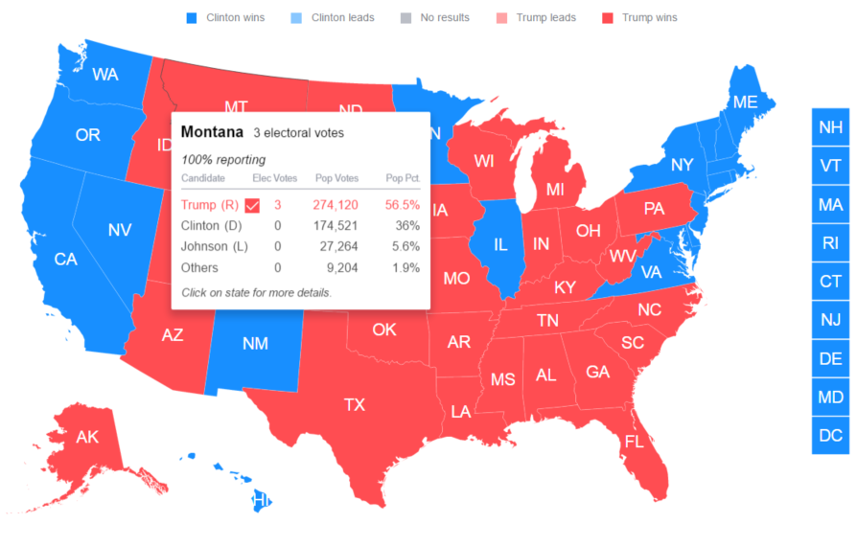
Data maps
û

Slide 28
Keyboard accessibility
Ensure all actions that can be achieved using the mouse can also be achieved using the keyboard or via touch
    Zoom in and zoom out
    Moving around the map (in a meaningful sequence)
    Popups on mouseover
    Activating an icon for more information
    Closing icons and popups

Slide 29
Keyboard accessibility
Where possible, use links for the active regions of an interactive map
If you have to use something else like a glyphicon or a span, ensure that it has a text alternative, and is in the keyboard focus order by adding tabindex=0

Slide 30
Step Four
Colour contrast

Slide 31
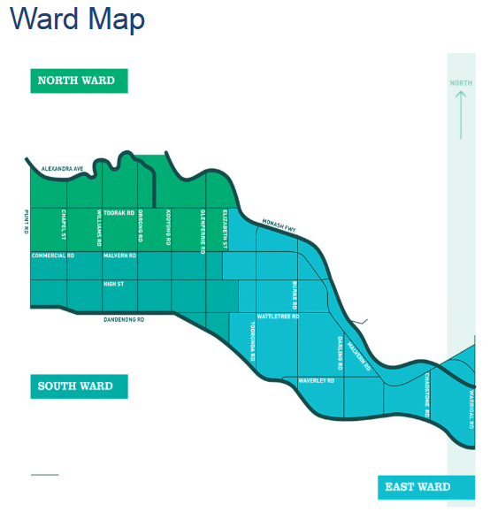
Color contrast – incorrect example
û

Slide 32
Color contrast
Ensure that your map design complies with the 4.5:1 color contrast ratio. Use colour contrast testers:
    Juicy Studio Luminosity Color Contrast Analyser (by HEX value)
    The Paciello Group’s Colour Contrast Analyser (by eye-dropper)

Slide 33
Add a border to each region of your map – then your map colors only need to contrast with the border color – not each other!

Slide 34
Step Five
Use icons in addition to colour

Slide 35
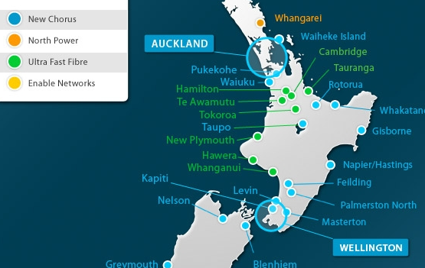
Use of color: incorrect example
û

Slide 36
Use of color: incorrect example
û

Slide 37
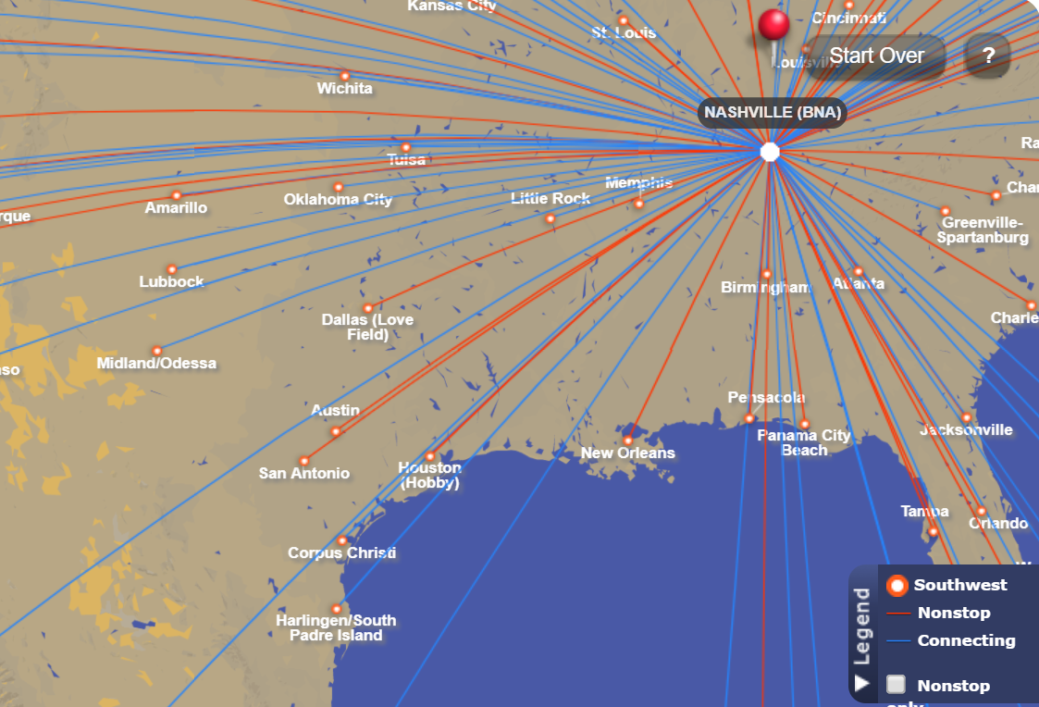
Use of color: incorrect example
û

Slide 38
Use of color
Do not rely on color to differentiate important parts of the map. Ensure that your maps use:
    borders to separate one area from another
    different types of shading and change of color to indicate different areas
    label markers with an icon and individual colors/icons for different markers.

Slide 39
Step Six
Ensure users can increase text size

Slide 40
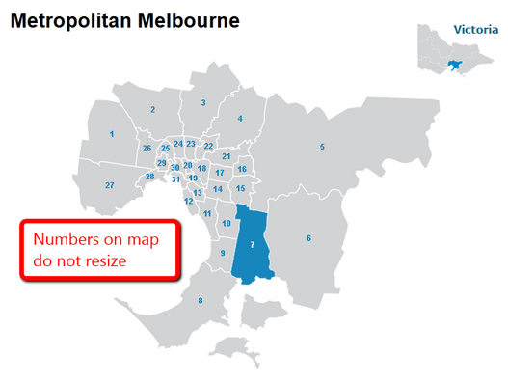
Text size – incorrect example
û

Slide 41
Text size
Ensure users can increase the size of the map, legend and any text. Often maps do not respond to browser requests to increase size.

Slide 42
Text size
    Provide a “large” version of the map, where the user has increased the normal text size by 250%; and
    Maximise a particular point/area, or add a highlight box that shows the particular point/area in a larger size.

Slide 43
Let’s look at some accessible interactive maps

Slide 44
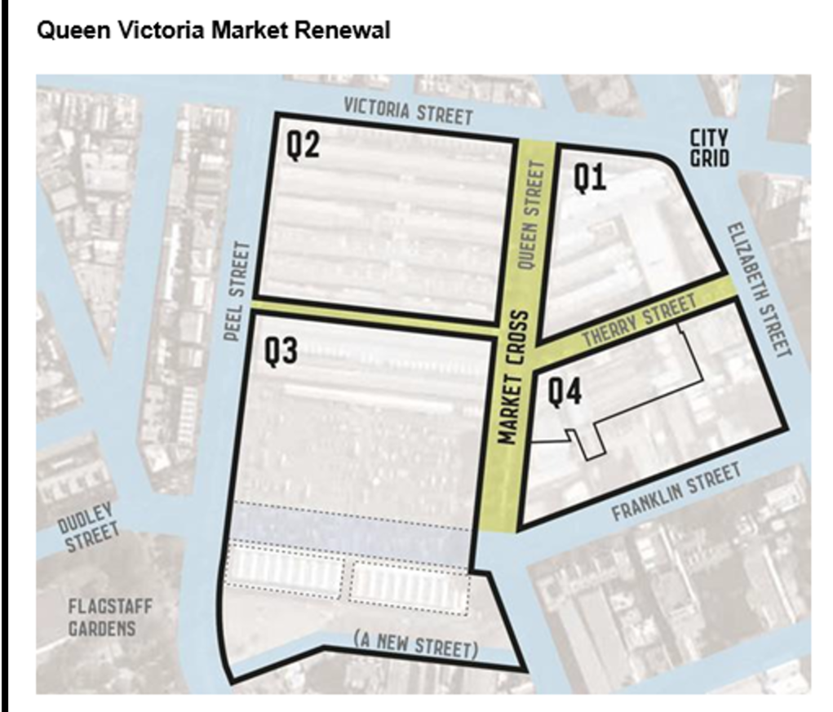
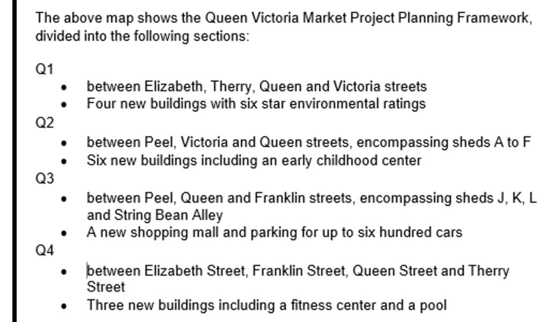
Long description in text

Slide 45
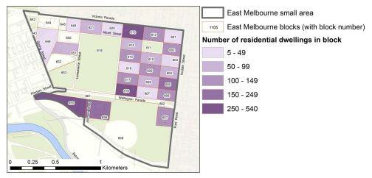
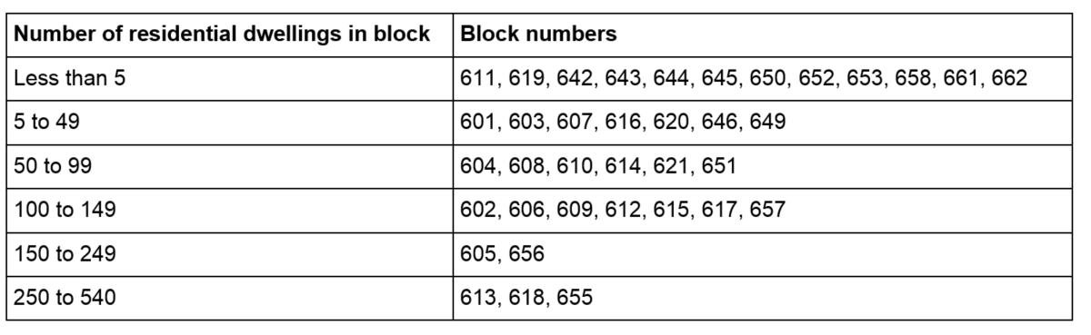
Long description in a table

Slide 46
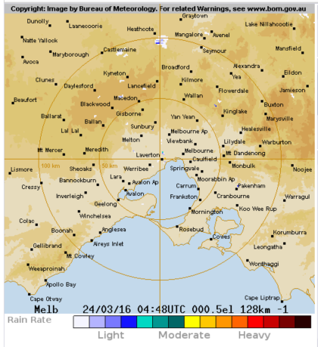
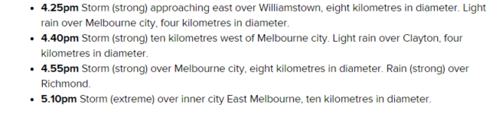
Long description for GIS map

Slide 47
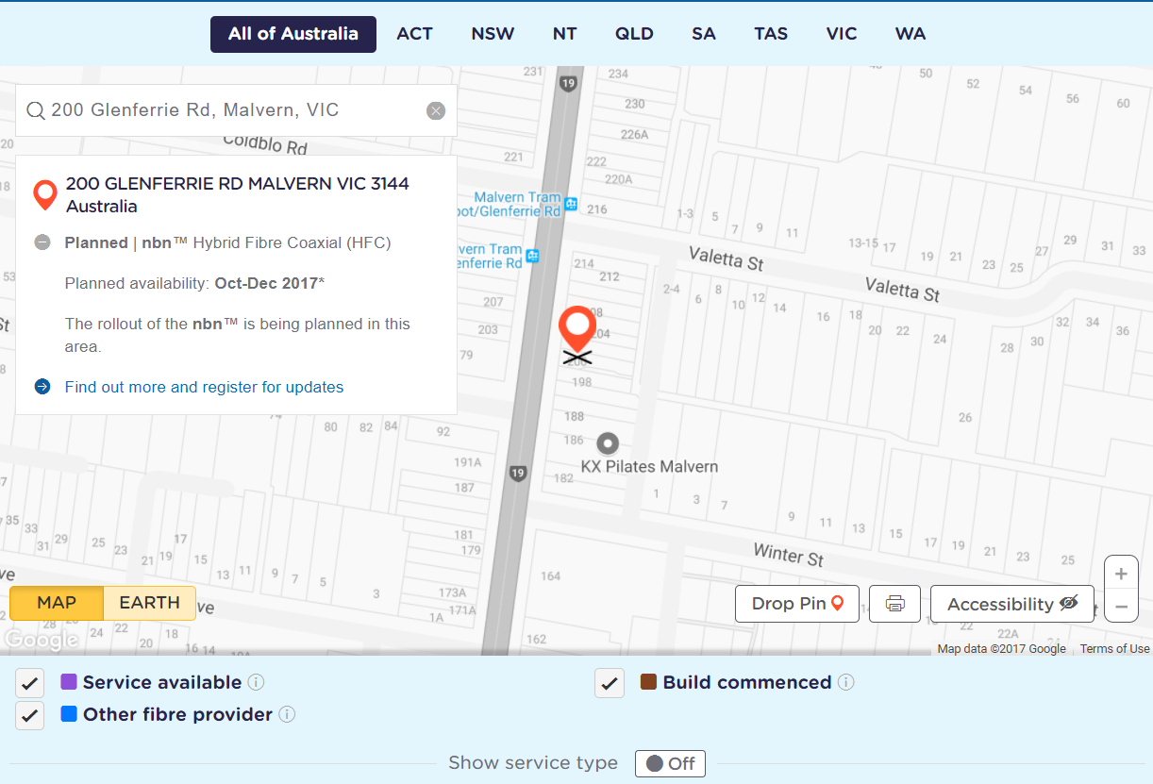
Long description by form

Slide 48
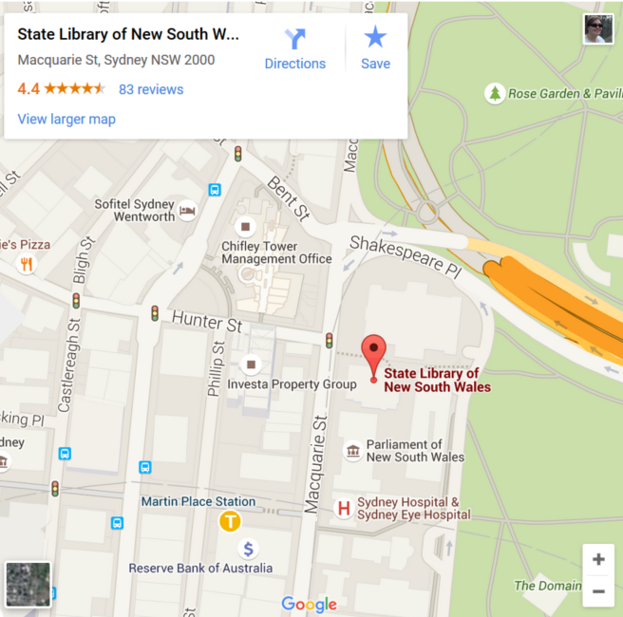
Text size

Slide 49
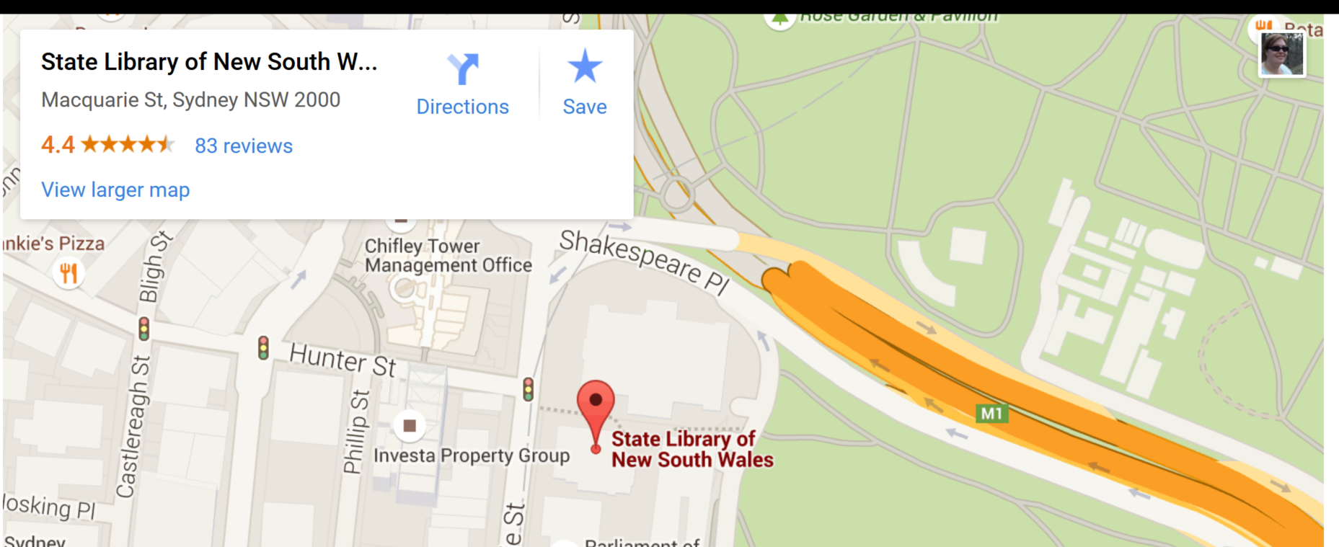
Text size

Slide 50
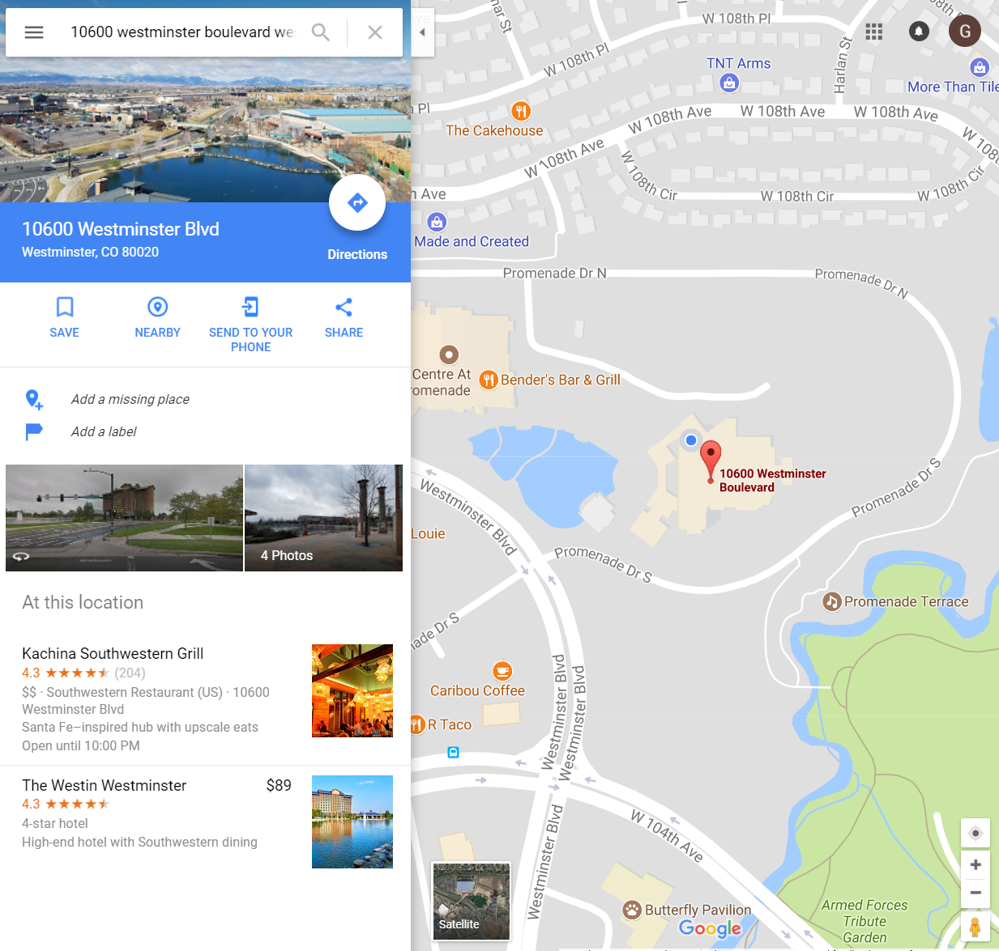
Text size

Slide 51
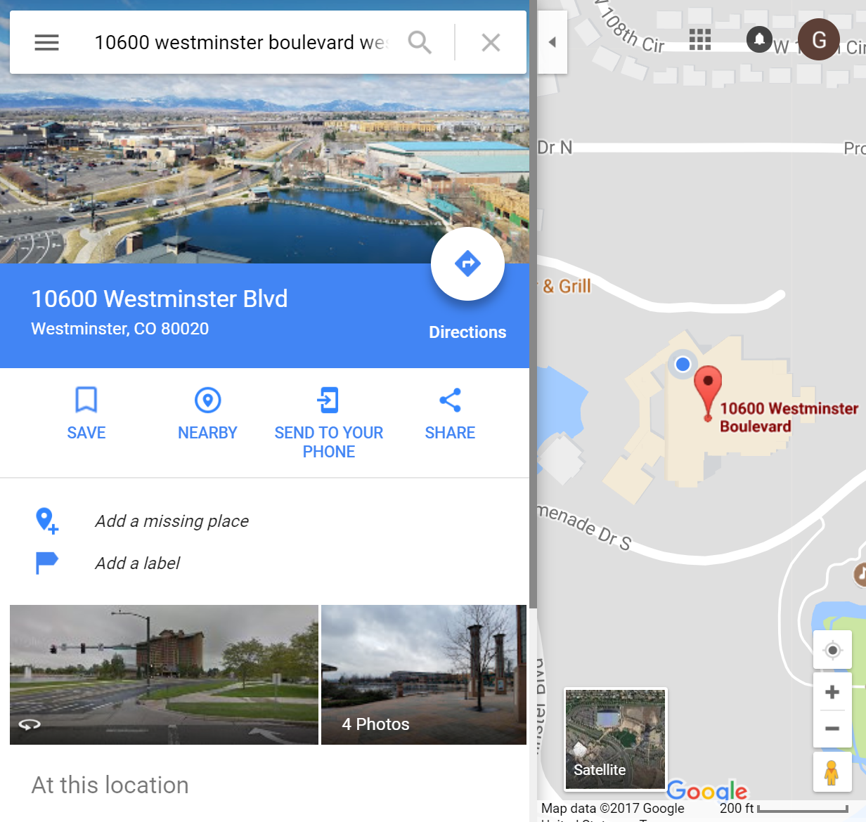
Text size

Slide 52
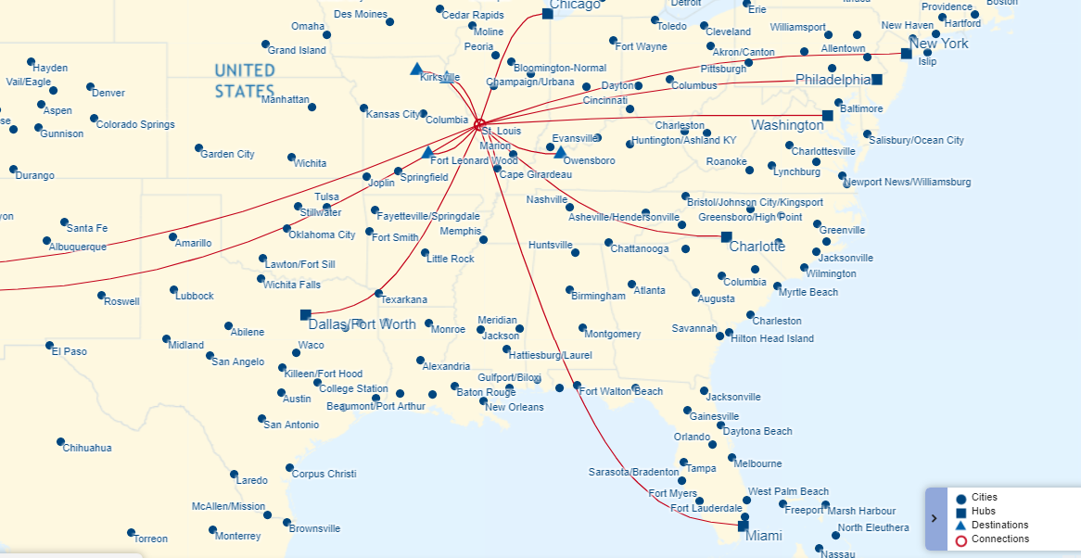
Use of color and shape

Slide 53
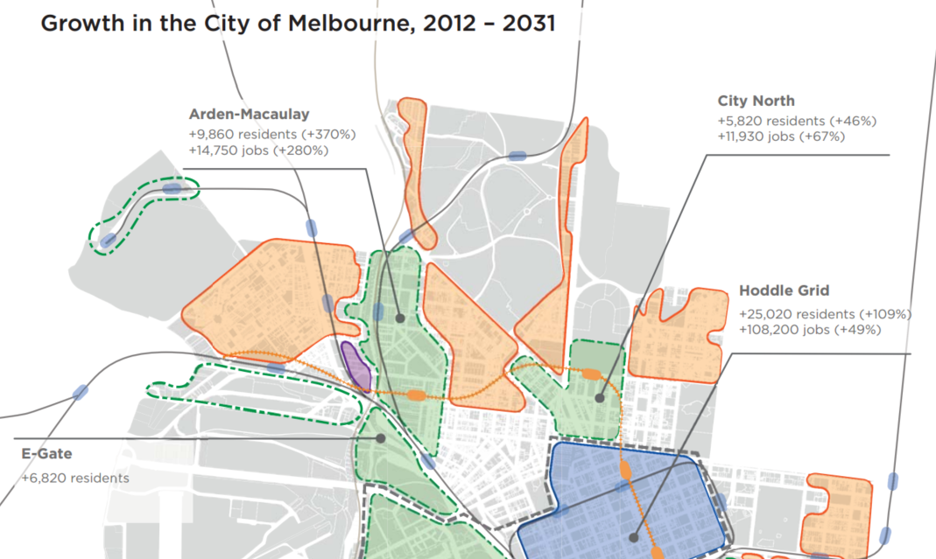
Use of color and pattern

Slide 54
Use of color and labels

Slide 55
Questions?
pz.tt/ahg17-map

