Slide 1
PDFs and Accessibility a11yoz.com/wcsyd

Slide 3
Hidden in plain sight
Speech-to-text program
Magnifier
Epilepsy
Migraines

Slide 4
It’s not just about vision impairments

Slide 5
Conformance requirements
Disability Discrimination Act moved to W3C WCAG, Version 2.0 in October 2010
AGIMO has a recommended timeframe for Government sites:
WCAG2 Level A: December 2012
WCAG2 Level AA: December 2014
AHRC has a timeframe for corporate sites too:
WCAG2 Level AA: December 2013

Slide 6
WCAG1 requirements for PDFs…
Level A
Requires an accessible equivalent for all PDFs:
HTML or
Word or
RTF or
Text
Level AA
Requires PDFs to be tagged with accessibility features:
Headings
Alternative text for images
Bookmarks
Links etc

Slide 7
The AGIMO PDF enquiry

Slide 8
The AGIMO PDF enquiry
40 submissions to the AGIMO PDF project:
Adobe
Government departments
Assistive technology manufacturers
People with disabilities
Accessibility specialists

Slide 9
The AGIMO PDF enquiry
Vision Australia tested a variety of PDFs with only low vision and blind users:
There was a strong negative attitude about PDF
Even with assistance a tagged PDF was often impossible to use
Lack of support for certain scanning and navigation features

Slide 10
The AGIMO PDF enquiry
PDFs were tested against WCAG2
Different PDFs were tested:
Adobe tagged “best practice” PDFs
Specialist tagged PDFs
Non-tagged PDFs

Slide 11
The AGIMO PDF enquiry
Talked to assistive technology manufacturers:
What is supported?
How many people use the technology?
What will be supported?

Slide 12
The AGIMO PDF enquiry
Overall, the Study found that there is insufficient evidence to establish that the development of the Portable Document Format and improvements in assistive technologies have advanced enough for PDF files to be considered accessible for people with a disability, particularly for those who are blind or have low vision

Slide 13
The AGIMO PDF enquiry
The Commission’s advice, current October 2010, is therefore that PDF cannot be regarded as a sufficiently accessible format to provide a user experience for a person with a disability that is equivalent to that available to a person without a disability, and which is also equivalent to that obtained from using the document marked up in traditional HTML.

Slide 14
The AGIMO PDF enquiry
PDF is not defined as “accessibility supported” because:
The design of the PDF file
Technical functionality of the assistive technology
Skill of the end user

Slide 15
WCAG2 requirements for PDFs…
Level A
Requires an accessible equivalent for all PDFs:
HTML or
Word or
RTF or
Text
Requires PDFs to be tagged with accessibility features:
Headings
Alternative text for images
Bookmarks
Links etc

Slide 16
The AGIMO PDF enquiry
The Commission will review the accessibility of PDF documents again in 2013, by which time it is expected that the provision, support, and utilisation of accessibility features will have improved.

Slide 17
The excuses for PDFs
Security

Slide 18
DDA Web Advisory Notes
Some file formats provide mechanisms for enhancing the security of documents by preventing unauthorised editing, copying, or printing. Some of these mechanisms are not compatible with accessibility for people with a disability, and document authors should ensure that security features do not prevent access to the document by assistive technology.

Slide 19
DDA Web Advisory Notes
If there are concerns about ensuring the authenticity of material published on the web in multiple formats, then a statement should be included that specifies which format is to be regarded as definitive or authorised, and noting that additional formats are being provided to maximise access.

Slide 20
What’s more secure than PDFs?

Slide 21
The excuses for PDFs
Brand

Slide 22
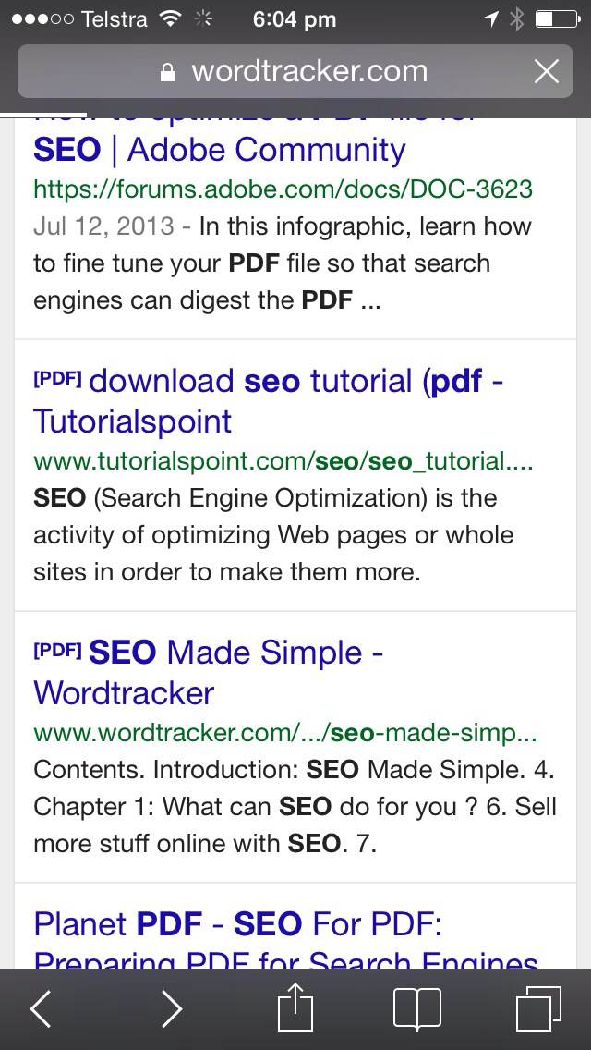
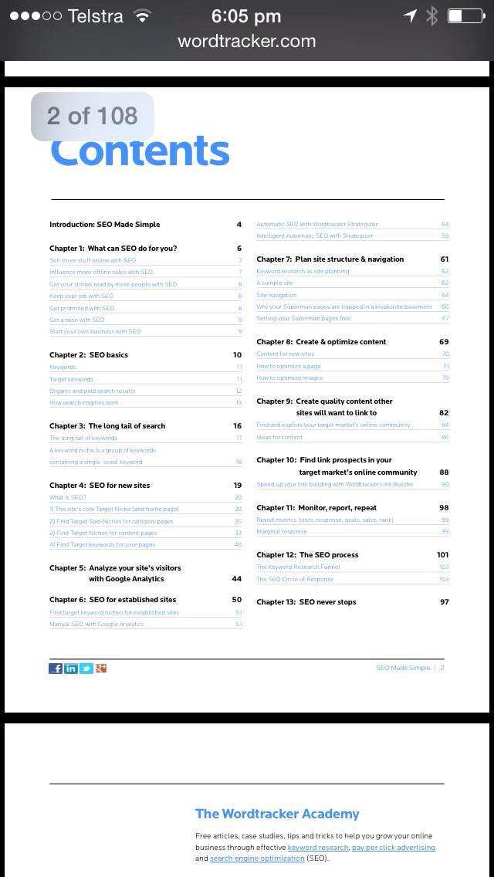
Which is better for your brand?

Slide 23
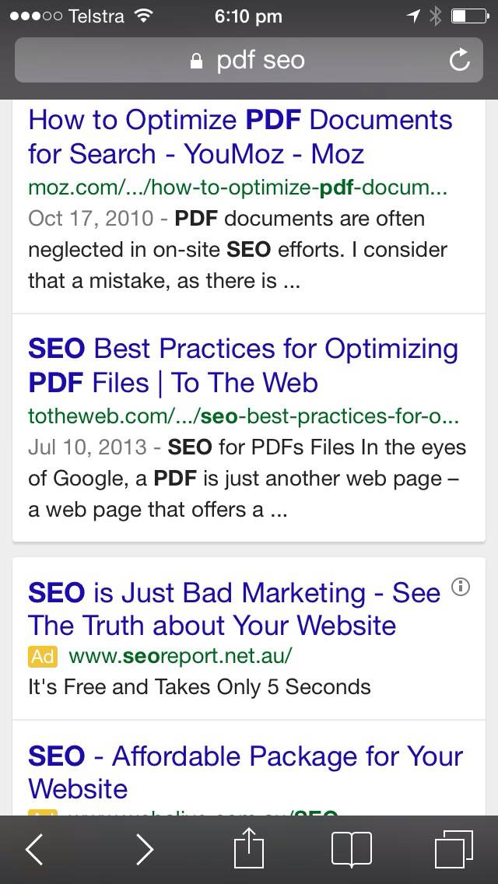
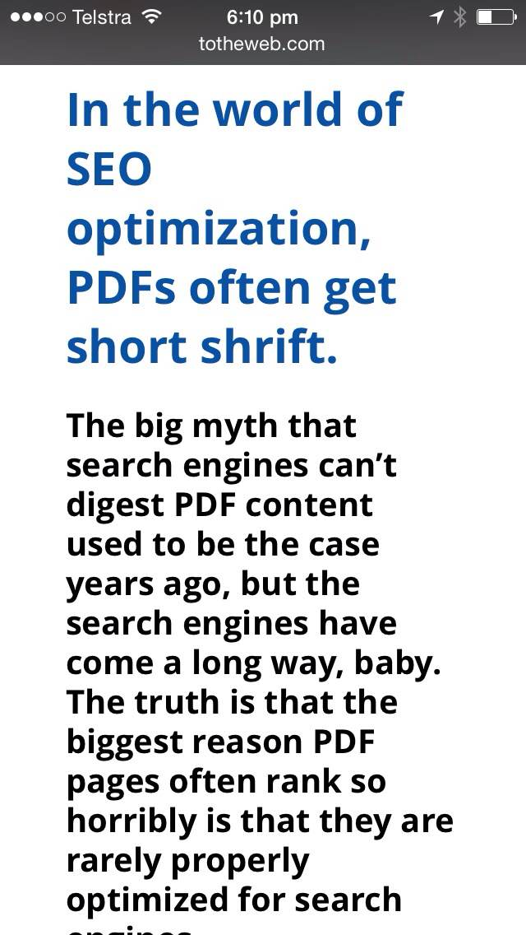
Which is better for your brand?

Slide 24
The excuses for PDFs
Print

Slide 25
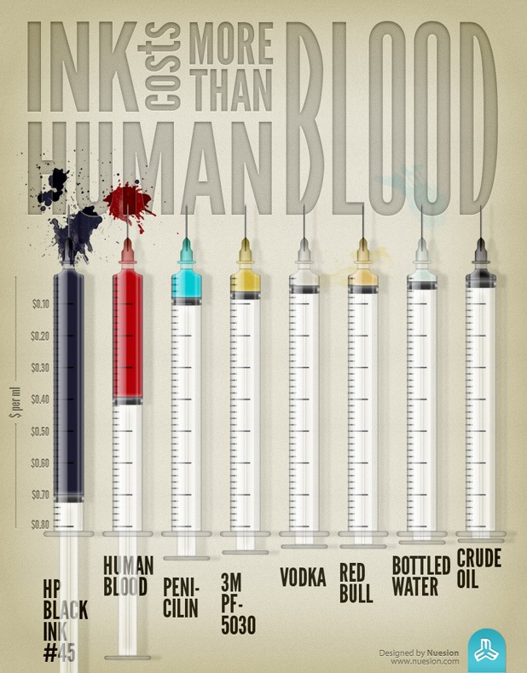
If people want print versions, maybe you should give them…
print versions

Slide 26
The excuses for PDFs
It’s easy

Slide 27
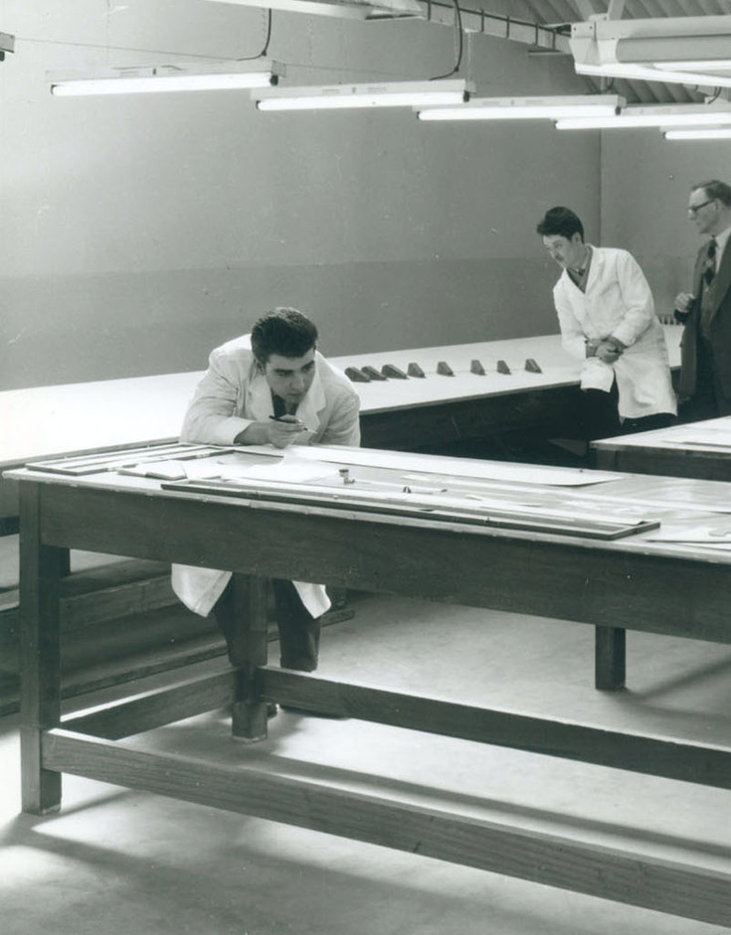
No one ever created a PDF in Acrobat…
(well almost never)

Slide 28
Why PDFs are bad for you
Google

Slide 29
PDFs are not ranked as highly by Google as HTML…

Slide 30
Google
In an overall SEO showdown, I’d still pick HTML over PDFs any day of the week, and you’re not likely to catch me creating brand new web content for my clients in Adobe Acrobat.
Reid Bandremer, Lunametrics, 2013

Slide 31
The DPI case study
If you are spending money preparing content for the web, then that money is essentially being wasted if that content is locked up in a format people are unwilling to use.
Initially we tried to create a web page to match each PDF, but in the end... it was far too difficult to manage both formats.
DPI completed a PDF purge of their website in 2011 resulting in a 1.6 million (38%) page view increase.

Slide 32
Why PDFs are bad for you
Sharing

Slide 33
An information-centric approach
…moves us from managing ‘documents’ to managing discrete pieces of open data and content which can be tagged, shared, secured, mashed up and presented in the way that is most useful for the consumer of that information.

Slide 34
Why PDFs are bad for you
Mobile

Slide 35
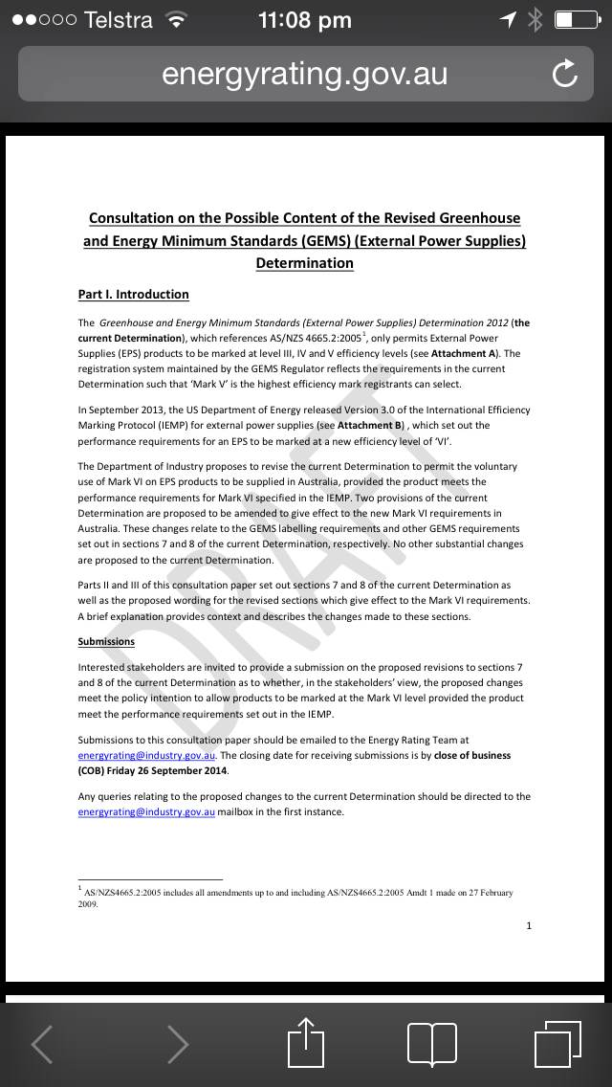
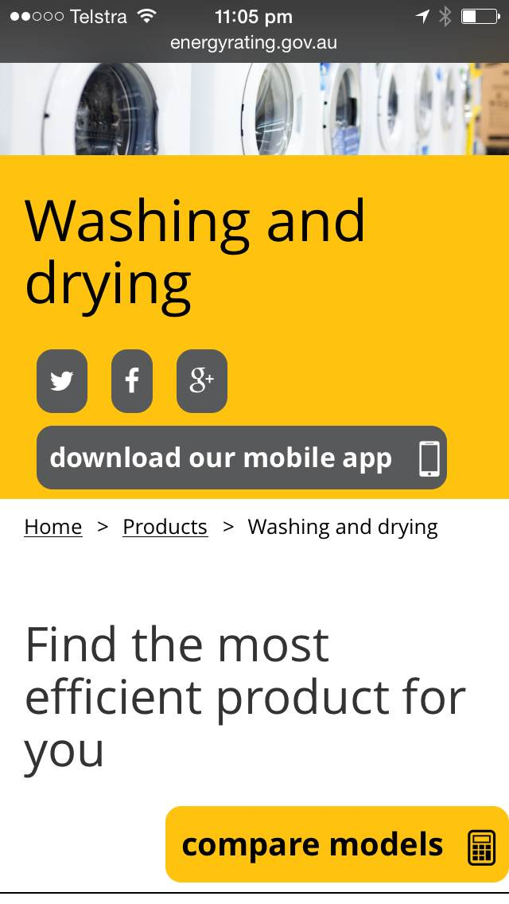
Which would you prefer?

Slide 36
Larger file sizes + slower connection
equals
longer download + increased data usage

Slide 37
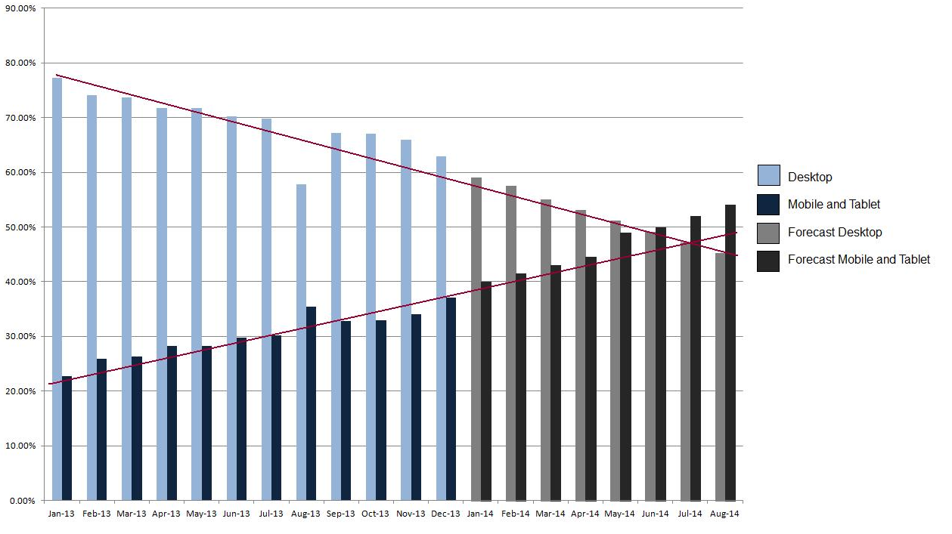
UK mobile vs desktop usage
UK mobile usage

Slide 38
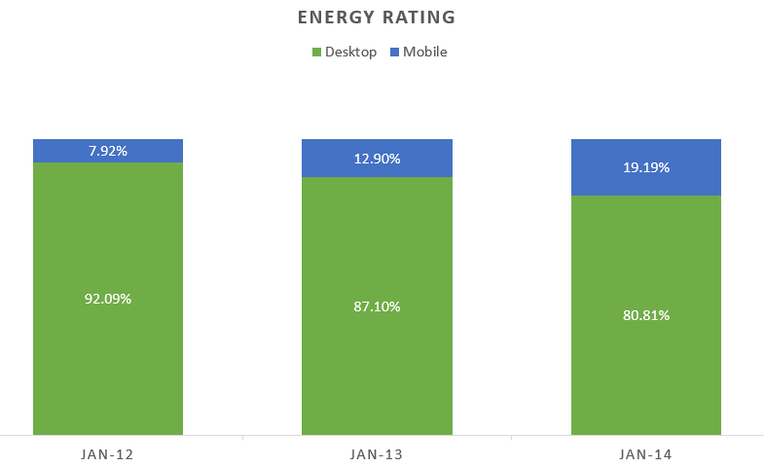
Mobile and desktop visitors

Slide 39
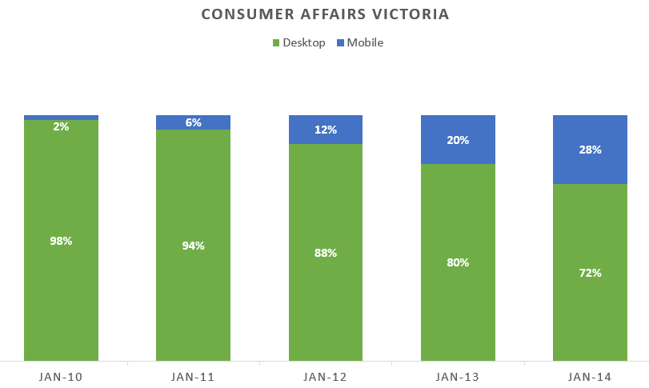
Mobile and desktop visitors

Slide 40
Why PDFs are bad for you
Nobody likes them = Nobody uses them

Slide 41
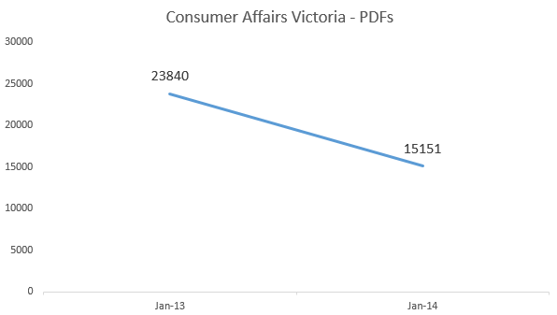
PDF usage
Year | Number of PDFs
2013 | 23,840
2014 | 15,151

Slide 42
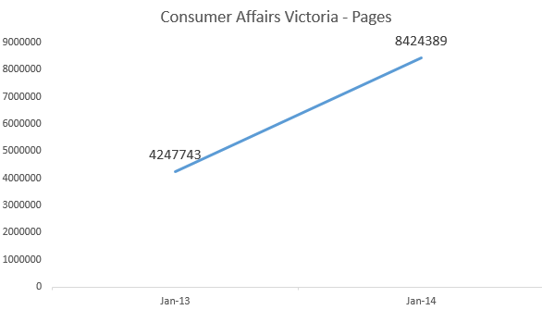
Page usage
Year | Number of pages
2013 | 4,247,743
2014 | 8,424,389

Slide 43
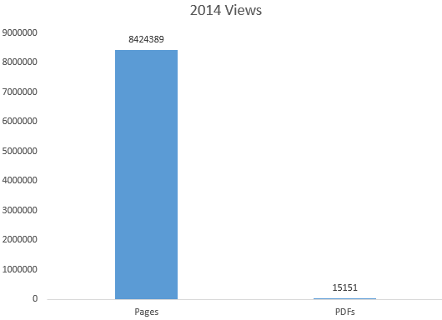
Comparison
Year | % pages | % PDFs
2013 | 99.44% | 0.56%
2014 | 99.82% | 0.18%

Slide 44
Everyone convinced?

Slide 45
Chances are…
You have thousands of PDFs on your site
They may have been created from Word documents but no one knows where those are anymore
None of them are tagged
No one owns them
No one wants to take them down

Slide 46
Chances are…
You need to be WCAG2 Level AA compliant by the end of the year (or the end of last year if you are corporate)

Slide 47
Breathe!

Slide 48
Breathe
Yes, every single one of your PDFs must have an equivalent and be tagged for your site to technically meet WCAG2, Level A
This is not feasible for mostly everyone.
Everyone knows this.

Slide 49
Step One
Let’s talk accessibility

Slide 50
Let’s talk accessibility
Provide an easy and accessible method to request:
An accessible version of the PDF
An audio version of the PDF
A printed (and sent) version of the PDF
Remember to make sure someone is responsible for these tasks!

Slide 51
Provide a solution
BrowseAloud:
Assistive technology purchased by the web site owner.
Free for the web site user
Reads untagged (text) PDFs
Disclaimer: AccessibilityOz is a reseller, but we really don’t know any other product as good as this one

Slide 52
Step Two
Identify

Slide 53
Not all PDFs are created equal

Slide 54
Identify
Identify those that are:
Aimed at people with disabilities
You are legally required to provide to the public
Popular and downloaded often
Are required to access your product or service (application forms etc)

Slide 55
Step Three
Plan

Slide 56
Plan
Create a process to:
Find the alternative accessible version
Create the alternative accessible version (HTML, Word, text or RTF)
Tag the PDF

Slide 57
Tagging PDFs and the print clause

Slide 58
Step Three
Share

Slide 59
Share your enhanced knowledge of PDFs

Slide 60
Share
Create a process to:
Always upload the alternative version with the PDF
Or…
Get rid of them entirely

Slide 61
Win an online training course
Discount code: wcsyd14
a11yoz.com/train

Slide 62
More information
a11yoz.com/wcsyd

Slide 63
Questions
a11yoz.com/wcsyd

