Slide 1
JavaScript accessibility http://pz.tt/desertjs

Slide 2
Agenda – Types of JavaScript functionality
Binding functionality to existing interactive components, such as links, buttons and text fields.
Non-interactive functionality that presents information.
Creating custom components that are both interactive and informative.

Slide 3
Agenda – Ten accessibility principles
All functionality must take a form that can be interpreted as text
All functionality must be accessible to all input devices
Information and structure can be programmatically determined
A meaningful sequence and logical focus order is maintained

Slide 4
Agenda – Ten accessibility principles
Instructions do not rely on sensory characteristics or nonsensical characters
Timed activity can be controlled
Provide mechanisms to help people find and interact with content correctly
Do not cause a change of context or content unexpectedly

Slide 5
Agenda – Ten accessibility principles
Identify components consistently
Identify and describe errors and error suggestions in text

Slide 6
Types of JavaScript functionality

Slide 7
Type 1
Binding functionality to existing interactive components, such as links, buttons and text fields.
Assistive technologies can derive information from their attributes and text; for example, a dynamic menu would be made using links organised into nested lists, in which the menu levels are denoted by the hierarchy, and by the use of structural labels around each top-level link

Slide 8
Type 2
Non-interactive functionality that presents information.
This must be implemented in such a way that the information can be derived from associated text; for example, a visual progress-meter would also show a % figure, or JavaScript might be used to identify and highlight form validation errors.

Slide 9
Type 3
Creating custom components that are both interactive and informative.
These components must be implemented using elements that are already understood by assistive technologies, so that their content and interactions can be programmatically determined; for example, a calendar widget would have a LABEL to describe it and a button to trigger it, while the calendar itself would be made using TABLE markup, which assistive technologies can understand and interpret as structured text.

Slide 10
Accessibility principles
JavaScript

Slide 11
Accessibility principles
Web accessibility is important to people with the following disabilities:
Blindness
Low vision
Motor impairments
Cognitive impairments

Slide 12
Principle 1
All functionality must take a form that can be interpreted as text

Slide 13
Principle 1: Text alternatives
Any of these groups of people may rely on assistive technology, such as a screen reader, a Braille reader, or a speaking browser. These technologies represent all information as structured text.

Slide 14
Principle 1: Text alternatives
If visual information has no text equivalent, assistive technologies will not be able to relay that information to the user.
If interactive components do not have a descriptive label, people who use assistive technologies, or who have a cognitive disability, may not understand what it is.

Slide 15
CAPTCHA

Slide 16
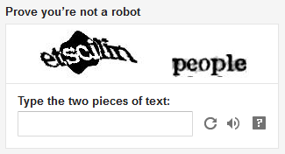
Correct example: CAPTCHA

Slide 17
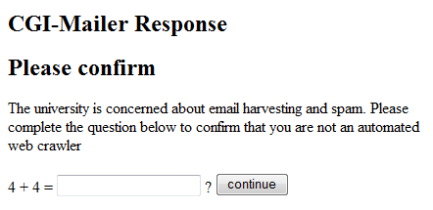
Better example: CAPTCHA

Slide 18
Visually-dynamic content

Slide 19
Examples: Visually-dynamic content
Visually-dynamic information (such as a progress meter) should have a text equivalent
Incorrect example: http://jqueryui.com/progressbar/
Correct example: Psalaciak,
http://jqueryui.com/progressbar/#label, JS_G_A1

Slide 20
Complex content

Slide 21
Examples: Long descriptions for non-text content
Functionality that can't be made accessible must have a long description that provides the same information
Incorrect example: Mobile coverage
Correct examples: Find a Telstra store,
Grains Canada, Brisbane City Council , JS_G_A2

Slide 22
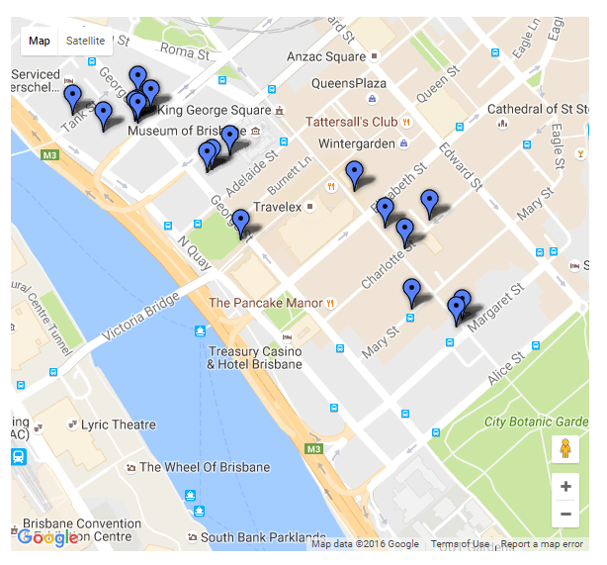
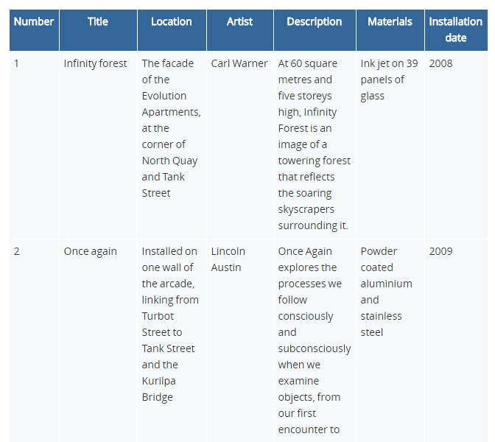
Correct example: Text alternative

Slide 23
Text alternative requirements
CAPTCHAs must be multiple sensory modalities
Complex systems must have a valid long description

Slide 24
Principle 2
All functionality must be accessible to all input devices

Slide 25
What are input devices?
Mouse
Keyboard
Touchscreen on a mobile device (with onscreen keyboard)

Slide 26
Assistive tech that mimic input devices
Joystick (mimicking a mouse)
Onscreen keyboard (mimicking a keyboard)
External keyboard on a mobile device (mimicking a keyboard)
Thumb switch (mimicking a keyboard)
Headwand (mimicking a mouse)

Slide 27
Principle 2: Input device accessible
Assistive technologies are usually controlled with the keyboard, rather than with a mouse or pointing-device, and there are also many people who are simply unable to use a mouse or trackpad, because of a motor impairment.

Slide 28
Principle 2: Input device accessible
If interactive content can’t be operated with the keyboard, it will be entirely inaccessible to people who can’t use a mouse or pointing device.
There are also people entirely reliant on other input devices; so it is essential that all the site functions using only one type of input device.

Slide 29
Keyboard

Slide 30
Using the keyboard
Use TAB, ESC or arrow keys to exit, or
Document the feature needed to exit, prior to entering application
Must be able to TAB from start to finish

Slide 31
Example: Keyboard trap
Interactive content should be accessible to the keyboard, using common keystrokes like Tab, Enter and Arrow Keys

Slide 32
Examples: Keyboard focus indicator
Do not use events to restrict keyboard access or remove focus indication
Incorrect example: Sony
Incorrect example: onfocus=“this.blur()”
Correct example: OzWiki, AccessibilityOz slideshow

Slide 33
Examples: Dynamic menus
Dynamic menus should be fully accessible to the keyboard, using Tab and Arrow Keys
Incorrect example: Sony, NBC10
Correct example: Government of Canada, JS_N_A1

Slide 34
Keyboard requirements
There must be no keyboard traps
When creating a modal window / dialog box focus must remain on the modal window / dialog box
Dynamic menus must be fully keyboard accessible
Ensure that mouse-only functionality has a keyboard equivalent
Ensure everything has a keyboard focus indicator

Slide 35
Principle 3
Information and structure can be programmatically determined

Slide 36
Principle 3: Information and structure
If scripting is used to implement standard functionality, assistive technologies will not understand what it is, and will therefore not be able to describe it or provide the appropriate keystrokes.
If custom widgets are built using non-semantic markup, assistive technologies will similarly fail to understand what they are.

Slide 37
Principle 3: Information and structure
When content requires user input, labels or instructions should be provided to assist the user with completing their task, and to minimise mistakes made:
If labels and instructions are not provided and associated with a form input, a blind user will not know what information to enter.

Slide 38
Principle 3: Information and structure
Similarly, labels and instructions that are not visually located closely to a input can prevent users of screen magnifiers from seeing this information.
Labels and instructions that do not give examples of expected user input can reduce the likelihood of users with cognitive, language and learning disabilities entering the correct information.

Slide 39
Principle 3: Information and structure
Keyboard users may submit incomplete forms if required fields are not labelled; trying to find the incomplete input is a tiresome task when information is not provided to assist.

Slide 40
Labels and fieldsets

Slide 41
Examples: Field Labels
Fields must have an associated and coded field label.
Incorrect example: AirBNB
Correct example: Amazon

Slide 42
Tabs

Slide 43
Examples: Bypass blocks
Use an expandable/collapsible menu to bypass blocks of content
Incorrect example: University of Sunderland
Correct example: TAC forms, JS_G_A8

Slide 44
Principle 4
A meaningful sequence and logical focus order is maintained

Slide 45
Principle 4: Sequence and focus order
The visual reading order of form content should be presented in a meaningful and logical sequence i.e. left to right and top to bottom.
Screen readers will read form components in the order that it appears in the source mark-up. When meaningful sequence is not maintained, form content may be displayed incorrectly when presented in alternative formats by assistive technologies.

Slide 46
Principle 4: Sequence and focus order
Users of assistive technologies sometimes do not have access to the entire page at once, so changes before the user’s current focus or elsewhere on the page may be missed.

Slide 47
Principle 4: Sequence and focus order
Navigating with the keyboard is a one-dimensional process, and users who rely on speech output can only hear one thing at a time, so content which is not in a logical order is harder to comprehend and use. When a keyboard user presses a button and new interactive content appears, they’ll expect that content to be immediately next in the Tab order, not to have to jump around the page to get to it.

Slide 48
Why sequence is important
Websites are accessed by a variety of devices including mouse, keyboard, touchscreen, switch, joystick and assistive technologies such as screen readers and magnifiers. When the source order, keyboard focus order and visual reading order of a webpage are inconsistent with each other this can greatly impact their ability to navigate and access a web page effectively.

Slide 49
Three orders
Source order
The order that the underlying HTML or other mark-up is written.
Keyboard focus order
The order of interactive page elements, such as links and form controls, when accessed by the keyboard i.e. the order in which items receive keyboard focus.
Visual reading order
The logical and intuitive order in which a sighted user naturally reads the page content. This is generally left to right and top to bottom – all content should be presented in a meaningful sequence so that any relationship within the data is clear.

Slide 50
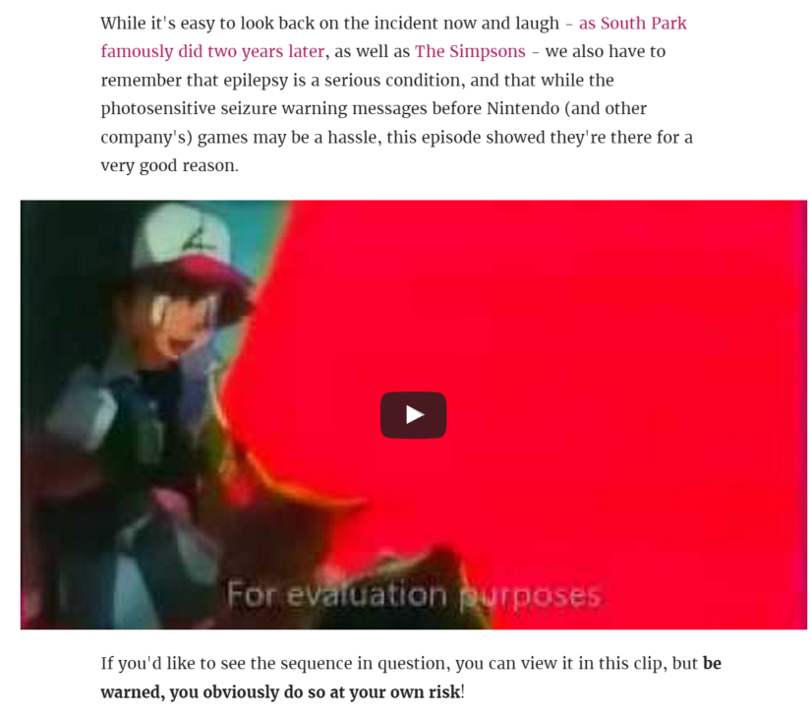
Visual reading order
It matters!

Slide 51
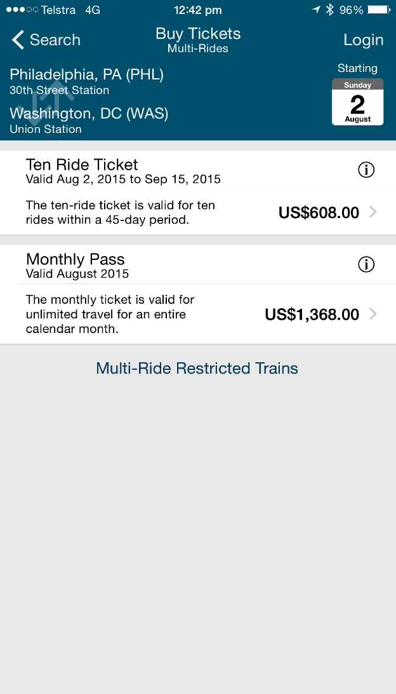
Incorrect example
Don’t assume people read to the bottom of the screen

Slide 52
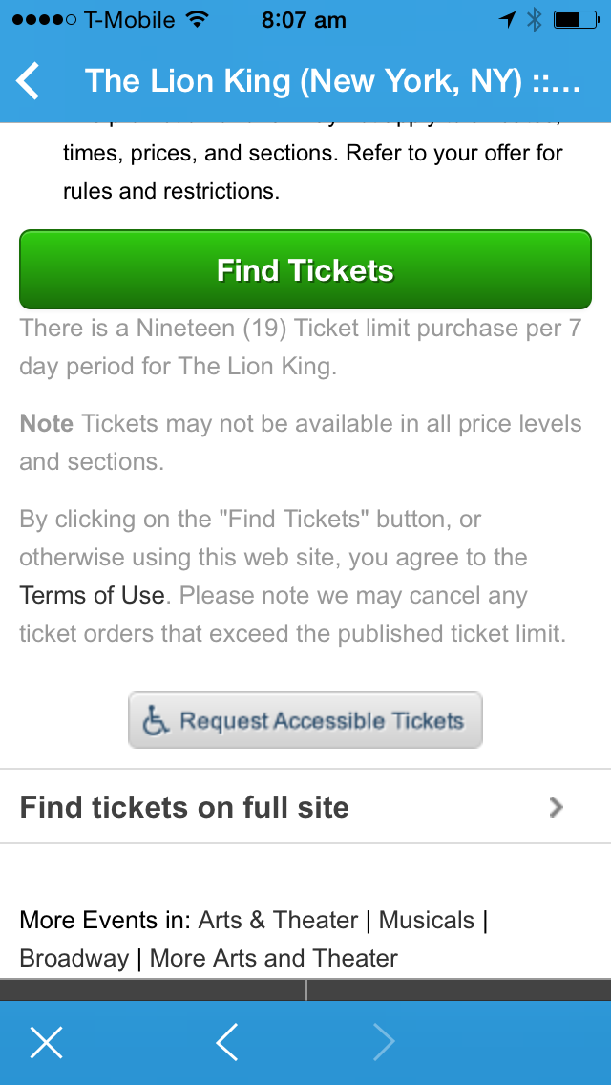
Incorrect example
Important information should never be after a Submit button

Slide 53
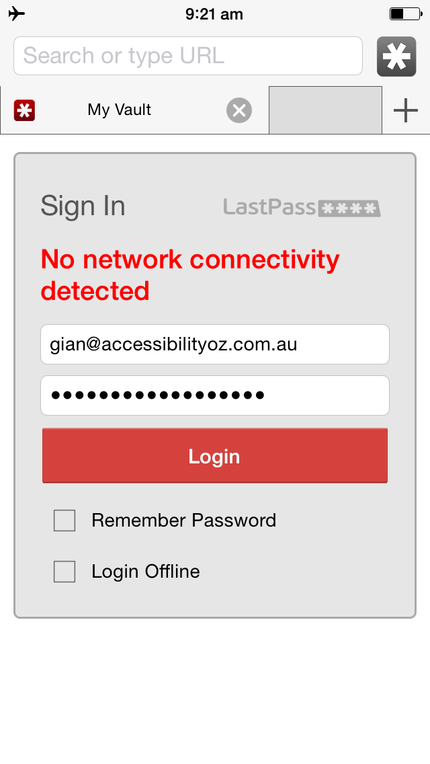
Incorrect example
Important information should never be after a Submit button

Slide 54
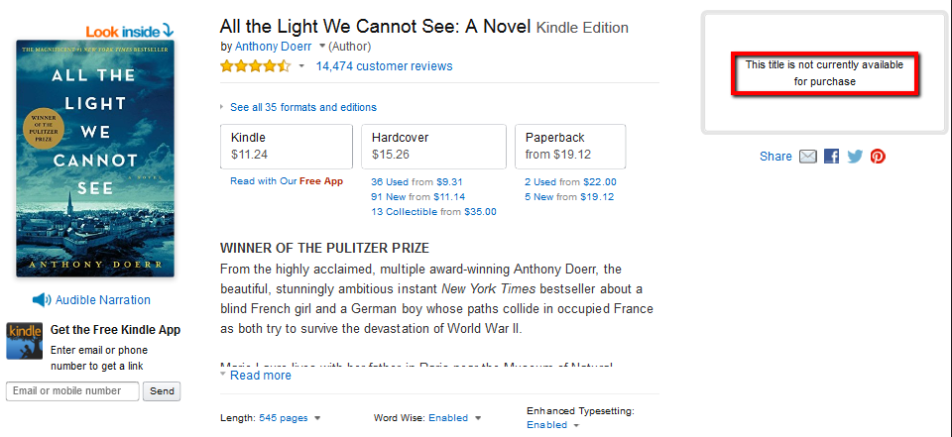
Incorrect example:Visual reading order

Slide 55
Adding and re-ordering content

Slide 56
Examples: Adding content
Use functions of the DOM to add content to a page
Incorrect example: Dynamic Drive
Correct example: JS_G_A6

Slide 57
Logical focus order
Insert dynamic content into the DOM immediately following its trigger element
Correct example: Amnesty International Australia, JS_C_A9

Slide 58
Logical focus order
Use scripting to re-order content in the DOM
Incorrect example: Scripting to re-order DOM
Correct example: Sortable list, JS_C_A11

Slide 59
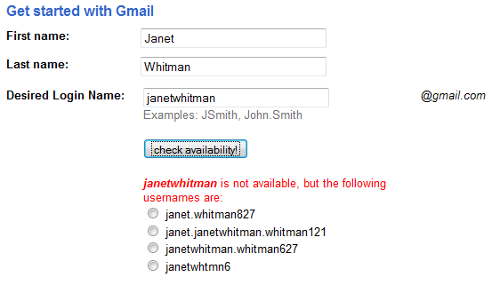
Correct example: Focus order
ü

Slide 60
Custom dialogs

Slide 61
Logical focus order
Create custom dialogs in a device independent way
Incorrect example: jQuery gallery
Correct example: Butterfly gallery, JS_C_A10-12
Notes:
Disable JS

Slide 62
Initiated on request
Use progressive enhancement to open custom dialogs on user request
Incorrect example: Fancybox (keyboard focus remains on the underlying page)
Correct example: JS_C_A10-12

Slide 63
Principle 5
Instructions do not rely on sensory characteristics or nonsensical characters

Slide 64
Principle 5: Illegible instructions
When sensory characteristics (colour, shape and location) or nonsensical characters (asterisks, dashes etc) are used instead of text, users of screen readers may not be able to understand the meaning of the content. Often these are ignored by the screen reader which means information is omitted completely.

Slide 65
Fields

Slide 66
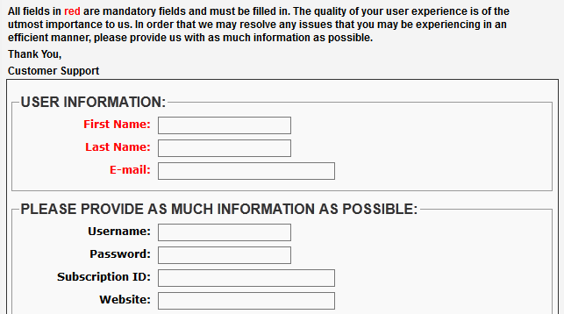
Incorrect example: Mandatory fields
û

Slide 67
Principle 6
Timed activity can be controlled

Slide 68
Principle 6: Timed activity
Users of assistive technology often take a lot longer to read a page or undertake required functionality, either because of a cognitive disability, or because they can only focus on a few words at once, or because it takes longer to listen to synthesized speech than to visually read. It would be confusing and disorientating for people if content were to change while they were reading it.

Slide 69
Principle 6: Timed activity
Continual animation or flickering effects may trigger a seizure in someone who has photosensitive epilepsy. It’s also more difficult for someone with a cognitive disability to ignore these effects, which makes the actual content harder to focus on.

Slide 70
Flickering

Slide 71
Pokemon Shock
Electric Soldier Porygon is the 38th episode of the Pokemon’s Anime series. It was broadcast in Japan on December 16, 1997 on 37 stations to 4.6 million households.
There were repetitive visual effects (flashing red and blue lights) – effectively strobe lights at a rate of 12 Hz for six seconds

Slide 72
No flashing
Flashing images, especially those with red, should not flicker faster than three times per second. If the image does not have red, it still should not flicker faster than five times per second.
Flashing images should not be displayed for a total duration of more than two seconds.
Stripes, whirls and concentric circles should not take up a large part of the television screen.

Slide 73
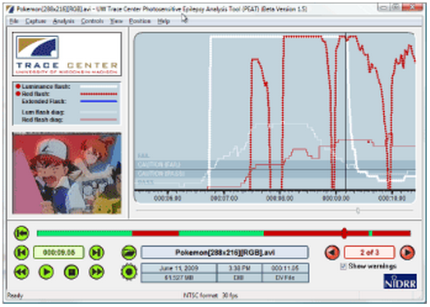
Incorrect example: Flickering
Use the PEAT tool:
http://trace.wisc.edu/peat/

Slide 74
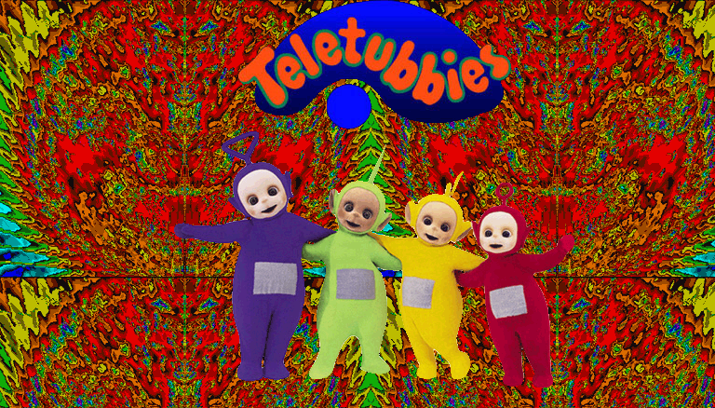
Incorrect example: Flickering
û

Slide 75
Incorrect example: Flickering
Warning – this contains flickering and could cause epileptic attacks or migraines.
Kickstarter campaign – LiFX

Slide 76
Time limits

Slide 77
Timed activity
Warn the user when a time-limit is about to expire, and provide a mechanism for extending it
Incorrect example: ANZ Banking
Correct example: JS_C_A5

Slide 78
Incorrect example: Timing
û

Slide 79
Movement

Slide 80
Timed activity
Use scripting to scroll content and provide a mechanism to pause it
Incorrect example: Simple Marquee for Joomla
Correct example: AccessibilityOz

Slide 81
Timed activity
Use scripting to create a blinking animation that stops in 5 seconds
Correct example: JS_C_A8

Slide 82
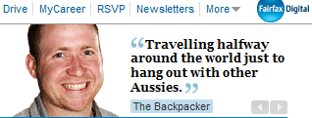
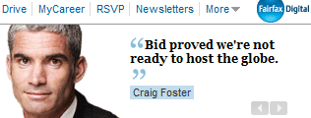
Incorrect example: Pause, stop, hide
û

Slide 83
Correct example: Pause, stop, hide
ü

Slide 84
Alternatives to moving content

Slide 85
Timed activity
Use scripting to create an alternative, static version of scrolling content
Incorrect example: Ajax Scroller for Joomla
Correct example: JS_C_A6-A7

Slide 86
Timed redirects

Slide 87
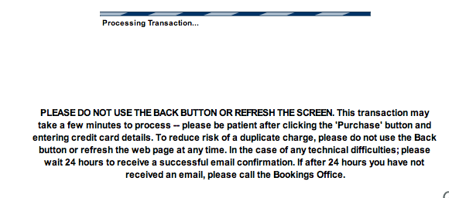
Incorrect example: Pause, stop, hide
û

Slide 88
2.2.2: Pause, stop, hide
Timed server redirects not allowed
Non-timed server redirects ok
Animated GIF must stop moving in 5 seconds
Do not use BLINK
Stop by:
Stop moving content with user agent stop button or ESC key; and/or
Reloading page stops the blinking; and/or
Link to stop content.

Slide 89
Principle 7
Provide mechanisms to help people find and interact with content correctly

Slide 90
Principle 7: Finding & interacting with content
People rely on mechanisms to find information that are most suited to their needs. On a large website, if a search is not provided, blind users may find it cumbersome to tab through a large navigation block, or visually impaired users may find it difficult and confusing when doing the same with a screen magnifier or screen reader. Providing a search benefits everyone by allowing information to found quicker.

Slide 91
Principle 7: Finding & interacting with content
When functionality is visible that doesn’t work it can be particularly confusing to people with disabilities.
Selecting a link or button which then does nothing at all, is confusing and frustrating for any user, but particularly to someone who has a cognitive disability.

Slide 92
Principle 7: Finding & interacting with content
There are two different ways of ensuring that scripted functionality is not present when JavaScript is unavailable:
Static HTML, which is hidden using display:none that's applied through a CSS class. The content is then displayed again by adding an additional "script-enabled" class, and that's done with JavaScript
Content is generated with JavaScript

Slide 93
Principle 7: Finding & interacting with content
Generating content via JavaScript is best, because it means that the content will not re-appear when CSS is also unavailable. However that's not a very common situation, and sometimes the amount or complexity of the HTML makes it impractical to generate through scripting. So the static HTML is acceptable if necessary.

Slide 94
Instructions

Slide 95
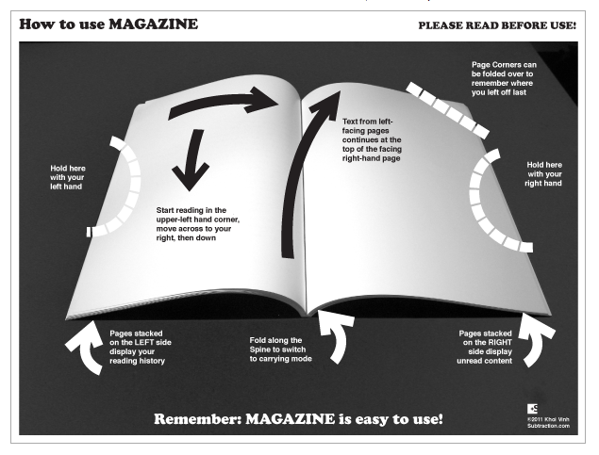
Correct example: Instructions
Complex content should have instructions

Slide 96
Non-text content (JavaScript)
Functionality that can't be presented in text must be descriptively identified
Incorrect example: Typing example, Bouncing balls
Correct example: JS_G_A3

Slide 97
JavaScript functionality

Slide 98
Non-text content (JavaScript)
Functionality that relies on JavaScript should not be present when JavaScript is unavailable
Incorrect example: Telstra.com
Correct example: TAC forms, JS_G_A4

Slide 99
Principle 8
Do not cause a change of context or content unexpectedly

Slide 100
Principle 8: Change in content and context
Navigating a document or inputting data into a form should be a predictable experience for all users. People with visual, cognitive or motor impairments may become disoriented if changes in context or content occur unexpectedly, such as a new window popping up or the focus being moved to another form component. The user may be not aware that a change has occurred as a result of their actions if they were not adequately informed or did not initiate the change.

Slide 101
New windows

Slide 102
Initiated on user request
Use an actuation event, rather than focus or load event, to programmatically open links or trigger popup windows
Incorrect example: JS_N_A2

Slide 103
Initiated on user request
Use progressive enhancement to open windows on user request
Correct example: JS_N_A3

Slide 104
Change on user request

Slide 105
Initiated on user request
Do not use the change event of a SELECT element for navigation
Incorrect example: JS_N_A4
Correct example: AccessifyForum
Notes:
phpBB- Jump to at the bottom

Slide 106
Initiated on user request
Do not automatically redirect the page using JavaScript
Incorrect example: JS_N_A5

Slide 107
Initiated on user request
Do not automatically refresh the page without user confirmation or control
Correct example: JS_N_A6

Slide 108
Incorrect example: On focus
û

Slide 109
Incorrect example: On focus
û

Slide 110
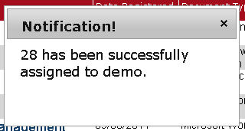
Incorrect example: On focus
û

Slide 111
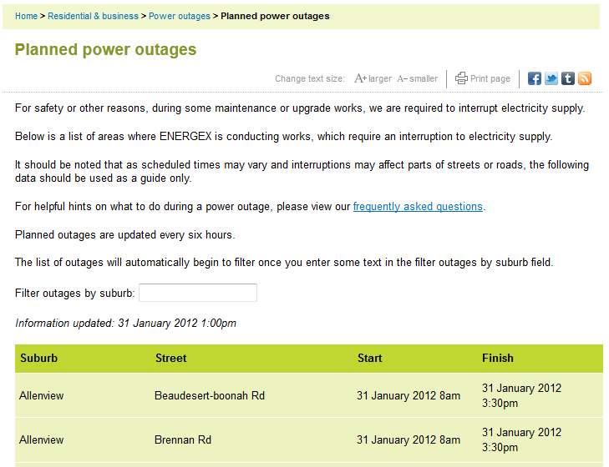
Incorrect example: On input
û

Slide 112
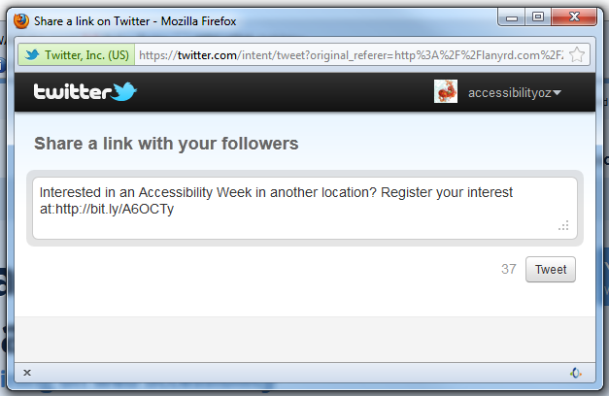
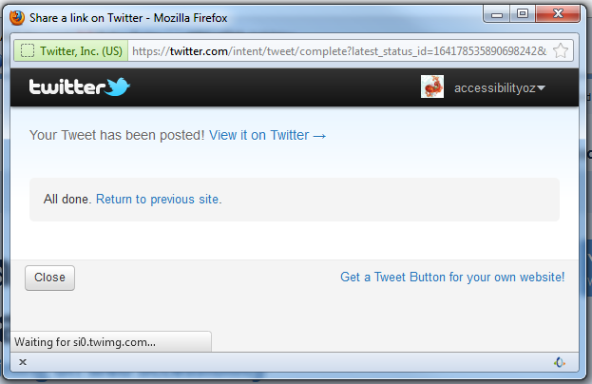
Incorrect example: On input
û

Slide 113
Principle 9
Identify components consistently

Slide 114
Principle 9: Consistent components
Functionality that is similar or used more than once on a website should be labelled consistently to create familiarity and ease of use. This improves a user’s ability to find information or use similar functionality on other pages without having to relearn how.

Slide 115
Principle 10
Identify and describe errors and error suggestions in text

Slide 116
Principle 10: Error descriptions & suggestions
When an error is detected it should be identified in text and described in detail. Without specific information about the error, screen reader users may believe a form is not functioning and may abandon it altogether. Errors that are identified with colour alone, or symbols or icons, may not be understood or recognised by users who are blind or colour blind. This may also be the same for users with learning or language difficulties, or other cognitive impairments.

Slide 117
Principle 10: Error descriptions & suggestions
When error messages are provided, they should include suggestions on how to correct mistakes, such as examples of the correct user input. Without suggestions, people with visual or motor impairments, or cognitive, language and learning difficulties may not understand what the required input is and may not be able to correct their mistakes.

Slide 118
Principle 10: Error descriptions & suggestions
After repeatedly trying to input the correct information, which can be very tiresome; users may ultimately abandon the form altogether.

Slide 119
Principle 10: Error descriptions & suggestions
When a form is used to initiate a legal or financial commitment, or to modify or delete user data, a step to reverse, check or confirm the user input before submitting the form should be provided to prevent users from making a serious mistake. Users with visual or cognitive, language and learning difficulties may have input incorrect characters, or users with a motor impairment may have hit incorrect keys.

Slide 120
Field errors

Slide 121
Describe input errors
Form validation should be triggered by submission, rather than individual field events
Form validation should trigger an alert then set focus on the first invalid field
Validation error messages should be programmatically inserted directly after the field they relate to, using functions of the DOM (and in the LABEL element)

Slide 122
Describe input errors
Incorrect example: Smashing Magazine, Validation library
Correct example: JS_F_A1-A3-A4
Notes:
Smashing Magazine - Search

Slide 123
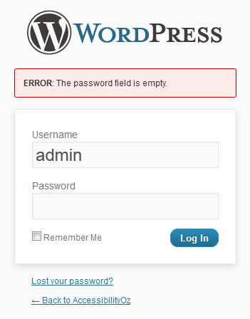
Correct example: Field error
ü

Slide 124
Describe input errors
Do not force the focus to remain in invalid fields
Incorrect example: JS_F_A5
Correct example: Form

Slide 125
Describe input errors (AA)
Where form fields require a specific format or range of values, contextual help-text can be programmatically inserted directly after the field it relates to, using functions of the DOM (and in the LABEL element).
Correct example: JS_F_AA1

Slide 126
Questions?
http://pz.tt/desertjs

