Slide 1
Mobile and Accessibility http://pz.tt/desertmobile

Slide 3
Speech-to-text program
Onscreen magnifier
Keyboard only
Screen reader
Epilepsy / Migraines
Fibromyalgia
Dyslexia
Notes:
PWD: 38 million
Physical: 20 million
Cognitive: 14 million
Hearing: 11 million
Vision: 7 million
http://factfinder2.census.gov/faces/tableservices/jsf/pages/productview.xhtml?pid=ACS_12_1YR_S1810&prodType=table

Slide 4
It’s not just about vision impairments
Notes:
PWD: 38 million
Physical: 20 million
Cognitive: 14 million
Hearing: 11 million
Vision: 7 million
http://factfinder2.census.gov/faces/tableservices/jsf/pages/productview.xhtml?pid=ACS_12_1YR_S1810&prodType=table

Slide 5
Our Services
Audits
Mobile testing
Building web sites
CMS testing
Accessible design
Video accessibility
User testing
OS / browser testing
Consultation
Accessible documents

Slide 6
Our Products
OzPlayer
OzART
OzWiki
More information:
www.accessibilityoz.com

Slide 7
Mobile accessibility features
Native screen readers
TalkBack (Android)
Narrator (Windows)
VoiceOver (iOS)
Text-to-speech / speech recognition
Volume control
Visual, auditory and vibrational notifications
Haptic keyboard
Zoom

Slide 8
Mobile accessibility features
System accessibility settings:
Font size
Touch and hold delay
Screen rotation
High contrast
Assistive touch
Mono audio (left / right balance)

Slide 9
Specific mobile requirements
There is some correlation between mobile site / app issues and the WCAG2 guidelines - however, mobile sites / apps are not specifically covered by WCAG2.
For example, although WCAG2 requires sites /apps to be accessible to the keyboard user it does not specify that it should also be accessible to the mouse or touchscreen user.

Slide 10
Mobile usage

Slide 11
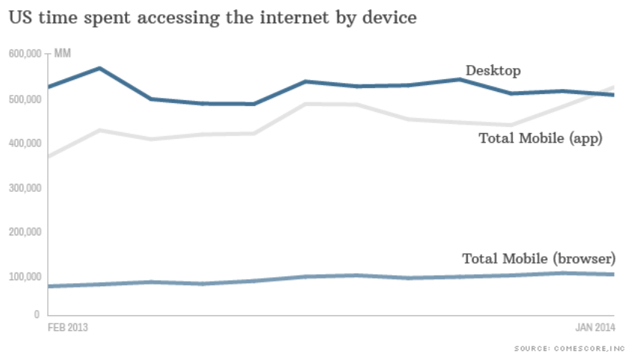
US mobile vs desktop usage
US mobile usage
Notes:
55% of Americans owns smartphones
47% of Americans own tablets
http://money.cnn.com/2014/02/28/technology/mobile/mobile-apps-internet/

Slide 12
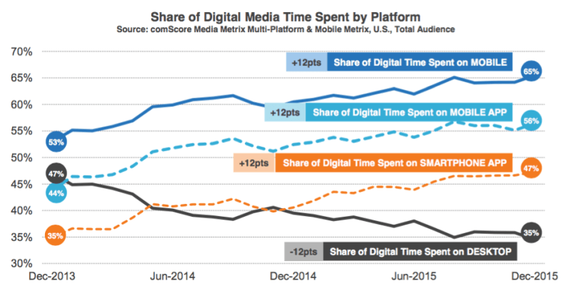
More recent statistics
Notes:
http://marketingland.com/digital-growth-now-coming-mobile-usage-comscore-171505

Slide 13
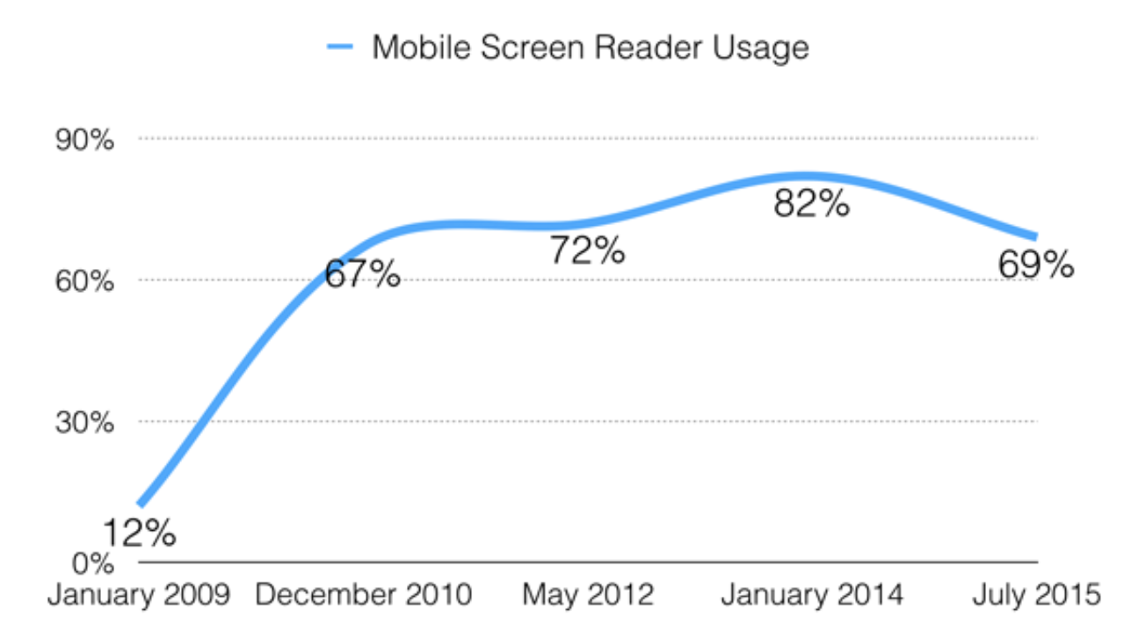
Mobile screen reader use
Percentage of screen reader users that use mobile
Notes:
WebAIM screen reader survey
http://webaim.org/projects/screenreadersurvey5/

Slide 14
Mobile-specific issues
PDFs

Slide 15
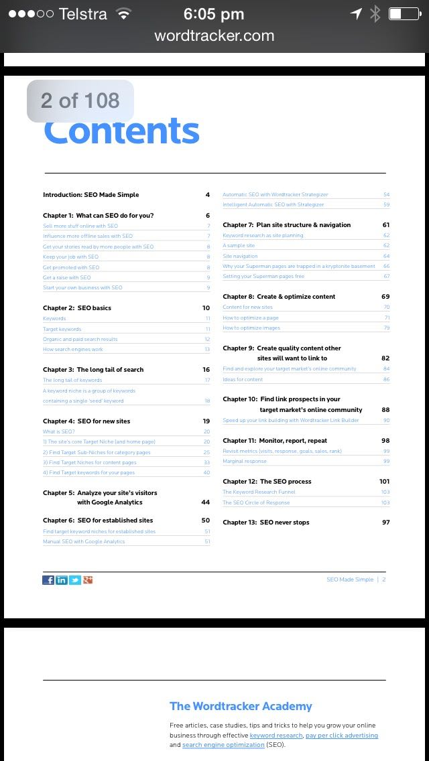
PDFs
Not mobile friendly

Slide 16
PDFs
Which would you prefer?

Slide 17
PDFs
Which would you prefer?

Slide 18
Larger file sizes + slower connection
equals
longer download + increased data usage

Slide 19
Mobile-specific issues
Friendly to mobile

Slide 20
Mobile sites
Which would you prefer?

Slide 21
Mobile sites
Which would you prefer?

Slide 22
Mobile issues
Autoplay & movement

Slide 23
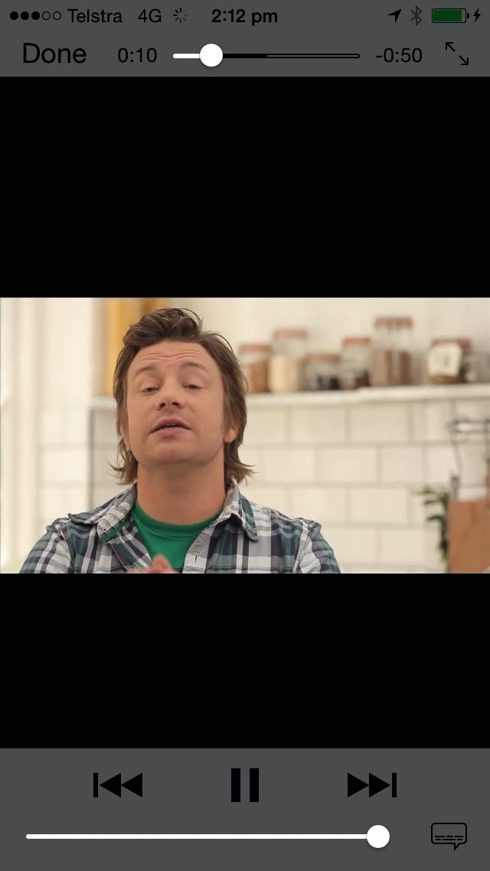
Autoplay
#AccessibilityFail
One of the most serious accessibility failures of all time

Slide 24
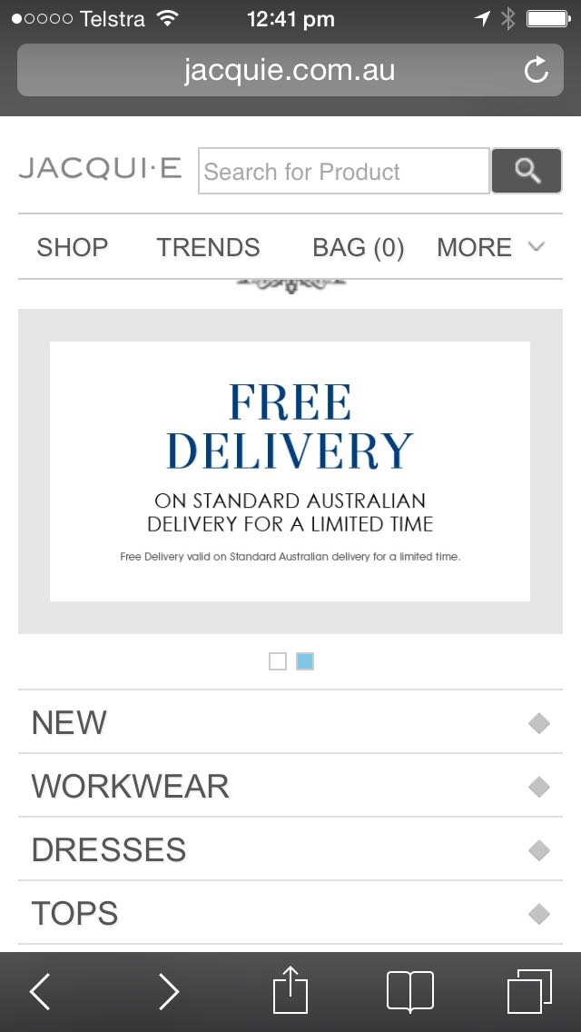
Continuous movement
#Annoying

Slide 25
Mobile issues
Traps

Slide 26
Onscreen keyboard trap
Cannot dismiss keyboard

Slide 27
Onscreen keyboard trap
Cannot dismiss keyboard

Slide 28
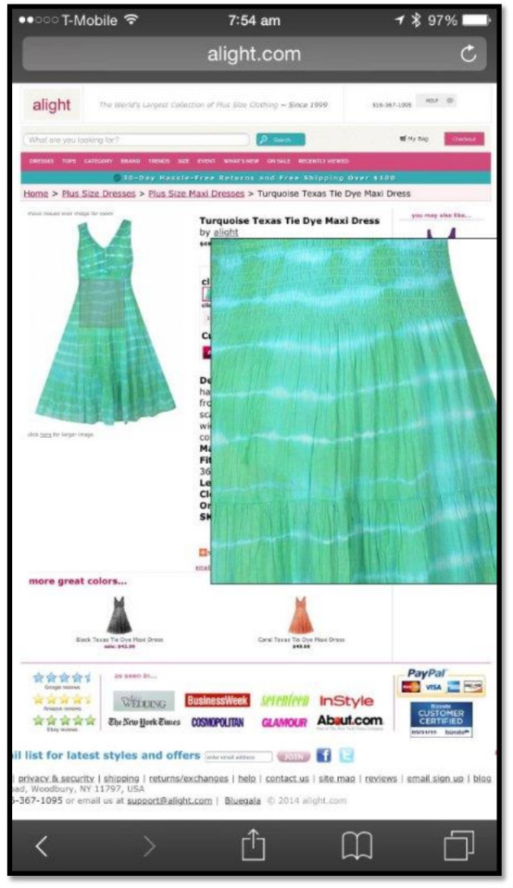
Hover trap
Cannot dismiss zoomed in section

Slide 29
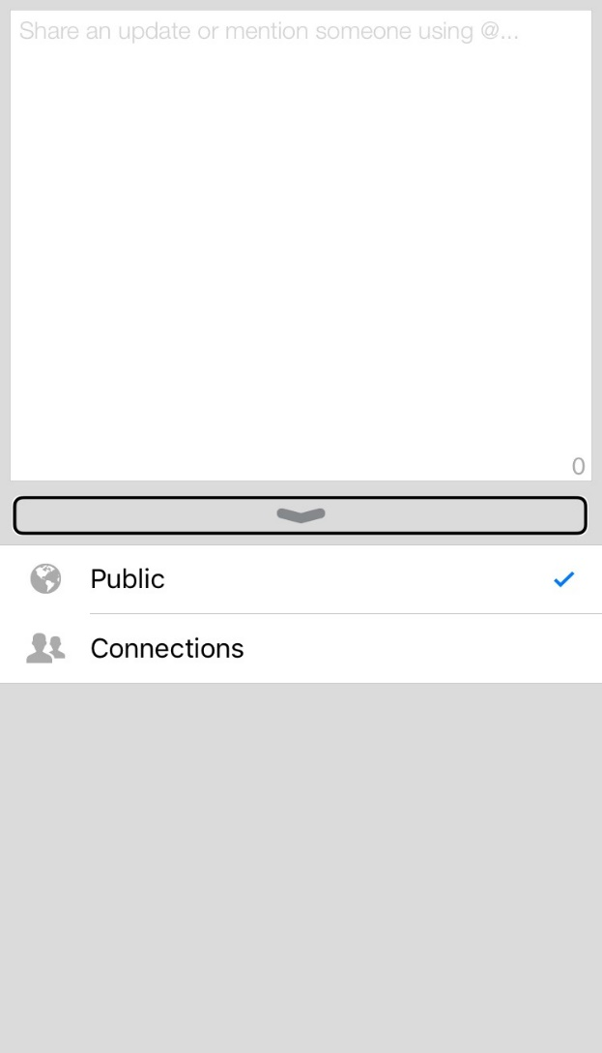
Voiceover swipe trap
LinkedIn – status update
Cannot dismiss page or access keyboard or back buttons

Slide 30
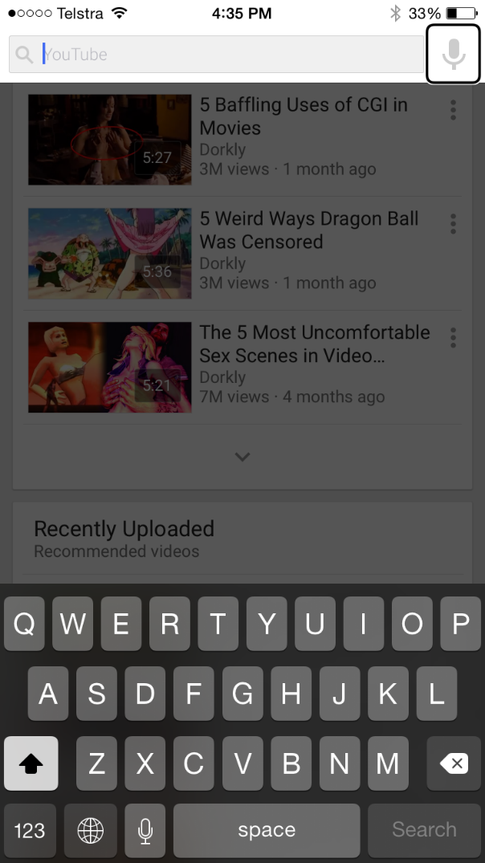
Voiceover swipe trap
YouTube - homepage
Cannot escape from search box

Slide 31
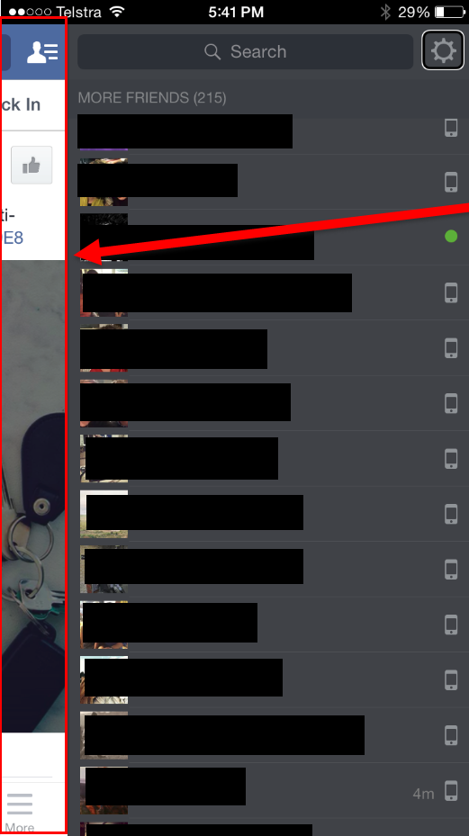
Voiceover swipe trap
Facebook– Friends list
Cannot go back to news feed, access keyboard or back button

Slide 32
Touch trap
Cannot move the screen unless you activate the up arrow

Slide 33
Mobile issues
Alternatives

Slide 34
Alternatives
Buttons need alternatives too…

Slide 35
Mobile issues
Access

Slide 36
Keyboard
Know your inputs

Slide 37
Mobile issues
Text size too small

Slide 38
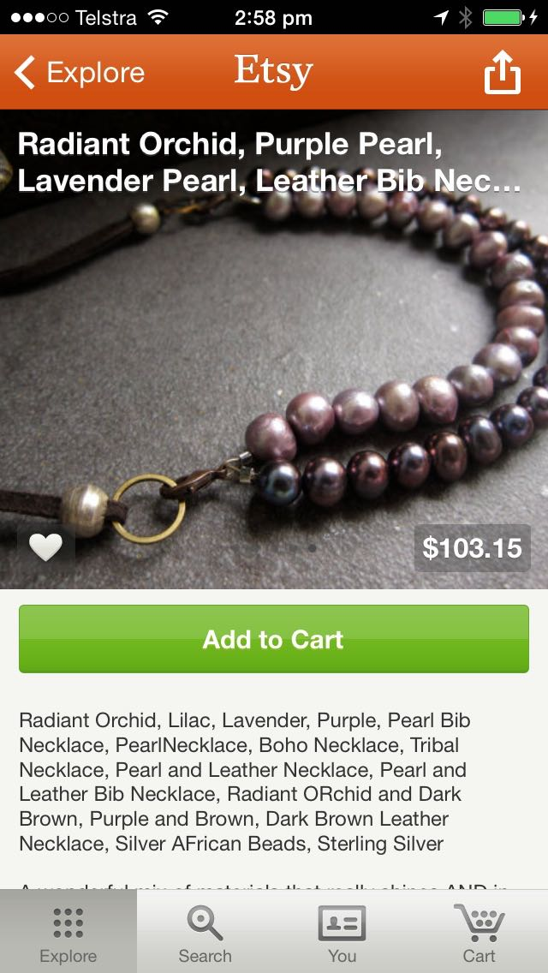
Text size
Too small

Slide 39
Text size too small
Too small

Slide 40
Mobile issues
Text size settings not supported

Slide 41
System settings
#TestAllThe Things

Slide 42
System settings
#TestAllThe Things

Slide 43
System settings
If Apple can’t get it right…

Slide 44
Mobile issues
Large text is not…
large.

Slide 45
Text size
Do you call that large text?

Slide 46
In-app settings
Do you call that large text?

Slide 47
In-app settings
Do you call that large text?

Slide 48
In-app settings
Ummm… where is the large text?

Slide 49
Mobile issues
Colour contrast

Slide 50
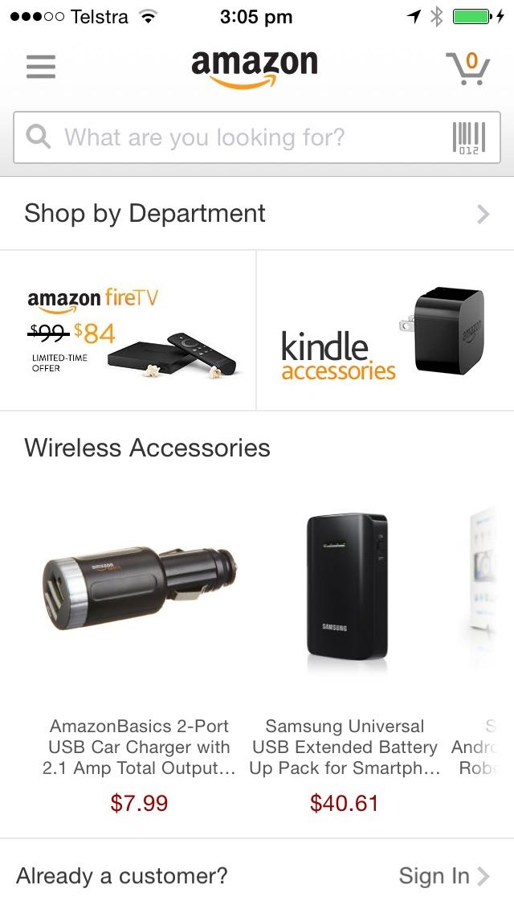
Colour contrast
Grey text on a white background: #JustSayNo

Slide 51
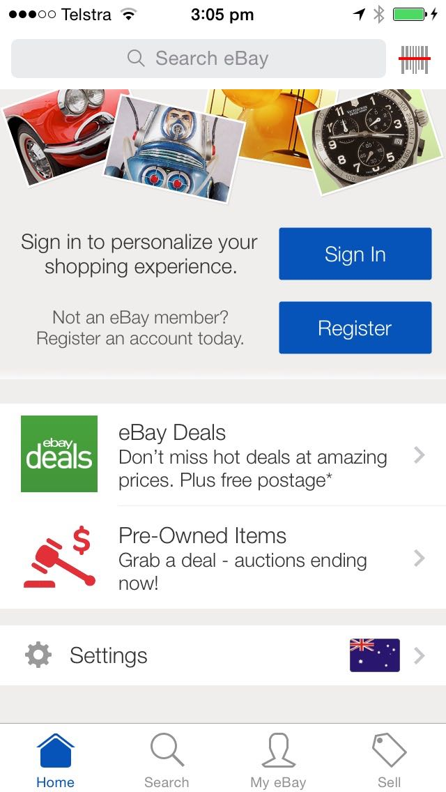
Colour contrast
Grey text on a grey background: #JustSayNo

Slide 52
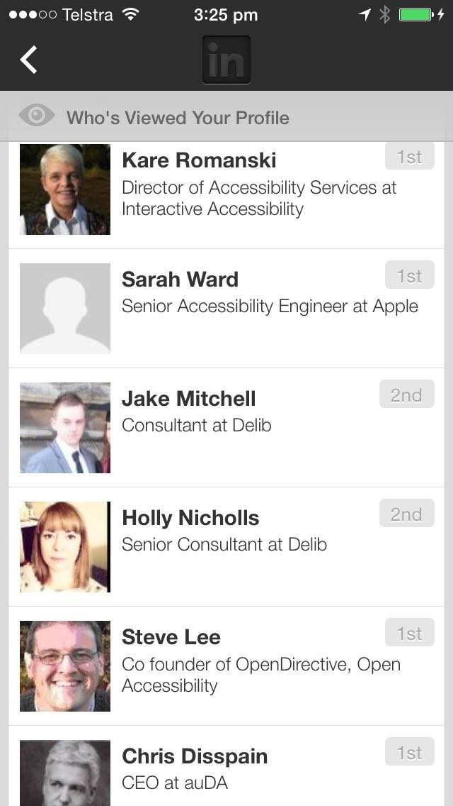
Colour contrast
Grey text on a grey background: #JustSayNo

Slide 53
Mobile issues
Colour alone

Slide 54
Colour alone
What’s today’s date?

Slide 55
Colour alone
Which date?

Slide 56
Mobile issues
Broken functionality

Slide 57
Functionality
It’s good if it works…

Slide 58
Functionality
Zooming breaks the site

Slide 59
Functionality
Zooming breaks the site

Slide 60
Functionality
Zooming breaks the site

Slide 61
Fine. I’ll just use the desktop version then…

Slide 62
Desktop / mobile
WTF?!?

Slide 63
Mobile issues
Functionality unclear

Slide 64
Functionality unclear
One way or return?

Slide 65
Functionality unclear
Select what?

Slide 66
Functionality unclear
Ah, green are links…
Or are they…?

Slide 67
Functionality unclear
Grey = inactive
Or does it…?

Slide 68
Mobile issues
Functionality different across devices

Slide 69
Functionality different on different devices
At Normal size the Upload button and Notifications button are visible in the top right of the screen.
At 200% zoom the Upload and Notifications buttons disappear.

Slide 72
Mobile issues
Pixellate on zoom

Slide 73
Pixellate on zoom
It’s a bad look

Slide 74
Pixellate on zoom
I’m supposed to pay for that?

Slide 75
Mobile issues
Source order

Slide 76
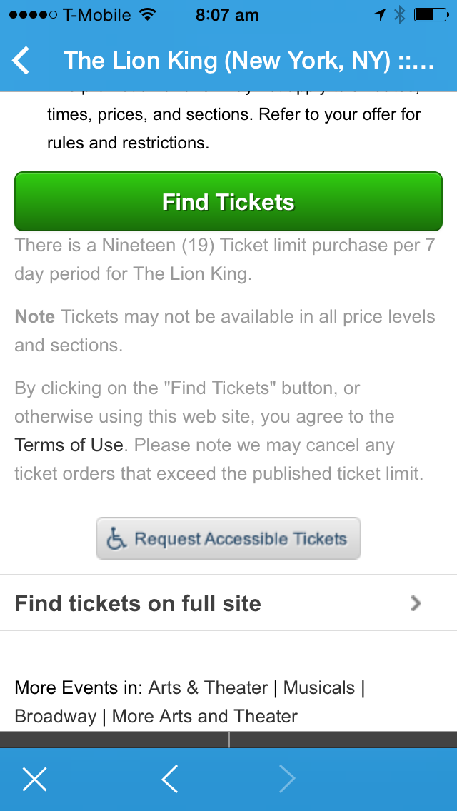
Source order
Important information should never be after a Submit button

Slide 77
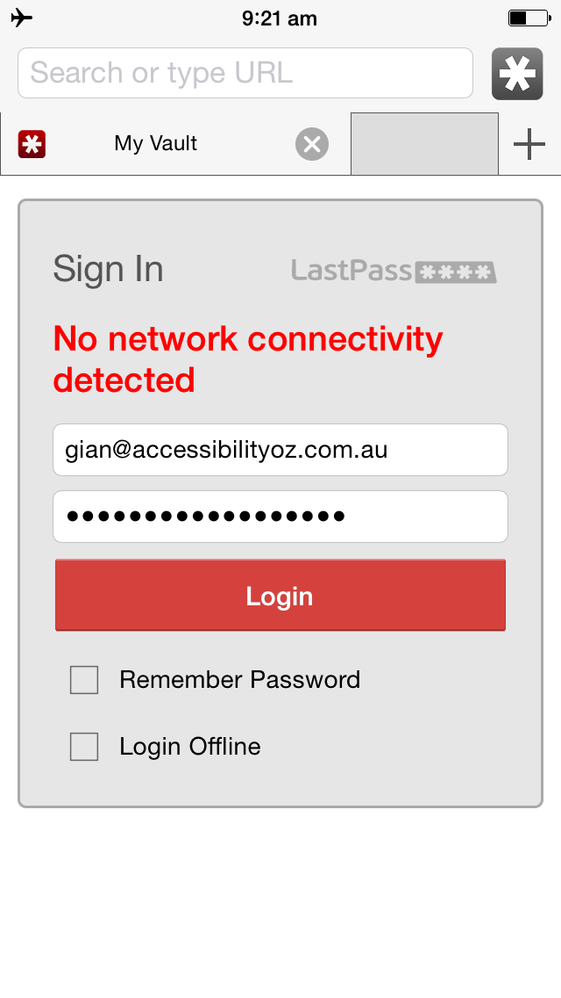
Source order
Important information should never be after a Submit button

Slide 78
Source order
Even Apple can’t get it right…

Slide 79
Mobile issues
Touch targets

Slide 80
Touch targets
I need my space

Slide 81
Touch targets & maps
Avoid the zoom of doom

Slide 82
Touch targets
Oops!

Slide 83
Mobile issues
Spacing

Slide 84
Spacing
Be careful what you select…

Slide 85
Spacing
No thanks
Oops…

Slide 86
Mobile issues
Lack of testing

Slide 87
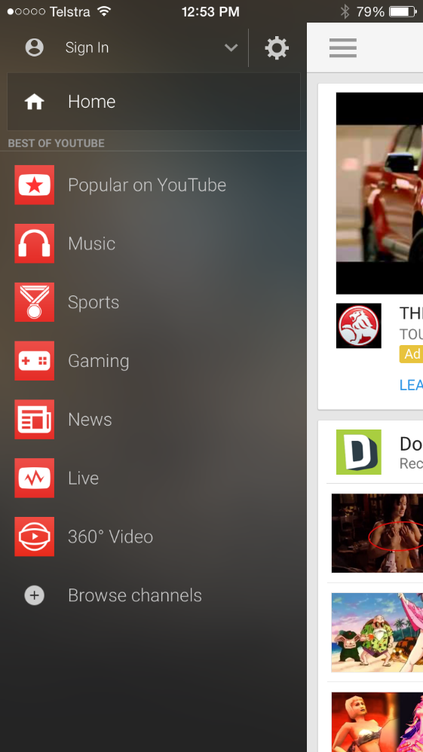
VoiceOver
‘BEST OF YOUTUBE’ read as ‘best of YaToob’
Screenshot of the YouTube mobile app with the menu open. Under the Home link is the text 'Best of YouTube' in all capital letters.
Zoomed in version of the same page.
Screenshot of the YouTube mobile app with the menu open. Under the Home link is the text 'Best of YouTube' in all capital letters.

Slide 88
Search
Ummmm….
No I didn’t

Slide 89
Images
Appropriate sizing

Slide 90
Maps
Where is it exactly?

Slide 91
Scrolling
At least you can scroll…

Slide 92
Scrolling
Oh, they decided to switch that function off…

Slide 93
Testing
#TestAllTheThings

Slide 94
Testing
#TestAllTheThings

Slide 95
Testing
#TestAllTheThings

Slide 96
Testing
#TestAllTheThings

Slide 97
Testing
#TestAllTheThings

Slide 98
Testing
#TestAllTheThings

Slide 99
Testing
#TestAllTheThings

Slide 100
Testing
#TestAllTheThings

Slide 101
Testing
#TestAllTheThings

Slide 102
Select options
Where would you like to fly from?

Slide 103
Correct implementations

Slide 104
Text size
Size and colour support!

Slide 105
Text size
That’s large text!

Slide 106
Text size
That’s really large text!

Slide 107
Functional zoom
That works!

Slide 108
Indicating functionality
But wait… there’s more!

Slide 109
Indication
But wait… there’s more!

Slide 110
Indication
But wait there’s more!

Slide 111
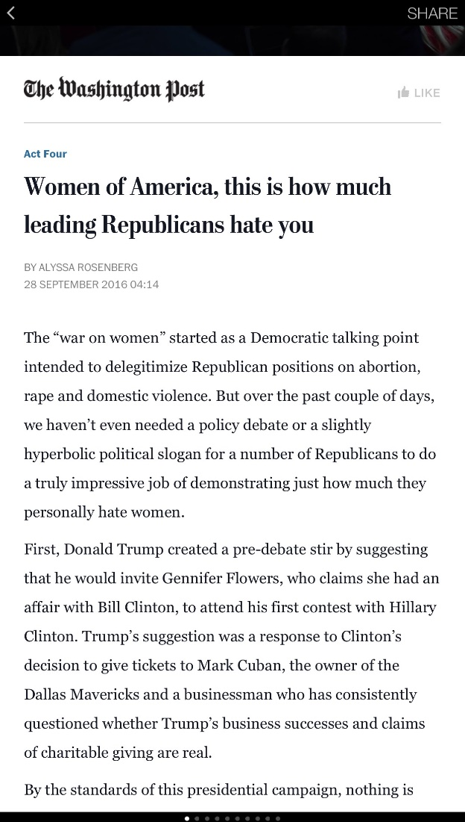
Indicating functionality

Slide 112
Indicating functionality
And more…

Slide 113
Keyboard
Dismiss and move on!

Slide 114
Keyboard
Correct inputs!

Slide 115
Colour and shape
Know exactly when you have booked

Slide 116
Column width
Width no more than 80 characters…

Slide 117
BBC Mobile accessibility guidelines
a11yoz.com/bbc-mobile

Slide 118
OzWiki: Accessibility Factsheets
https://www.accessibilityoz.com/factsheets/

Slide 119
Questions
http://pz.tt/desertmobile

