Slide 1
Video and accessibility pz.tt/AHEAD

Slide 3
Dyslexia
Moderate vision impairment
Severe vision impairment
Epilepsy
Migraines
Physical impairment
Fibromyalgia
Multiple Sclerosis
Crohns Disease
PTSD
Aspergers

Slide 4
It’s not just about vision impairments

Slide 5
Our Services
Audits
Mobile testing
Building web sites
CMS testing
Accessible design
Video accessibility
User testing
OS / browser testing
Consultation
Accessible documents

Slide 6
Our Products
OzPlayer
OzART
OzWiki
More information:
www.accessibilityoz.com.au

Slide 7
Videos
It’s more than just writing a transcript

Slide 8
OzWiki Video factsheet
A11yoz.com/fs-video

Slide 9
About video
    Video makes up approx 65% of all search results
    Completion of a video with captions doubles compared to without captions
    Videos with transcripts earned 16% more revenue than videos without transcripts
    80% of people that use captions are not Deaf or Hard Of Hearing

Slide 10
Common accessibility issues for video
    Inadequate keyboard access
    Insufficient control and operation
    Incorrect implementation
    Inaccessible content
    Inability to gain a full and complete understanding of all information contained in the video

Slide 11
Impact on the end user

Slide 12
Impacts: Keyboard trap
Some video players contain a keyboard trap:
    Screen reader users typically use the keyboard in conjunction with their assistive technology
    Users with restricted physical ability may also rely on the keyboard alone to access website content

Slide 13
Impacts: Keyboard inaccessibility
Some video players do not have the ability to operate the video controls with the keyboard.
    This limits the video use to mouse users only
Some video player controls do not have a highly visible keyboard focus indicator
    Does not prevent keyboard operation but makes it very difficult

Slide 14
Impact: Auto-play
Some video players will automatically start when a page opens.
    Video audio clashes with the user’s screen reader audio (both run at the same time)
    Screen reader users and keyboard users have to manually search through the page until they find the video and stop it using the player controls

Slide 15
There may not be a website mechanism to pause or stop the video.

Slide 16
Impact: Volume control
Some video players do not allow the volume to be controlled
    Users with a hearing disability may not be able to understand all or part of the video
    Control of the volume, independent of the system volume, should be provided

Slide 17
Impact: Flashing or flickering content
Videos with flashing content which flash more than three times in any one second period may:
    Induce seizures in users with photosensitive seizure disorder
    Trigger migraines in sensitive users

Slide 18
Pokemon Shock
Electric Soldier Porygon is the 38th episode of the Pokemon’s Anime series. It was broadcast in Japan on December 16, 1997 on 37 stations to 4.6 million households.
There were repetitive visual effects (flashing red and blue lights) – effectively strobe lights at a rate of 12 Hz for six seconds

Slide 19
Pokemon Shock
The most common side effects:
Blurred vision
Headaches
Dizziness
Nausea
The most serious side effects:
Seizures
Blindness
Convulsions
Loss of consciousness
Breathing difficulties

Slide 20
No flashing
Number of people taken to hospital via ambulance: 685
Longest period of hospitalisation: 2 weeks
Nintendo’s shares dropped 5%

Slide 21
Impacts: Transcripts
Missing or inadequate transcripts
    Videos which do not have a transcript exclude users that are unable to access the video itself
    Transcript must be provided in an accessible format
    Additional content presented in the transcript may be missed by non-transcript users

Slide 22
Impact: Captions
Missing or inadequate captions
    In some instances videos do not include captions or captions omit dialogue or important sound effects
    Additional content contained within captions may be missed by those not reliant on captions
    If colour contrast of captions is insufficient information may not be easily read

Slide 23
Impact: Audio descriptions
Missing or inadequate audio descriptions
    Videos with inadequate audio descriptions means vision impaired users miss video content

Slide 24
So how do you create an accessible video experience?

Slide 25
Accessible video
Accessible content in the video
Accessible video player
Never auto-play
No flashing content
Accessible transcript
Accessible captions
Accessible audio descriptions

Slide 26
Step One
Accessible video player

Slide 27
Accessible media player
Must address the common issues by providing
    Adequate keyboard access
    Sufficient control and operation
    Correct implementation

Slide 28
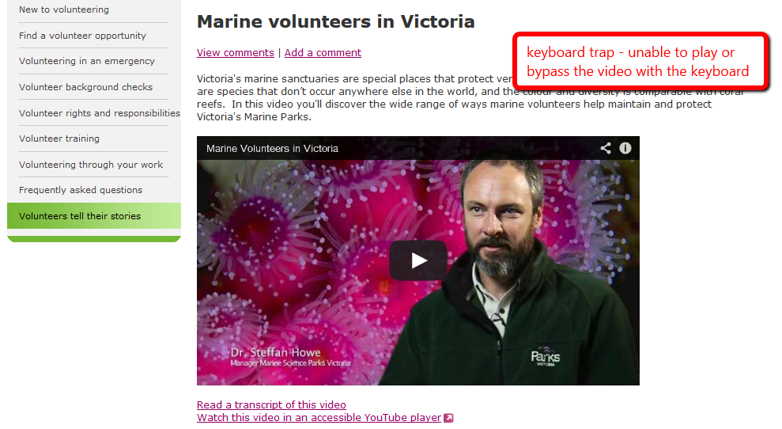
Keyboard trap
Notes:
Volunteering portal, modified YouTube player

Slide 29
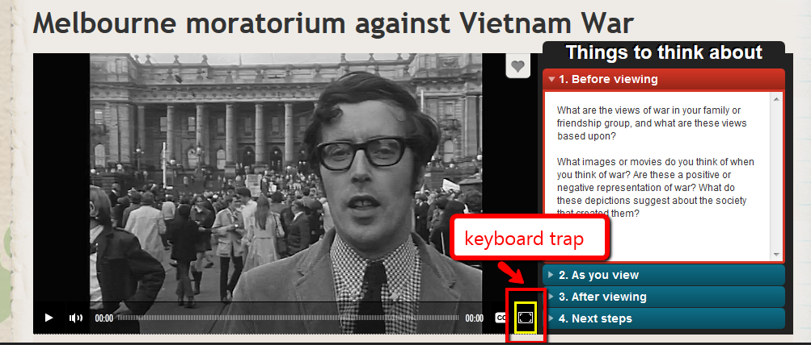
Keyboard trap
Notes:
ABC Splash – Viacorp player

Slide 30
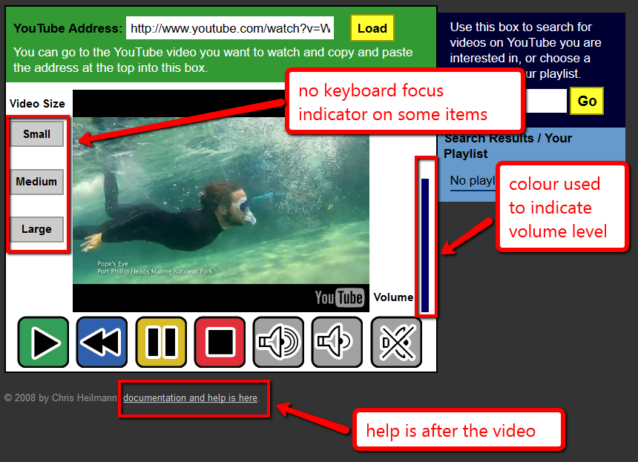
Keyboard focus missing
Notes:
The ICANT Accessible YouTube player

Slide 31

So we built…

Slide 32
OzPlayer features
Skip links
    Skip video entirely
    Skip to transcript
Access to help information before the video
Fully keyboard accessible
Highly visible keyboard focus indicator on all controls

Slide 33
OzPlayer features
Keyboard shortcuts
    space to toggle play and pause
    up and down arrow for volume
    left and right arrow for seek + page keys for broad seeking
    double-click to enter and exit full screen (where supported

Slide 34
OzPlayer features
Clear and simple controls
    Play, Pause, Captions, Audio Description, Full screen
Audio control is independent of the system volume
    Mouse and keyboard operable

Slide 35
OzPlayer features
Current state is clearly indicated
    Play/Pause, CC on or off; AD on or off; Audio on or off
Interactive transcript with a text fallback
    Current position is clearly marked
Accessible captions
Synchronised audio descriptions

Slide 36
YouTube is accessible right?

Slide 37

YouTube
All videos auto-play
There have been some accessibility improvements:
Embedded YouTube player & YouTube site is now somewhat keyboard accessible
Notes:
Last week, the FCC voted to require captions on online videos starting in 2016. - See more at: http://fedscoop.com/social-media-accessibility/#sthash.7to54PiF.dpuf
YouTube app (iPhone6)
When YouTube is in all-caps, it pronounces it YaToob!

Slide 38
Major YouTube accessibility issues
Keyboard trap & not fully keyboard-accessible
Order of items is incorrect
Uploading is not accessible
Zooming breaks the site
Not fully Voice-Over-accessible
Auto-captioning is problematic

Slide 39
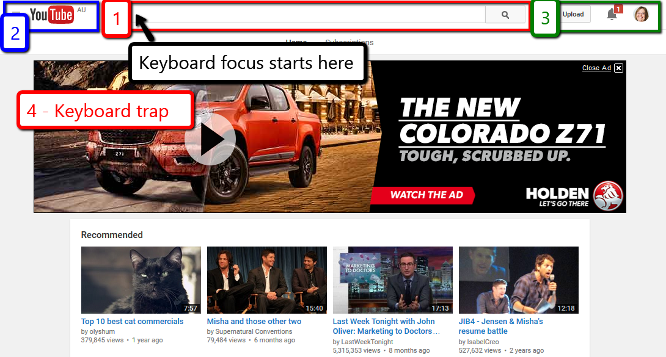
Keyboard focus starts in the search box in the middle of the top of the page. It then jumps to the left to the YouTube logo and menu. It then jumps over to the right of the search bar to the Upload, Notifications and personal icon. It then jumps to a large advertisement which is a keyboard trap.

Slide 40
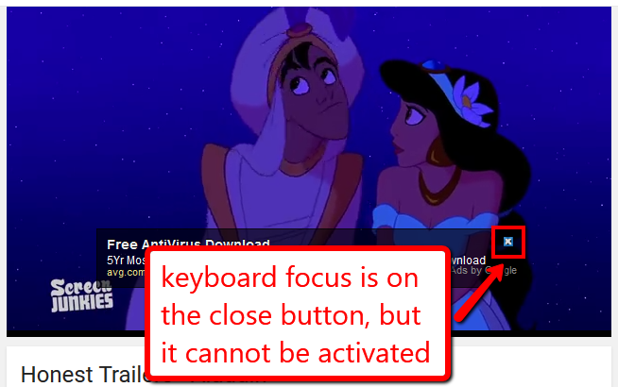
Not fully keyboard accessible
A video about Aladdin is onscreen and an ad appears over the video. Although the keyboard focus is on the close button it cannot be activated by the keyboard.

Slide 41
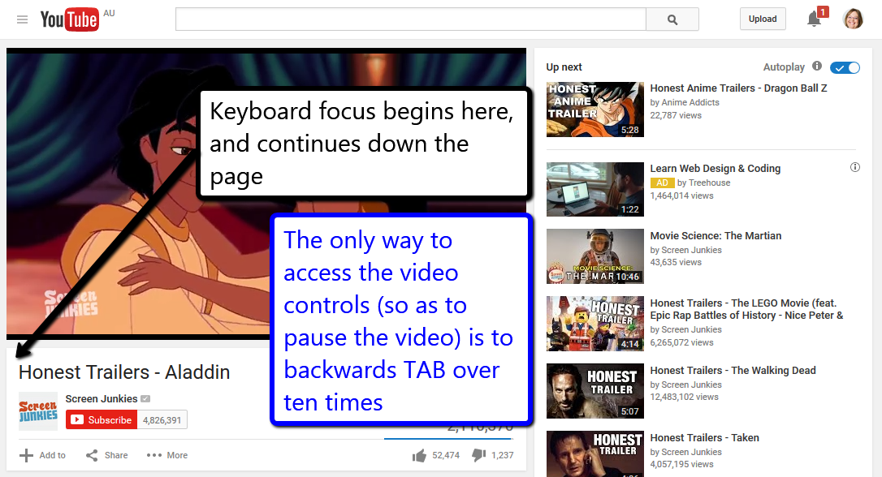
A YouTube video page is shown. When the page loads the keyboard focus begins underneath the video and tabbing continues down the page. The only way to access the video controls (so as to pause the video) is to backwards TAB over ten times.

Slide 42
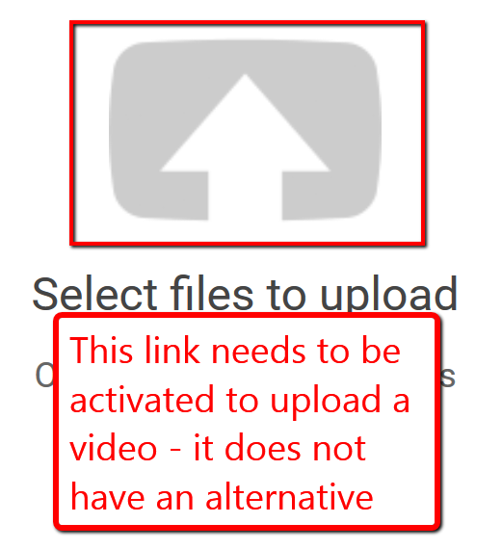
Upload button
You can only upload videos by activating this button – which has no alternative

Slide 43
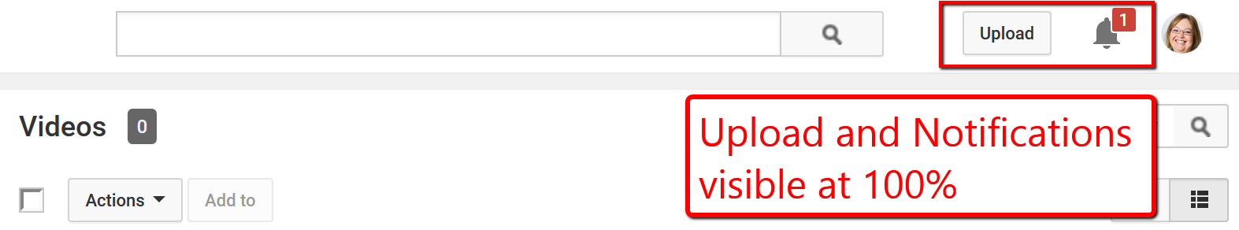
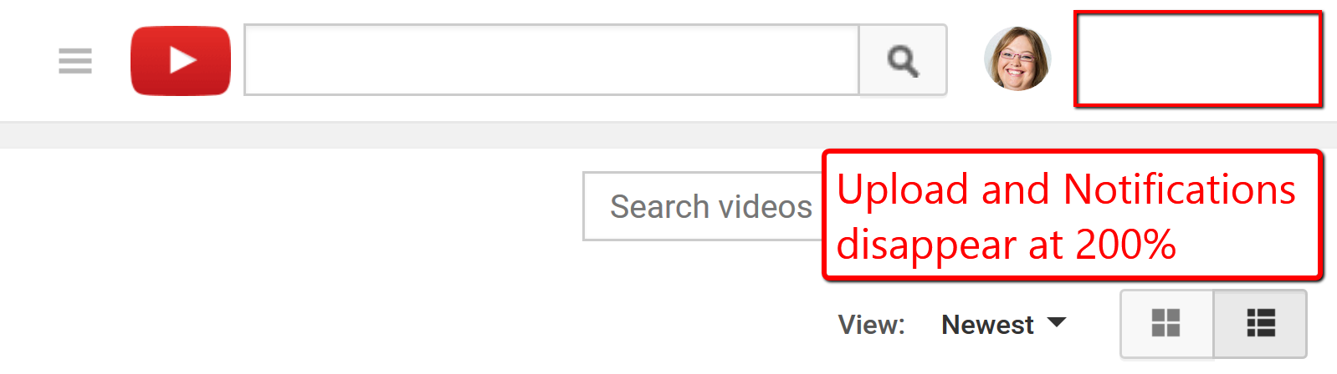
Zooming breaks the site
At Normal size the Upload button and Notifications button are visible in the top right of the screen.
At 200% zoom the Upload and Notifications buttons disappear.

Slide 44
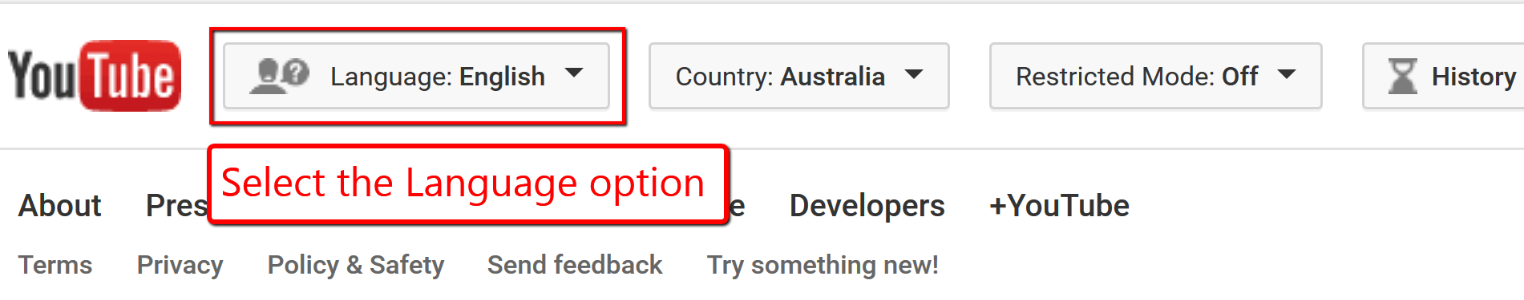
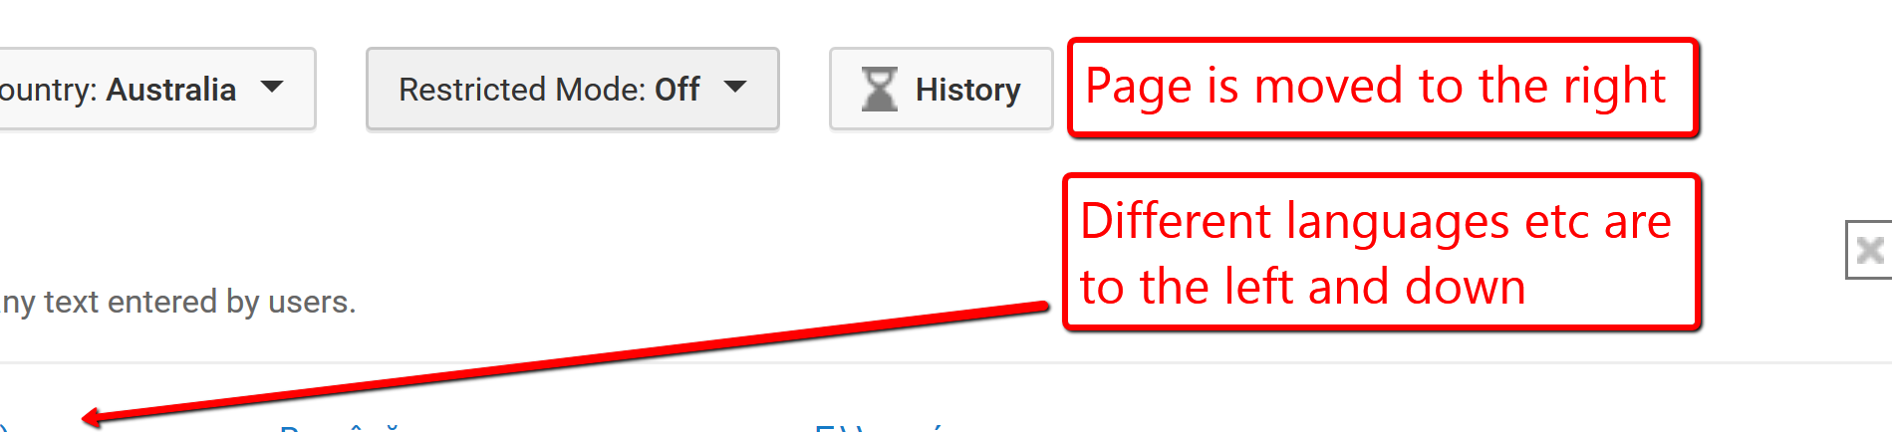
Zooming breaks the site
At the bottom of the YouTube page is the option to select a different language. The page is zoomed in.
Selecting the Language option moves the page to the very right and only blank space and some of the very right aligned headings are visible. The different languages are to the left and further down the page.

Slide 45
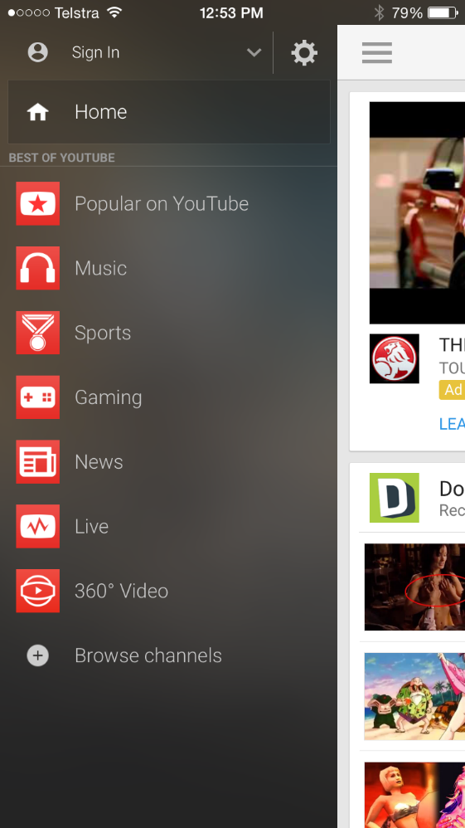

VoiceOver
‘BEST OF YOUTUBE’ read as ‘best of YaToob’
Screenshot of the YouTube mobile app with the menu open. Under the Home link is the text 'Best of YouTube' in all capital letters.
Zoomed in version of the same page.
Screenshot of the YouTube mobile app with the menu open. Under the Home link is the text 'Best of YouTube' in all capital letters.

Slide 46
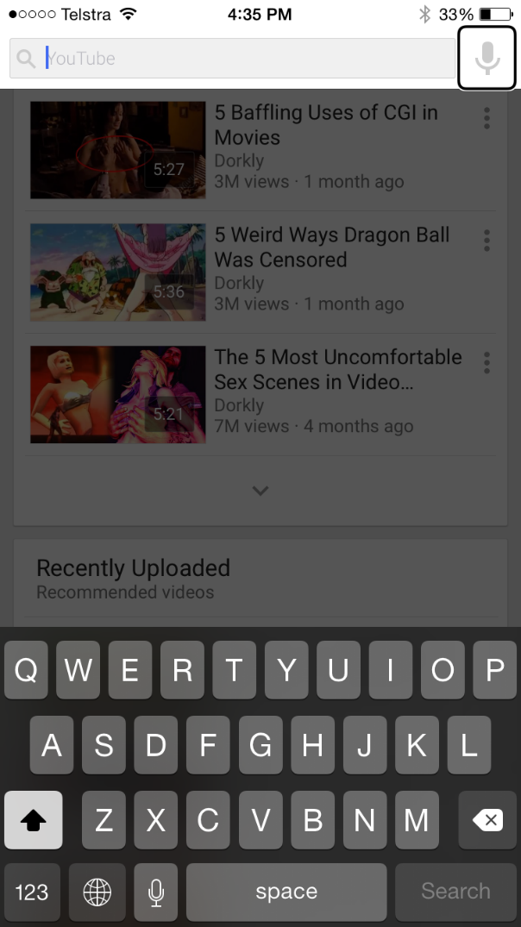
Swipe trap in VoiceOver
Search feature can’t be exited. User can force VoiceOver to read the content underneath but the search remains overlapping the content.
Screenshot of YouTube mobile app with Search feature highlighted at the top of the page. The rest of the page (videos etc) is greyed out as if inactive.
Notes:
Search feature can’t be exiting through swiping or and exit buttons. Can get it back to focus out of the search by visually touching out of the box but it start VO behind the search box which is still visual. This means that it still isn’t closed so you can’t use the back to top page option as that just sends you back to the search box focus. Could almost call it a swipe trap!

Slide 47
Step Two
Never auto-play

Slide 48
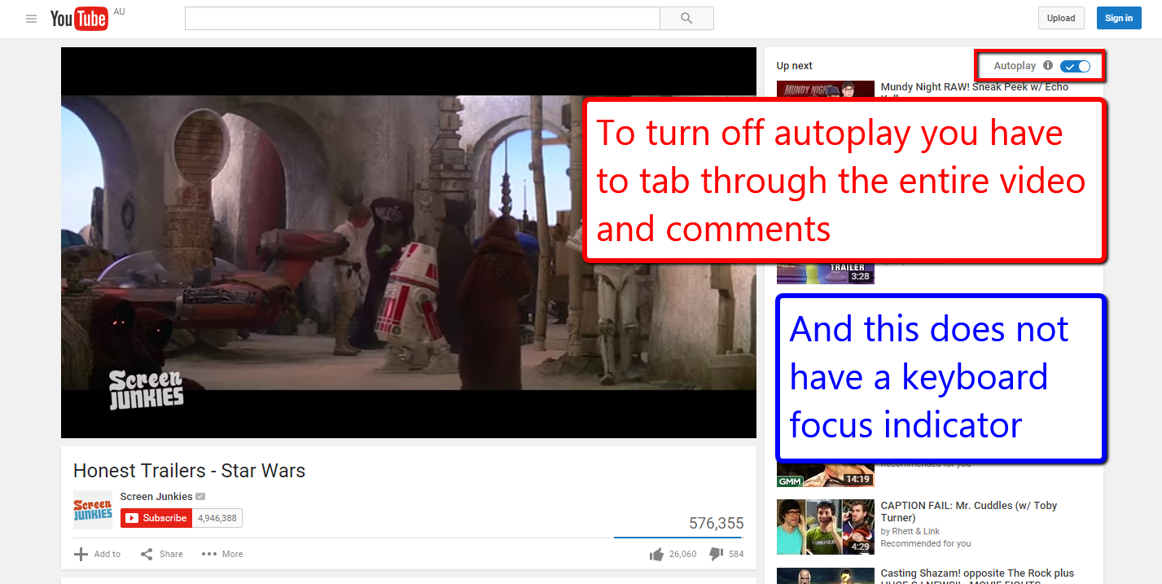
Auto-play
Notes:
YouTube

Slide 49
Step Three
No flashing content

Slide 50
No flashing
Flashing images, especially those with red, should not flicker faster than three times per second. If the image does not have red, it still should not flicker faster than five times per second.
Flashing images should not be displayed for a total duration of more than two seconds.
Stripes, whirls and concentric circles should not take up a large part of the television screen.

Slide 51
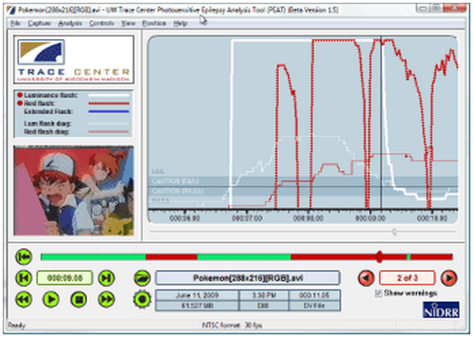
Flickering
Use the PEAT tool:
http://trace.wisc.edu/peat/

Slide 52
Step Four
Accessible content

Slide 53
Accessible content
    Use high contrast colours for any text overlaying video content
    Do not convey information with colour alone
    Avoid patterned backgrounds

Slide 54
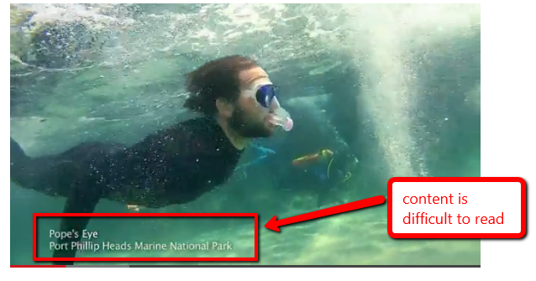
Low colour contrast

Slide 55
Step Five
Accessible transcripts

Slide 56
Accessible transcript
    Be in an accessible format
    Identify the speakers and include all speech
    Include relevant information about the speech
    Include relevant non-speech audio information
    Include any textual or graphical information

Slide 57
Accessible transcript
    Include a description of on-screen events and important changes of scene
    Indicate the end of the transcript if on the same page as the video or provide a mechanism to return to the video if on another page.

Slide 58
Step Six
Accessible captions

Slide 59
Accessible captions
    Synchronised to appear at the same time as the sound they are captioning
    Include all important audio information
    Can be read
      Sufficient colour contrast between background and caption text
      Appear on the screen for enough time

Slide 60
Accessible captions
    There are no periods without captions
    Attribute speech to a particular speaker and identify all changes in speaker
    Do not contain important information not included in the video

Slide 61
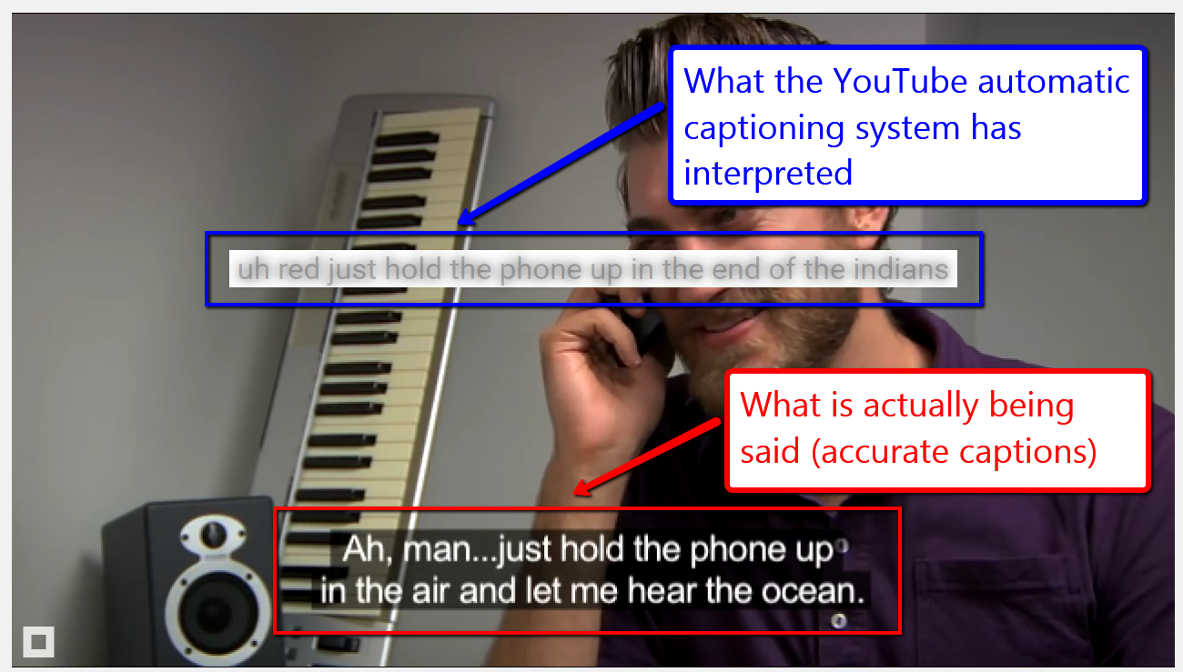
YouTube captioning
Screenshot of a video. What is actually being said is 'Ah, man... just hold the phone up in the air and let me hear the ocean.' What the YouTube auto-captioning feature captioned is 'uh red just hold the phone up in the end of the indians'.

Slide 62
Step Seven
Accessible audio descriptions

Slide 63
Accessible audio descriptions
    Adequately describes all important visual information
    Does not impact on other speech or important sounds
      May need to create an alternative video which includes pauses to allow sufficient time for information to be delivered at the appropriate point (extended audio description)

Slide 64
Accessible audio description
    Can be heard
      Is distinguishable from the audio content in the video itself
    Contains only information included in the video

Slide 65
Example extended Audio Descriptions
A11yoz.com/ead

Slide 66
Example automated captions
A11yoz.com/captionfail

Slide 67
Questions?

Slide 68
PDFs and accessibility

Slide 69
Down Under in the Dark Ages

Slide 70
Down Under in the Dark Ages
The Australian Government conducted an enquiry into the accessibility of PDF:
  Requested public comment
  Tested PDFs with blind and low vision users
  PDFs were tested against WCAG2
  Talked to assistive technology manufacturers

Slide 71
In conclusion…
PDF was not defined as “accessibility supported” because:
  The design of the PDF file
  Technical functionality of the assistive technology
  Skill of the end user

Slide 72
The Australian PDF enquiry
“Overall, the Study found that there is insufficient evidence to establish that the development of the Portable Document Format and improvements in assistive technologies have advanced enough for PDF files to be considered accessible for people with a disability, particularly for those who are blind or have low vision…

Slide 73
The Australian PDF enquiry
“The Commission’s advice, current October 2010, is therefore that PDF cannot be regarded as a sufficiently accessible format to provide a user experience for a person with a disability that is equivalent to that available to a person without a disability, and which is also equivalent to that obtained from using the document marked up in traditional HTML…

Slide 74
The Australian PDF enquiry
“The Commission will review the accessibility of PDF documents again in 2013, by which time it is expected that the provision, support, and utilisation of accessibility features will have improved.”

Slide 75
Down Under in more recent times

Slide 76
Disability Discrimination Act
If authors incorporate (accessibility) features into the design of their documents, the resulting accessibility will likely cater for people who use assistive technology such as screen-reading software, which has been designed to support these features in desktop/PC environment.

Slide 77
Disability Discrimination Act
However there is currently a significant limitation on the accessibility of PDF documents in the mobile environment, as mobile screen reader technology does not reveal any information contained in the markup tags.

Slide 78
Disability Discrimination Act
The Commission’s advice, current February 2014, is therefore that PDF cannot be regarded as a sufficiently accessible format to provide a user experience for a person with a disability that is equivalent to that available to a person without a disability, and which is also equivalent to that obtained from using the document marked up in traditional HTML.

Slide 79
WCAG2 requirements for PDFs…
Level A
  Requires an accessible equivalent for all PDFs:
    HTML or
    Word or
    RTF or
    Text
  Requires PDFs to be tagged with accessibility features:
    Headings
    Alternative text
    Bookmarks
    Links etc

Slide 80
Why do people still use PDF?

Slide 81
The excuses for PDFs
Security

Slide 82
DDA Web Advisory Notes
Some file formats provide mechanisms for enhancing the security of documents by preventing unauthorised editing, copying, or printing. Some of these mechanisms are not compatible with accessibility for people with a disability, and document authors should ensure that security features do not prevent access to the document by assistive technology.

Slide 83
DDA Web Advisory Notes
If there are concerns about ensuring the authenticity of material published on the web in multiple formats, then a statement should be included that specifies which format is to be regarded as definitive or authorised, and noting that additional formats are being provided to maximise access.

Slide 84
What’s more secure than PDFs?

Slide 85
The excuses for PDFs
Brand

Slide 86
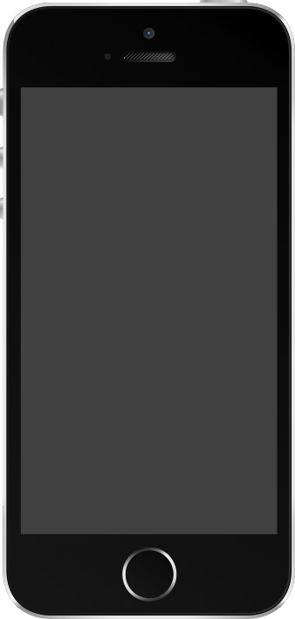
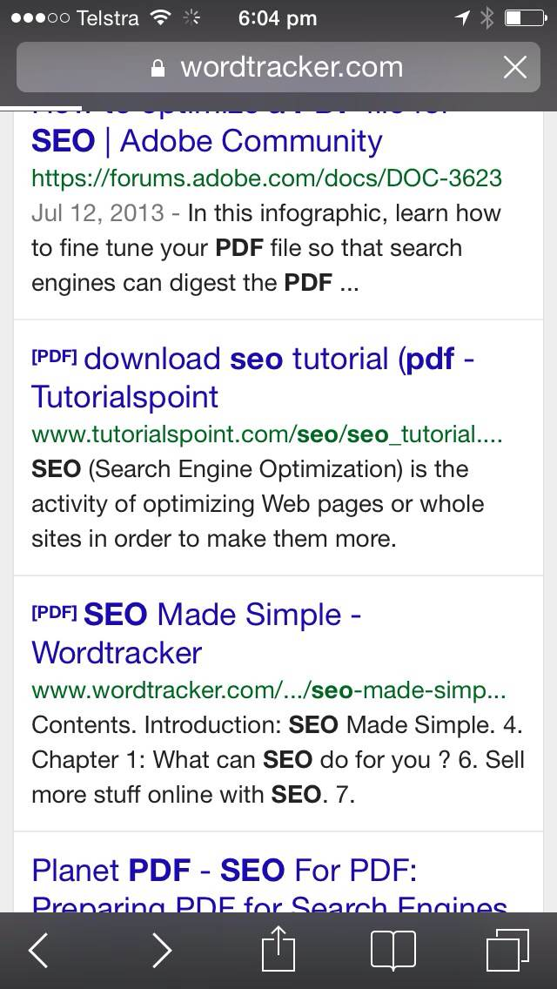

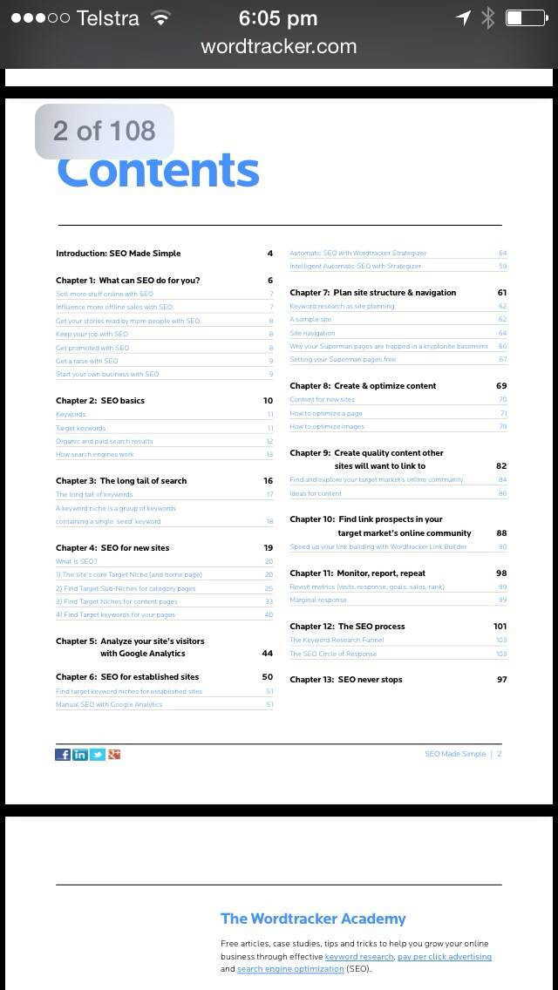
Which is better for your brand?

Slide 87
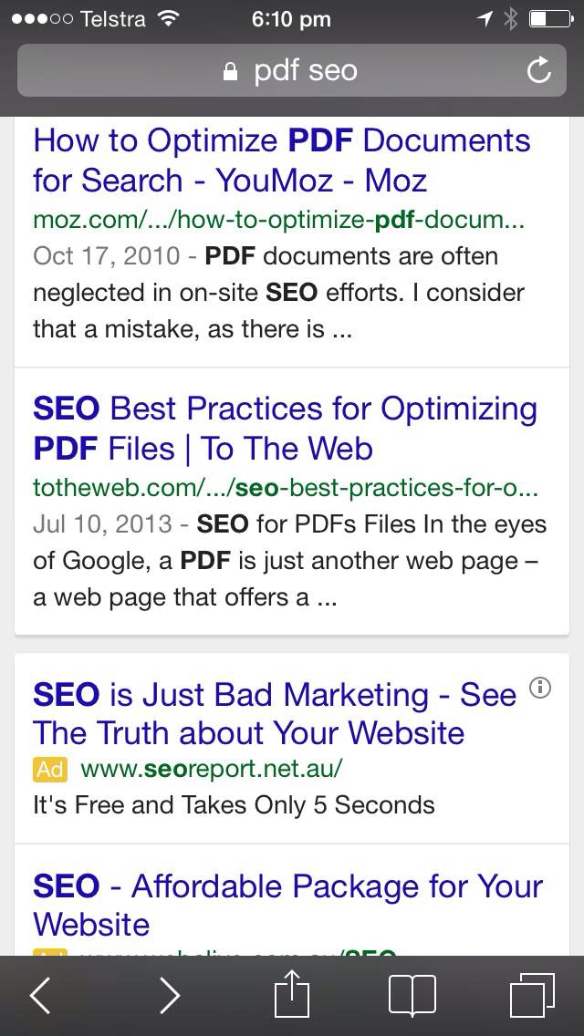
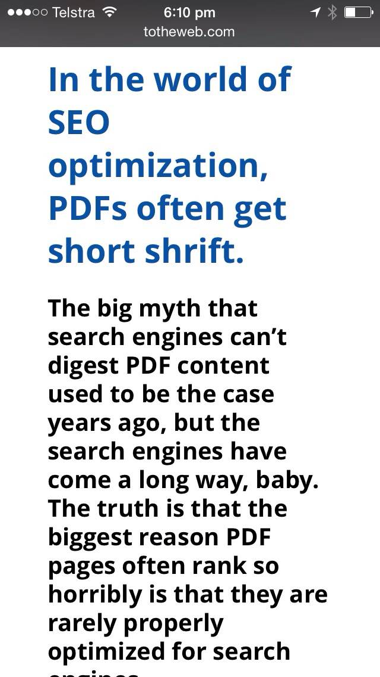
Which is better for your brand?

Slide 88
The excuses for PDFs
Print

Slide 89
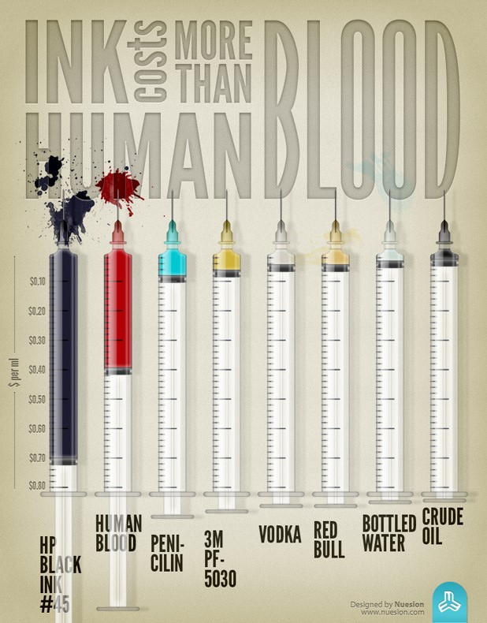
If people want print versions, maybe you should give them…
print versions

Slide 90
The excuses for PDFs
It’s easy

Slide 91
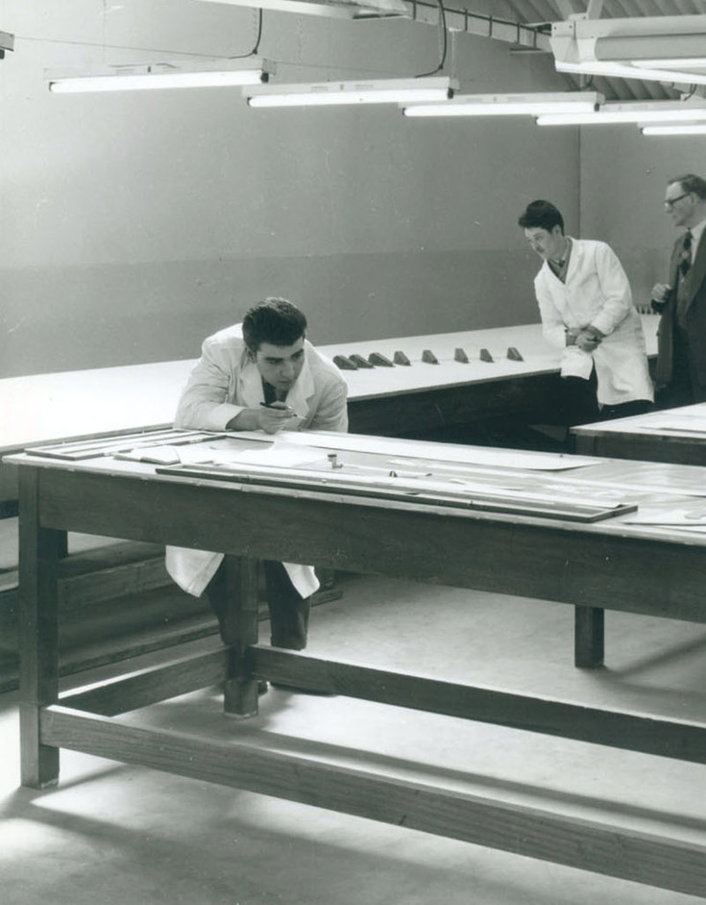
No one ever created a PDF in Acrobat…
(well almost never)

Slide 92

Why PDFs are bad for you
Google

Slide 93

PDFs are not ranked as highly by Google as HTML…

Slide 94
The DPI case study
“If you are spending money preparing content for the web, then that money is essentially being wasted if that content is locked up in a format people are unwilling to use.
Initially we tried to create a web page to match each PDF, but in the end... it was far too difficult to manage both formats.
DPI completed a PDF purge of their website in 2011 resulting in a 1.6 million (38%) page view increase.”

Slide 95
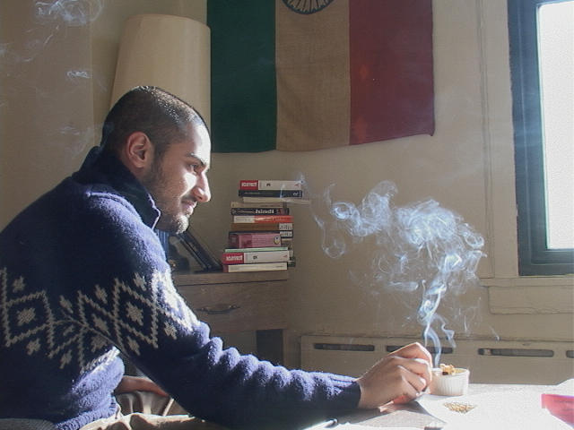
Why PDFs are bad for you
Sharing

Slide 96
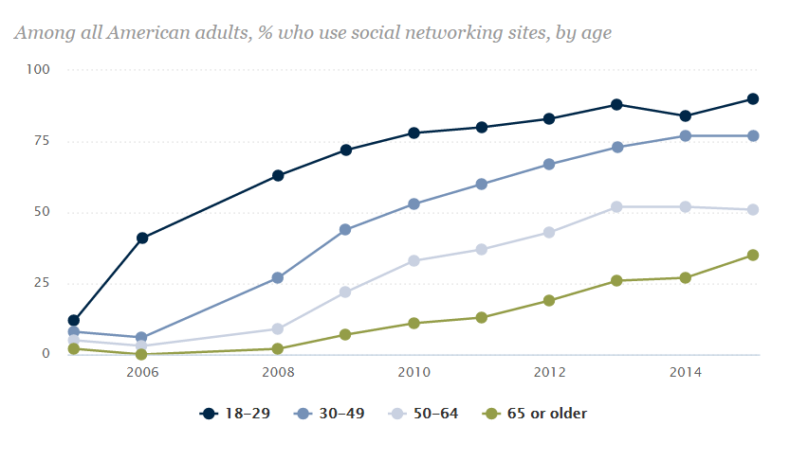
Social networking by age group
From Pew Research Centre
Social Media Usage: 2005 - 2015
From 2005 to 2015 all age groups have steadily increased their social media usage, starting at approximated five to ten percent of users in 2005 and increasing at a mostly linear rate to the following per age group
18 to 29 years at 90%
30 to 49 years at 75%
50 to 64 years at 50%
65 years and older at 30%

Slide 97
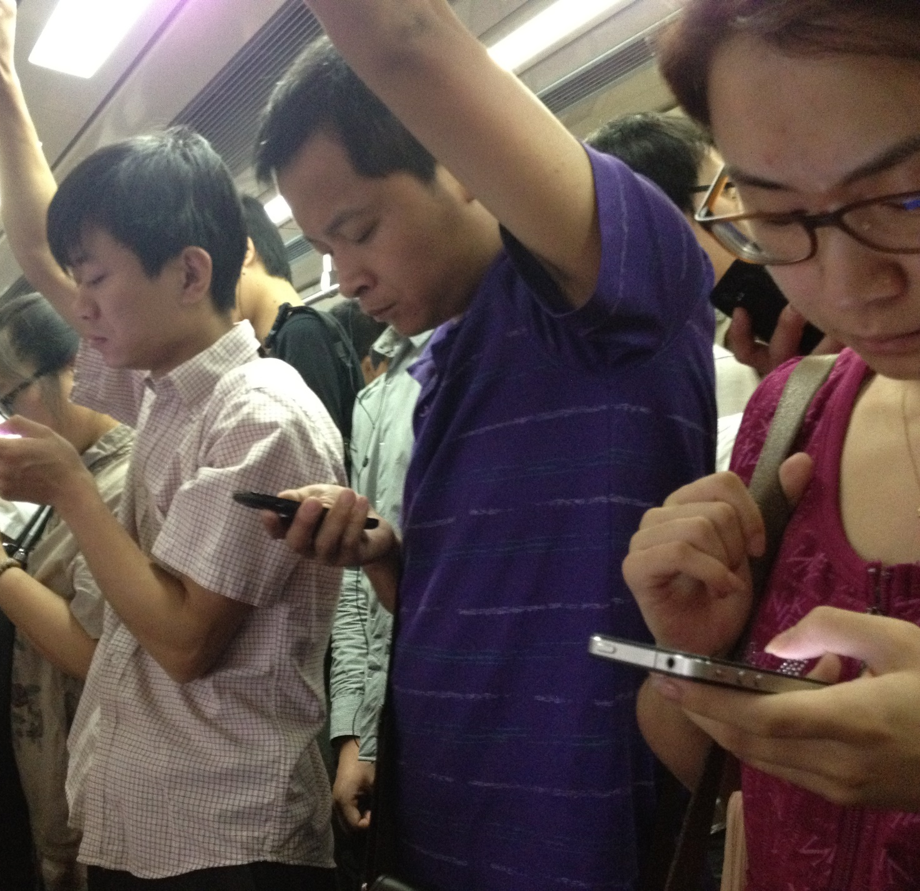
Why PDFs are bad for you
Mobile

Slide 98
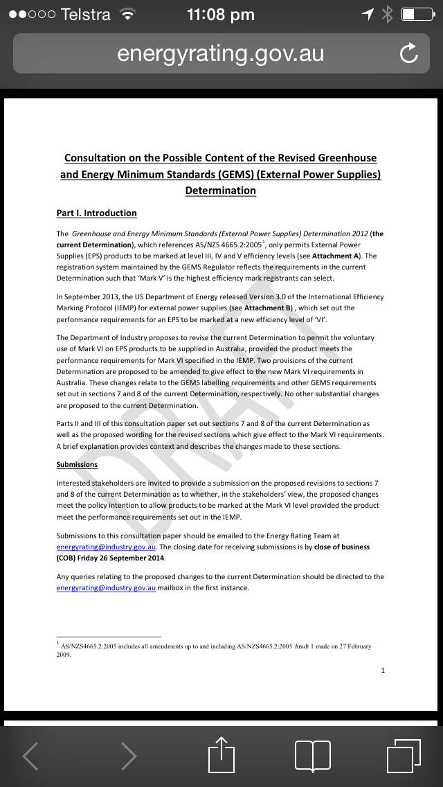
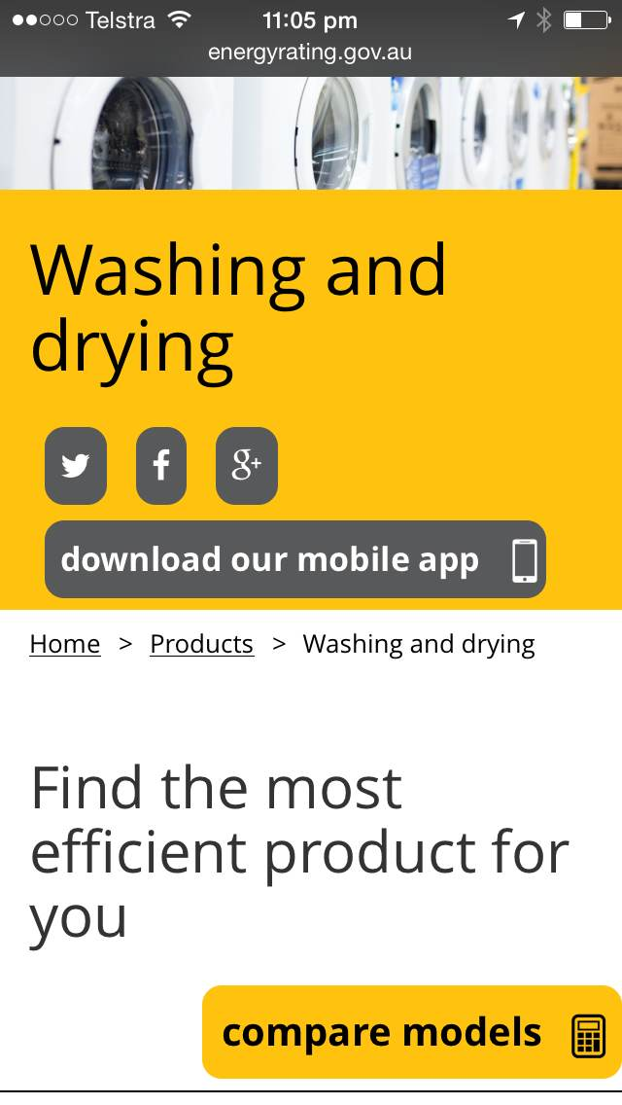
Which would you prefer?

Slide 99
Larger file sizes + slower connection
equals
longer download + increased data usage

Slide 100
Time spent per adult per day with digital

Slide 101

Why PDFs are bad for you
Nobody likes them = Nobody uses them

Slide 102
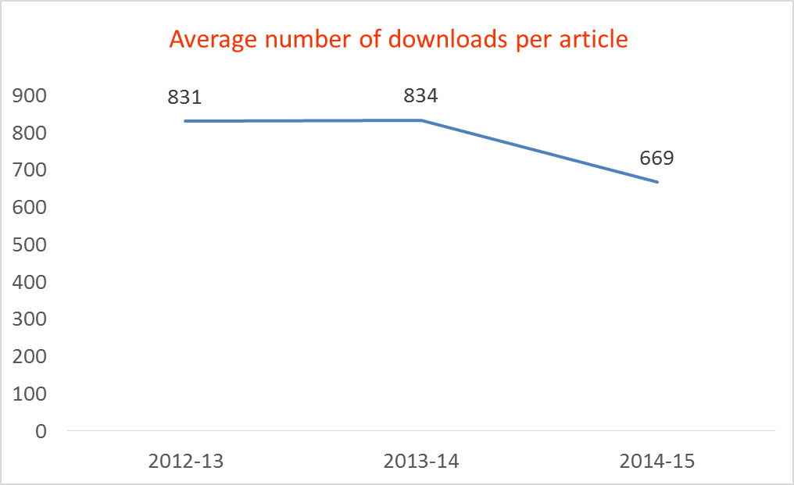
PDF usage – Consumer Affairs Victoria
Year | Average number of downloads per article
2012 - 13 | 831
2013 - 14 | 834
2014 - 15 | 669

Slide 103
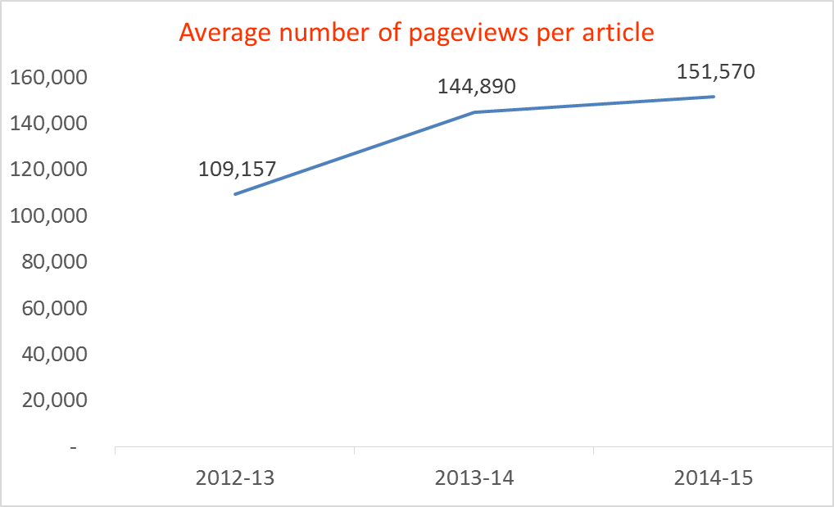
HTML pageviews
Year | Average number of HTML pageviews per article
2012 - 13 | 109,157
2013 - 14 | 144,890
2014 - 15 | 151,570

Slide 104
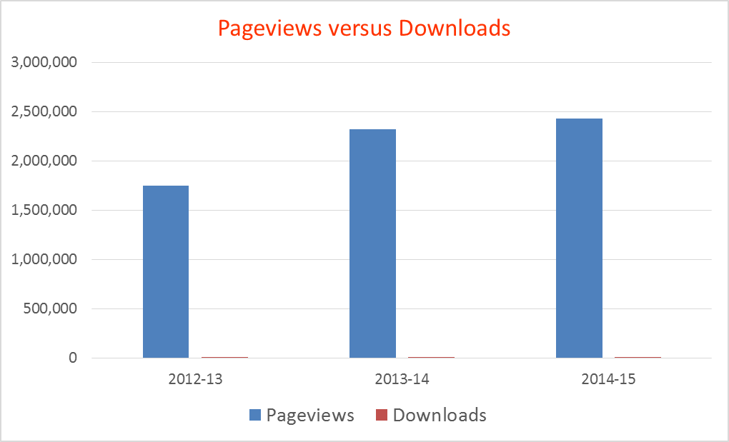
Comparing the two formats
Year | Downloads | Pageviews
2012 - 13 | 0.7% | 99.3%
2013 - 14 | 0.6% | 99.4%
2014 - 15 | 0.4% | 99.6%

Slide 105
Everyone convinced?

Slide 106
Chances are…
You have thousands of PDFs on your site
They may have been created from Word documents but no one knows where those are anymore
None of them are tagged
No one owns them
No one wants to take them down

Slide 107
Chances are … you still need to meet accessibility requirements

Slide 108

Step One
Let’s talk accessibility

Slide 109
Let’s talk accessibility
Provide an easy and accessible method to request:
An accessible version of the PDF
An audio version of the PDF
A printed (and sent) version of the PDF
Remember to make sure someone is responsible for these tasks!

Slide 110
Step Two
Identify

Slide 111
Not all PDFs are created equal

Slide 112
Identify
Identify those that are:
Aimed at people with disabilities
Legally required to be provided to the public
Popular and downloaded often
Required to access your product or service (application forms etc)

Slide 113
Step Three
Plan

Slide 114
Plan
Create a process to:
Find the alternative accessible version
Create the alternative accessible version (HTML, Word, text or RTF)
Tag the PDF

Slide 115
Step Four
Think of the future

Slide 116
Think of the future
Create a process to:
Always upload the alternative version with the PDF
Or…
Get rid of them entirely

Slide 117
Share your enhanced knowledge of PDFs

Slide 118
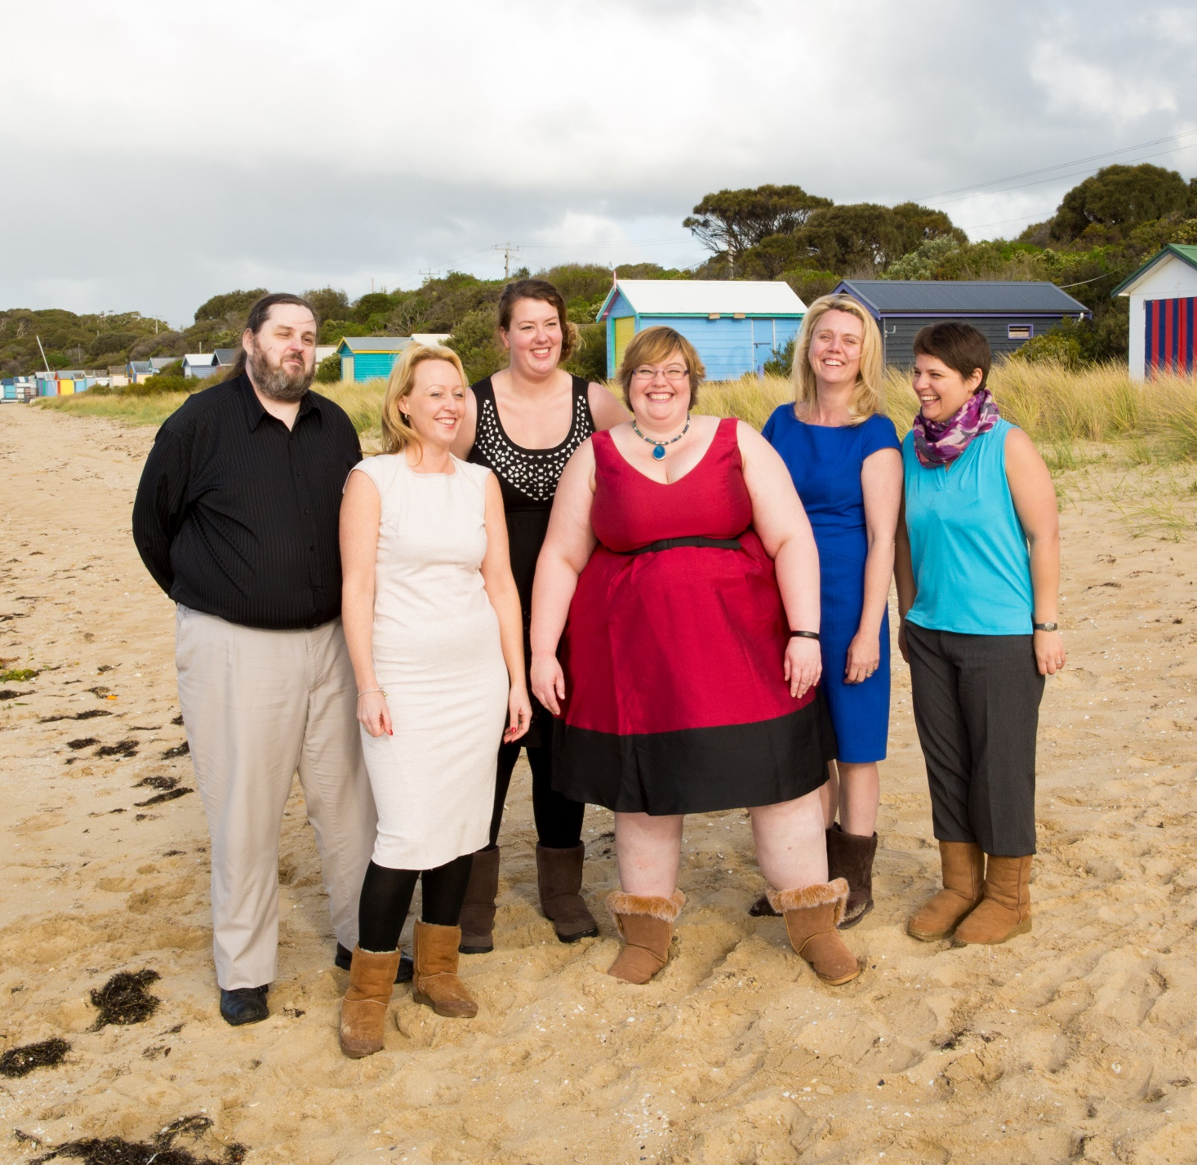
PDF Accessibility Factsheet
A11yoz.com/fs-pdf

Slide 119
Thanks to Flickr
Bbmexplorer
Britt Selvitelle
Chris Potter
Connor Lawless
Cory M Grenier
Dalesbest
Eflon
Fut Und Beidl
Ivan Walsh
Jason Baker
Marko Mikkonen
Plastic Revolver
Quinnanya
Ross Fowler
Sharis Berries
Sparkfun

