Slide 1
Video and accessibility

Slide 3
Dyslexia
Moderate vision impairment
Severe vision impairment
Epilepsy
Migraines
Physical impairment
Fibromyalgia
Multiple Sclerosis
Crohns Disease
PTSD
Aspergers

Slide 4
It’s not just about vision impairments

Slide 5
Our Services
Audits
Mobile testing
Building web sites
CMS testing
Accessible design
Video accessibility
User testing
OS / browser testing
Consultation
Accessible documents

Slide 6
Our Products
OzPlayer
OzART
OzWiki
More information:
www.accessibilityoz.com.au

Slide 7
Videos
It’s more than just writing a transcript

Slide 8
OzWiki Video factsheet
A11yoz.com/fs-video

Slide 9
About video
    Video makes up approx 65% of all search results
    Completion of a video with captions doubles compared to without captions
    Videos with transcripts earned 16% more revenue than videos without transcripts
    80% of people that use captions are not Deaf or Hard Of Hearing

Slide 10
Common accessibility issues for video
    Inadequate keyboard access
    Insufficient control and operation
    Incorrect implementation
    Inaccessible content
    Inability to gain a full and complete understanding of all information contained in the video

Slide 11
Impact on the end user

Slide 12
Impacts: Keyboard trap
Some video players contain a keyboard trap:
    Screen reader users typically use the keyboard in conjunction with their assistive technology
    Users with restricted physical ability may also rely on the keyboard alone to access website content

Slide 13
Impacts: Keyboard inaccessibility
Some video players do not have the ability to operate the video controls with the keyboard.
    This limits the video use to mouse users only
Some video player controls do not have a highly visible keyboard focus indicator
    Does not prevent keyboard operation but makes it very difficult

Slide 14
Impact: Auto-play
Some video players will automatically start when a page opens.
    Video audio clashes with the user’s screen reader audio (both run at the same time)
    Screen reader users and keyboard users have to manually search through the page until they find the video and stop it using the player controls

Slide 15
There may not be a website mechanism to pause or stop the video.

Slide 16
Impact: Volume control
Some video players do not allow the volume to be controlled
    Users with a hearing disability may not be able to understand all or part of the video
    Control of the volume, independent of the system volume, should be provided

Slide 17
Impact: Flashing or flickering content
Videos with flashing content which flash more than three times in any one second period may:
    Induce seizures in users with photosensitive seizure disorder
    Trigger migraines in sensitive users

Slide 18
Pokemon Shock
Electric Soldier Porygon is the 38th episode of the Pokemon’s Anime series. It was broadcast in Japan on December 16, 1997 on 37 stations to 4.6 million households.
There were repetitive visual effects (flashing red and blue lights) – effectively strobe lights at a rate of 12 Hz for six seconds

Slide 19
Pokemon Shock
The most common side effects:
Blurred vision
Headaches
Dizziness
Nausea
The most serious side effects:
Seizures
Blindness
Convulsions
Loss of consciousness
Breathing difficulties

Slide 20
No flashing
Number of people taken to hospital via ambulance: 685
Longest period of hospitalisation: 2 weeks
Nintendo’s shares dropped 5%

Slide 21
Impacts: Transcripts
Missing or inadequate transcripts
    Videos which do not have a transcript exclude users that are unable to access the video itself
    Transcript must be provided in an accessible format
    Additional content presented in the transcript may be missed by non-transcript users

Slide 22
Impact: Captions
Missing or inadequate captions
    In some instances videos do not include captions or captions omit dialogue or important sound effects
    Additional content contained within captions may be missed by those not reliant on captions
    If colour contrast of captions is insufficient information may not be easily read

Slide 23
Impact: Audio descriptions
Missing or inadequate audio descriptions
    Videos with inadequate audio descriptions means vision impaired users miss video content

Slide 24
So how do you create an accessible video experience?

Slide 25
Accessible video
Accessible content in the video
Accessible video player
Never auto-play
No flashing content
Accessible transcript
Accessible captions
Accessible audio descriptions

Slide 26
Step One
Accessible video player

Slide 27
Accessible media player
Must address the common issues by providing
    Adequate keyboard access
    Sufficient control and operation
    Correct implementation

Slide 28
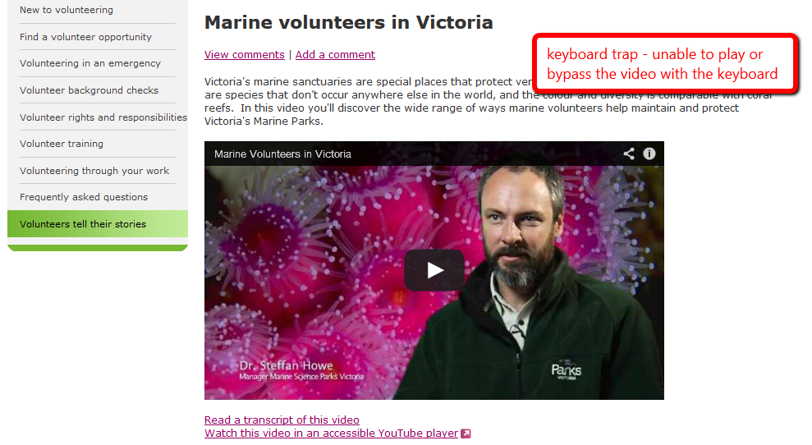
Keyboard trap
Notes:
Volunteering portal, modified YouTube player

Slide 29
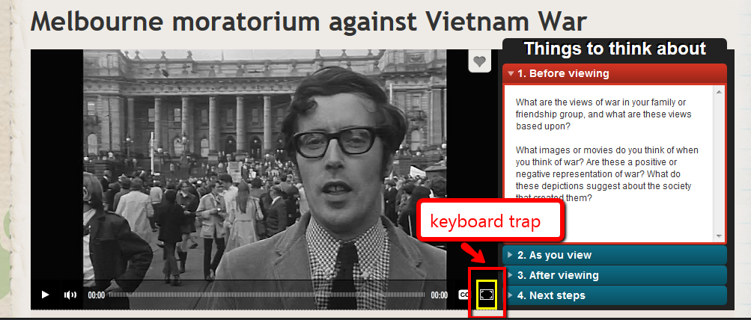
Keyboard trap
Notes:
ABC Splash – Viacorp player

Slide 30
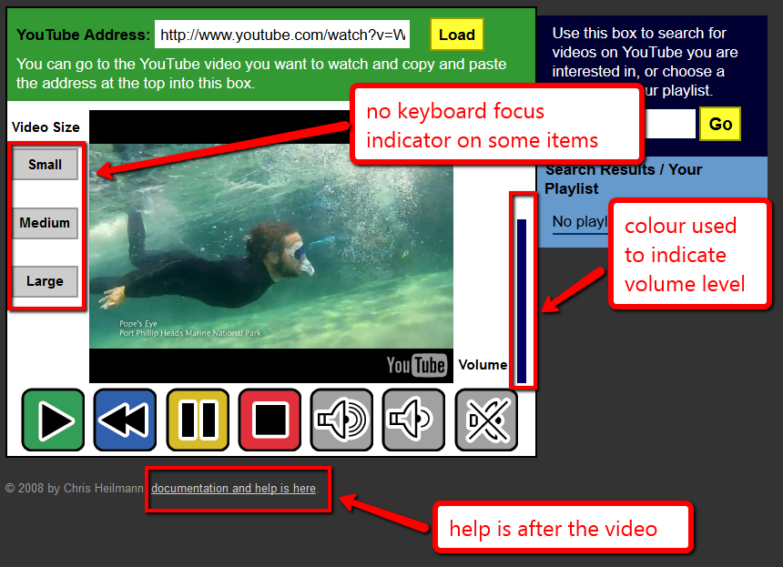
Keyboard focus missing
Notes:
The ICANT Accessible YouTube player

Slide 31

So we built…

Slide 32
OzPlayer features
Skip links
    Skip video entirely
    Skip to transcript
Access to help information before the video
Fully keyboard accessible
Highly visible keyboard focus indicator on all controls

Slide 33
OzPlayer features
Keyboard shortcuts
    space to toggle play and pause
    up and down arrow for volume
    left and right arrow for seek + page keys for broad seeking
    double-click to enter and exit full screen (where supported

Slide 34
OzPlayer features
Clear and simple controls
    Play, Pause, Captions, Audio Description, Full screen
Audio control is independent of the system volume
    Mouse and keyboard operable

Slide 35
OzPlayer features
Current state is clearly indicated
    Play/Pause, CC on or off; AD on or off; Audio on or off
Interactive transcript with a text fallback
    Current position is clearly marked
Accessible captions
Synchronised audio descriptions

Slide 36
YouTube is accessible right?

Slide 37

YouTube
All videos auto-play
There have been some accessibility improvements:
Embedded YouTube player & YouTube site is now somewhat keyboard accessible
Notes:
Last week, the FCC voted to require captions on online videos starting in 2016. - See more at: http://fedscoop.com/social-media-accessibility/#sthash.7to54PiF.dpuf
YouTube app (iPhone6)
When YouTube is in all-caps, it pronounces it YaToob!

Slide 38
Major YouTube accessibility issues
Keyboard trap & not fully keyboard-accessible
Order of items is incorrect
Uploading is not accessible
Zooming breaks the site
Not fully Voice-Over-accessible
Auto-captioning is problematic

Slide 39
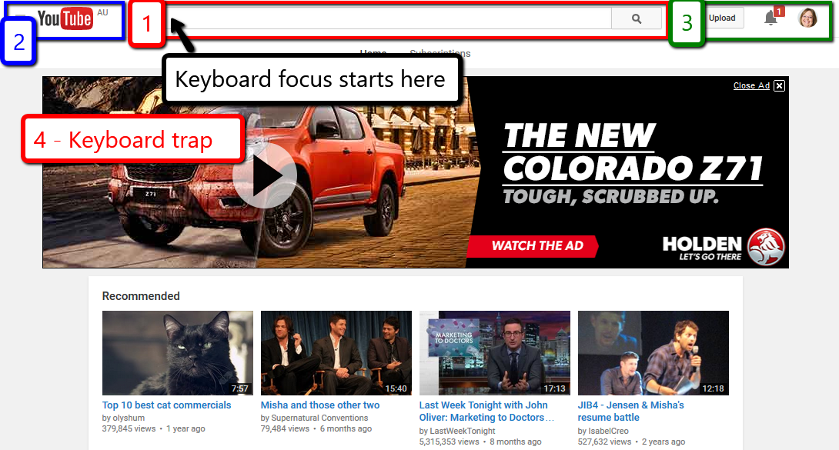
Keyboard focus starts in the search box in the middle of the top of the page. It then jumps to the left to the YouTube logo and menu. It then jumps over to the right of the search bar to the Upload, Notifications and personal icon. It then jumps to a large advertisement which is a keyboard trap.

Slide 40
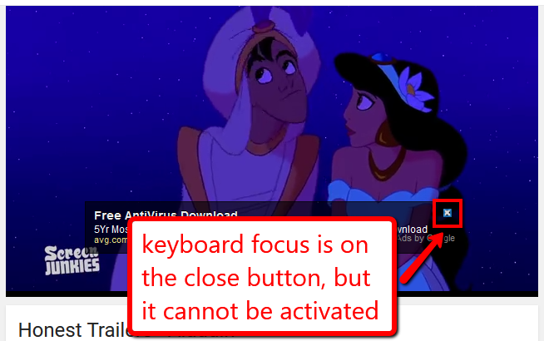
Not fully keyboard accessible
A video about Aladdin is onscreen and an ad appears over the video. Although the keyboard focus is on the close button it cannot be activated by the keyboard.

Slide 41
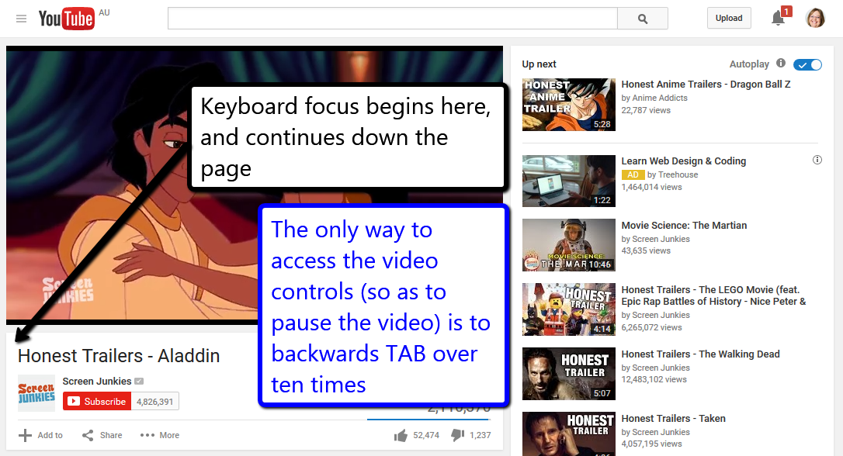
A YouTube video page is shown. When the page loads the keyboard focus begins underneath the video and tabbing continues down the page. The only way to access the video controls (so as to pause the video) is to backwards TAB over ten times.

Slide 42
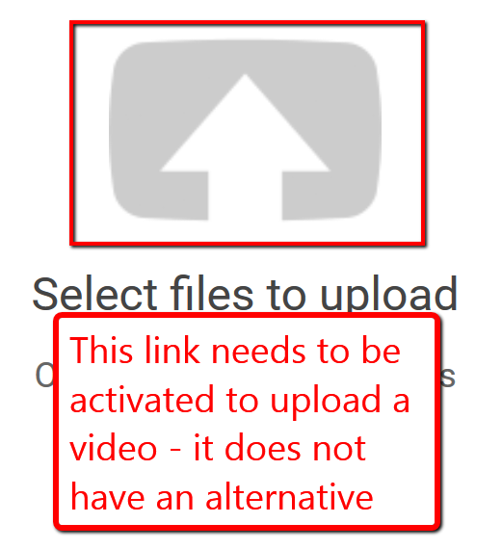
Upload button
You can only upload videos by activating this button – which has no alternative

Slide 43
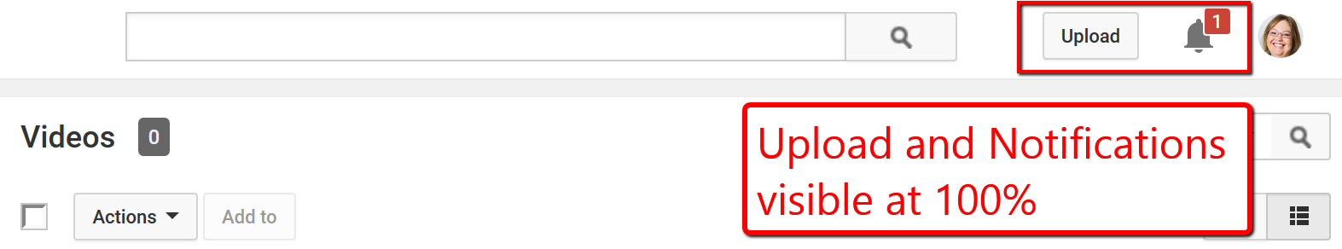
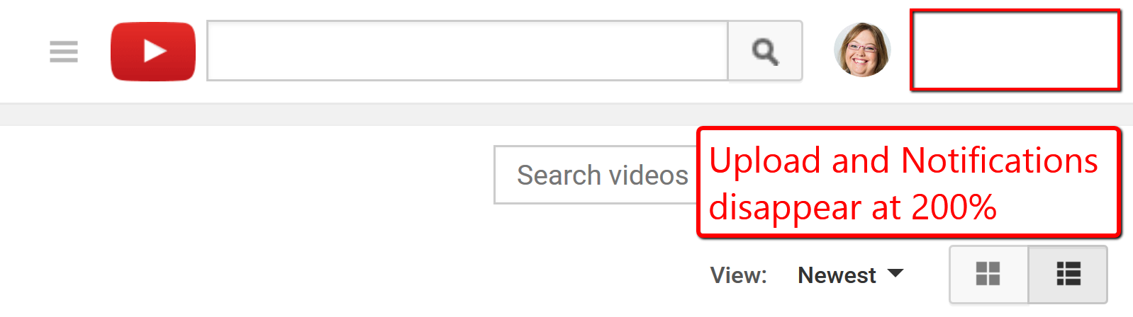
Zooming breaks the site
At Normal size the Upload button and Notifications button are visible in the top right of the screen.
At 200% zoom the Upload and Notifications buttons disappear.

Slide 44
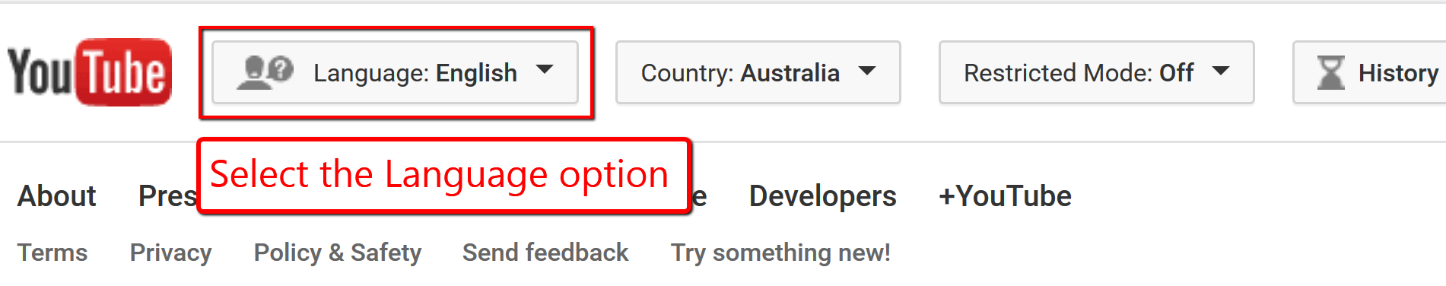
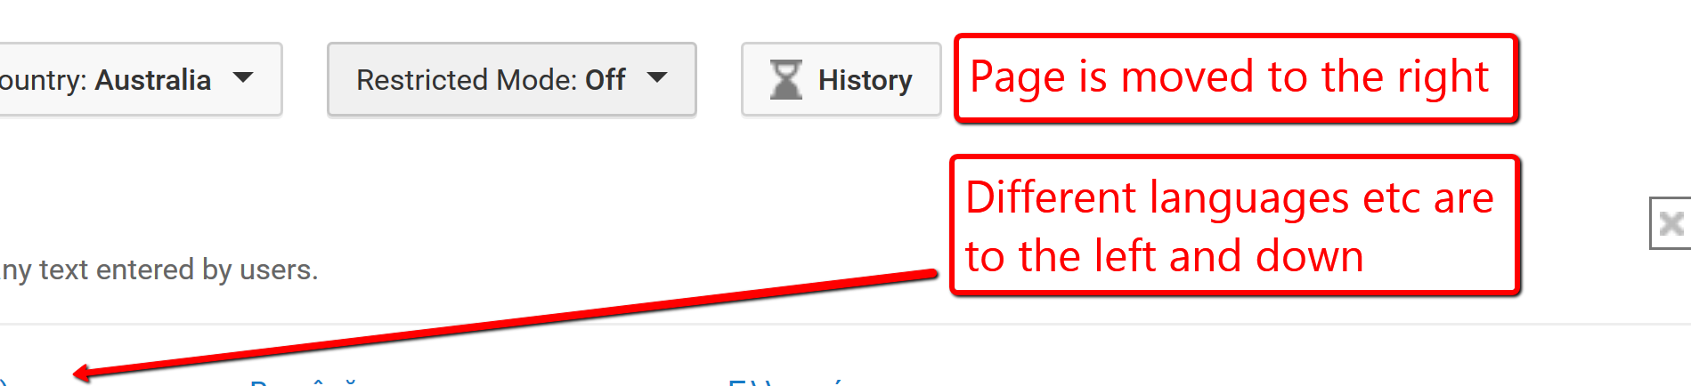
Zooming breaks the site
At the bottom of the YouTube page is the option to select a different language. The page is zoomed in.
Selecting the Language option moves the page to the very right and only blank space and some of the very right aligned headings are visible. The different languages are to the left and further down the page.

Slide 45
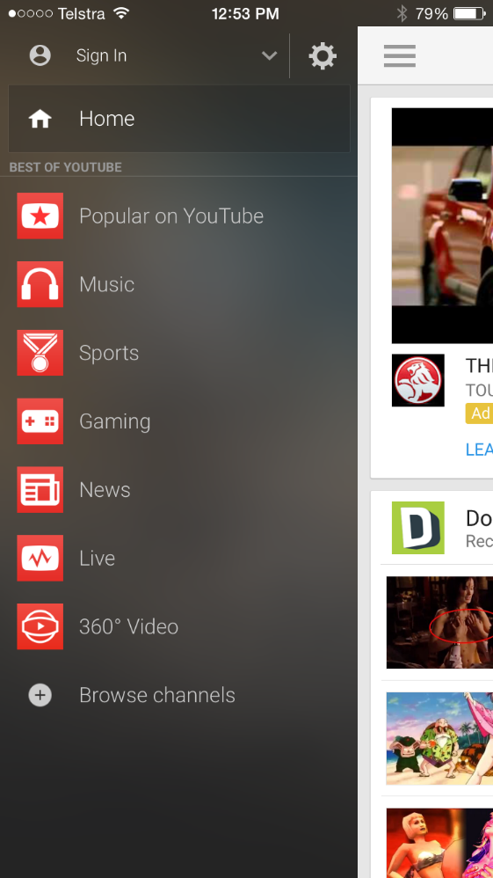

VoiceOver
‘BEST OF YOUTUBE’ read as ‘best of YaToob’
Screenshot of the YouTube mobile app with the menu open. Under the Home link is the text 'Best of YouTube' in all capital letters.
Zoomed in version of the same page.
Screenshot of the YouTube mobile app with the menu open. Under the Home link is the text 'Best of YouTube' in all capital letters.

Slide 46
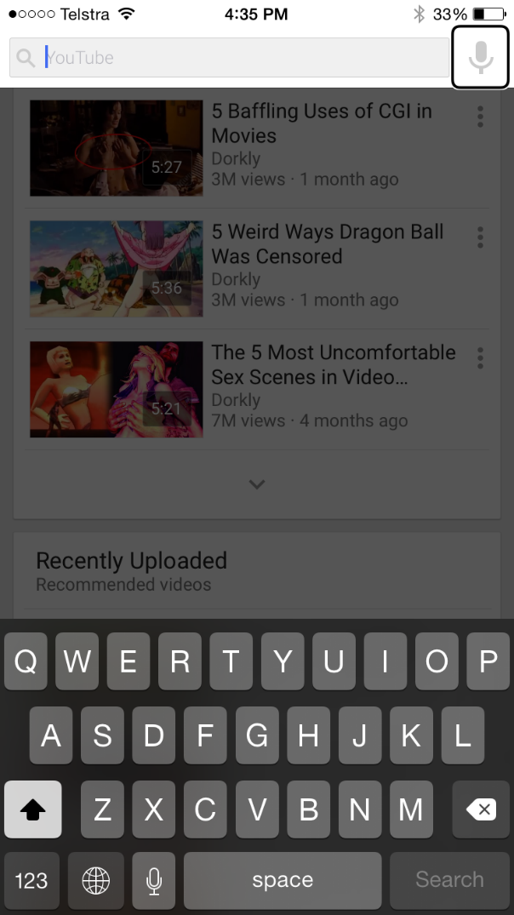
Swipe trap in VoiceOver
Search feature can’t be exited. User can force VoiceOver to read the content underneath but the search remains overlapping the content.
Screenshot of YouTube mobile app with Search feature highlighted at the top of the page. The rest of the page (videos etc) is greyed out as if inactive.
Notes:
Search feature can’t be exiting through swiping or and exit buttons. Can get it back to focus out of the search by visually touching out of the box but it start VO behind the search box which is still visual. This means that it still isn’t closed so you can’t use the back to top page option as that just sends you back to the search box focus. Could almost call it a swipe trap!

Slide 47
Step Two
Never auto-play

Slide 48
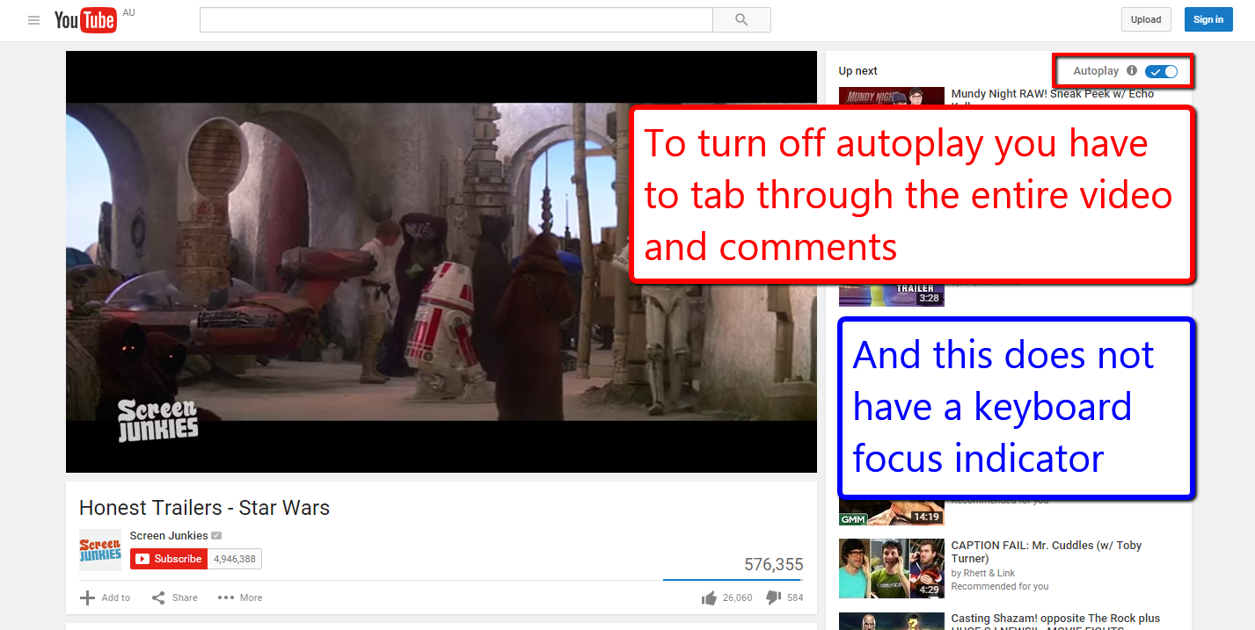
Auto-play
Notes:
YouTube

Slide 49
Step Three
No flashing content

Slide 50
No flashing
Flashing images, especially those with red, should not flicker faster than three times per second. If the image does not have red, it still should not flicker faster than five times per second.
Flashing images should not be displayed for a total duration of more than two seconds.
Stripes, whirls and concentric circles should not take up a large part of the television screen.

Slide 51
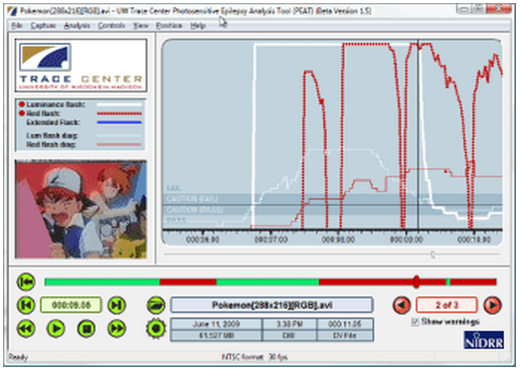
Flickering
Use the PEAT tool:
http://trace.wisc.edu/peat/

Slide 52
Step Four
Accessible content

Slide 53
Accessible content
    Use high contrast colours for any text overlaying video content
    Do not convey information with colour alone
    Avoid patterned backgrounds

Slide 54
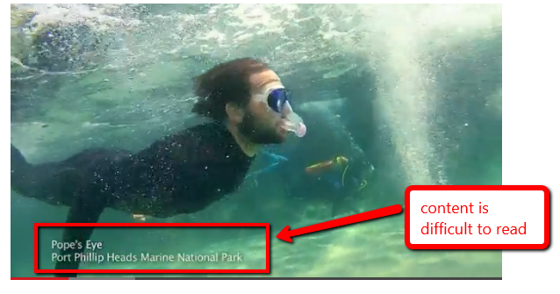
Low colour contrast

Slide 55
Step Five
Accessible transcripts

Slide 56
Accessible transcript
    Be in an accessible format
    Identify the speakers and include all speech
    Include relevant information about the speech
    Include relevant non-speech audio information
    Include any textual or graphical information

Slide 57
Accessible transcript
    Include a description of on-screen events and important changes of scene
    Indicate the end of the transcript if on the same page as the video or provide a mechanism to return to the video if on another page.

Slide 58
Step Six
Accessible captions

Slide 59
Accessible captions
    Synchronised to appear at the same time as the sound they are captioning
    Include all important audio information
    Can be read
      Sufficient colour contrast between background and caption text
      Appear on the screen for enough time

Slide 60
Accessible captions
    There are no periods without captions
    Attribute speech to a particular speaker and identify all changes in speaker
    Do not contain important information not included in the video

Slide 61
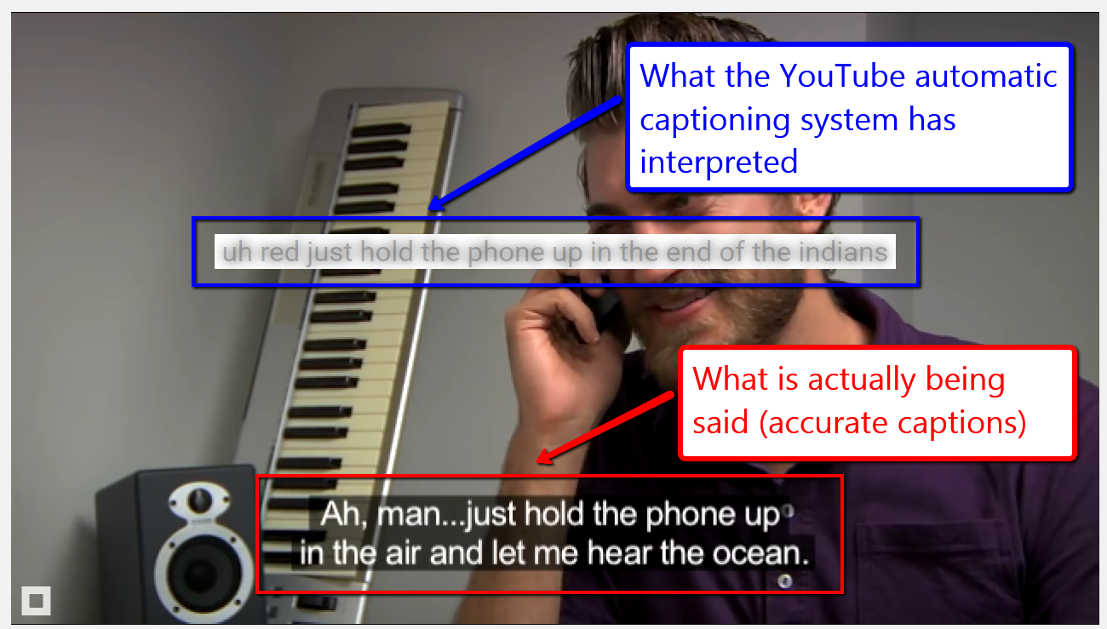
YouTube captioning
https://www.youtube.com/watch?v=23H8IdaS3tk
Screenshot of a video. What is actually being said is 'Ah, man... just hold the phone up in the air and let me hear the ocean.' What the YouTube auto-captioning feature captioned is 'uh red just hold the phone up in the end of the indians'.

Slide 62
Step Seven
Accessible audio descriptions

Slide 63
Accessible audio descriptions
    Adequately describes all important visual information
    Does not impact on other speech or important sounds
      May need to create an alternative video which includes pauses to allow sufficient time for information to be delivered at the appropriate point (extended audio description)

Slide 64
Accessible audio description
    Can be heard
      Is distinguishable from the audio content in the video itself
    Contains only information included in the video

Slide 65
Example extended Audio Descriptions
A11yoz.com/ead

Slide 66
Example automated captions
A11yoz.com/captionfail

Slide 67
Questions?

