Slide 1
History of Web A11y
Access slides and links: pz.tt/history

Slide 2
1995:
Unified Web Site Accessibility Guidelines released
Notes:
These were compiled by Gregg Vanderheiden developed by people in the a11y industry
Came out of a discussion between Tim Berners-Lee and Mike Paciello. Tim went to pre-conference workshop (run by Mike at WWW Conference) and then mentioned disability access in his keynote.
Version 8 was released in 1998 and was the starting point for WCAG1

Slide 3
1997:
WAI created
Notes:
The W3C created a division called Web Accessibility Initiative

Slide 4
1998:
Section 508
Notes:
Clinton signed Workforce Investment Act into law (basically Section 508)
This required a11y for electronic and IT for all federal purchases
Started working on WCAG1

Slide 5
1999:
WCAG 1.0 released

Slide 6
Web Content Accessibility Guidelines, Version 1.0
Released in 1999
14 guidelines, 65 checkpoints
Seen to be “too complex”
Notes:
It was not technology-independent. Referenced client-side and server-side image maps. No “Click here” links

Slide 7
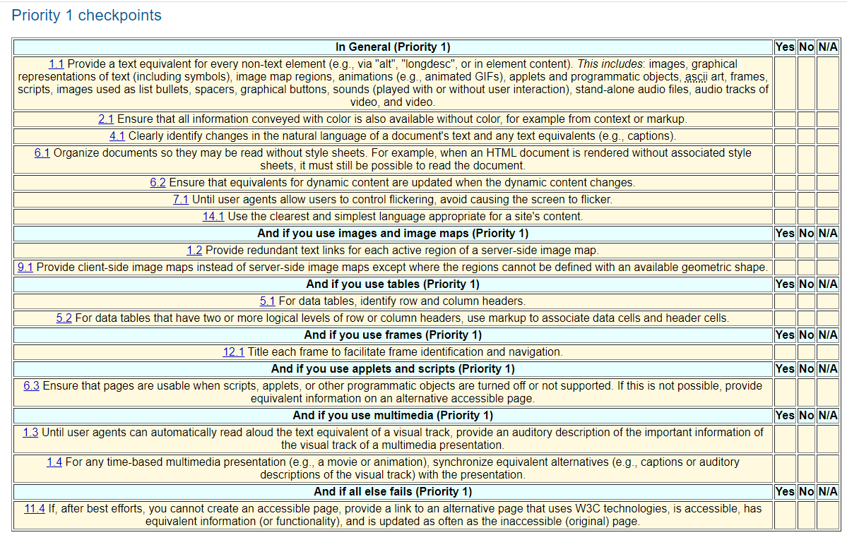
WCAG1 Checklist

Slide 8
2000:
First accessibility litigation
Notes:
Bruce Maguire wanted to buy tickets to see the Olympic Games. Vision impaired

Slide 9
Maguire vs SOCOG
JavaScript for navigation
Screenshots of tables of results instead of coded tables
SOCOG ignored Human Rights Commission
Notes:
SOCOG argued it would cost $16 million to make the site accessible.
Judge fined them $20,000 (deemed it would have cost $10,000 to make the site accessible)
Awarded attorney’s fees to Maguire and HREOC which were over $500,000
Hit the front page of every newspaper in Australia.
I joined WCAG WG

Slide 10
2006:
First public draft of WCAG2 released
Notes:
Very controversial

Slide 11
WCAG 2.0
“Testability” criteria
Lisa Seeman: Formal objection
WCAG Samurai Errata
WCAG2 published in 2008
Notes:
Testable: 8 out of 10 accessibility specialists agree on the outcome, NOT automated a11y testing
A List Apart article – example of ALT attributes
Lisa Seeman (and myself) lodged a formal objection that WCAG2 did not address the needs of people with cognitive disabilities
WCAG2 was pulled from public release
Small group of a11y specialists worked on WCAG Samurai Errata by Joe Clark (contributors were anonymous). I presented a third party review of the document.
WCAG2 was published in 2008 and I published a blog post called “Why I’m still using WCAG1”

Slide 12
2008:
WCAG2 published
Notes:
Very controversial

Slide 13
2008:
Target (US) sued by NFB
Notes:
Argued lack of alt text, online purchases required a mouse, inaccessible image maps, headings missing
NFB had been complaining since 2005. Judge found that although the site was not connected to a single physical place they are connected enough to be included.
2008 they settled with damages of $6 million. NFB legal costs were $3.5m

Slide 14
2012:
Netflix sued by NAD
Notes:
First time a company was sued that didn’t have a public location
Argued it would be a copyright violation
Required to provide captions to all video by 2012, $795,000 damages awarded
Released DareDevil in 2015 without AD

Slide 15
2014:
Coles sued
Notes:
Worked several years to make their online systems accessible
Released new system in mid 2014 which was not accessible
DDA commissioner retrenched by Government in 2014
Settled out of court

Slide 16
2014:
EN 301 549
Notes:
Public procurement of all EU ICT products and services

Slide 17
2014:
BBC Mobile Accessibility Guidelines released
Notes:
Merged mobile app and mobile site requirements
BBC said they shouldn’t be used

Slide 18
2018:
WCAG 2.1 released
Notes:
Addressed issues around people with cognitive disabilities and low vision being left out.
Touch targets size relegated to AAA

Slide 19
WCAG2
WCAG2 success criteria are applicable to mobile, however, not all aspects of mobile accessibility are specifically covered by WCAG2. For example, although WCAG2 requires sites to be accessible to the keyboard user, it does not specify that it should also be accessible to the touchscreen user.

Slide 20
2018:
First ICT Mobile Testing Methodology released
Notes:
Methodology on accessibility testing for mobile, firstly amalgamation of current standards

Slide 21
WCAG2.1
WCAG2.1 builds on this and addresses more criteria related to touch screen (pointer gestures), sensors and small screen devices, however it still does not cover all user needs related to mobile accessibility.

Slide 22
Mobile Testing Methodology
ICT Accessibility Testing Symposium has developed a methodology for evaluating the accessibility of mobile web sites. This document is an amalgamation of accepted mobile accessibility testing standards from around the world, including additional developments from the ICT Accessibility Testing Symposium’s Mobile Sub-Committee.

Slide 23
2020:
Second ICT Mobile Testing Methodology released
Notes:
Detailed standards for native app and mobile site

Slide 24
Q&A

Slide 25
Contact AccessibilityOz
@accessibilityoz
AccessibilityOz
inquiries
@accessibilityoz.com

