Slide 1
Social media and Accessibility http://a11yoz.com/smriskforum

Slide 3
Hidden in plain sight
Speech-to-text program
Magnifier
Epilepsy
Migraines
Notes:
PWD: 38 million
Physical: 20 million
Cognitive: 14 million
Hearing: 11 million
Vision: 7 million
http://factfinder2.census.gov/faces/tableservices/jsf/pages/productview.xhtml?pid=ACS_12_1YR_S1810&prodType=table

Slide 4
It’s not just about vision impairments
Notes:
PWD: 38 million
Physical: 20 million
Cognitive: 14 million
Hearing: 11 million
Vision: 7 million
http://factfinder2.census.gov/faces/tableservices/jsf/pages/productview.xhtml?pid=ACS_12_1YR_S1810&prodType=table

Slide 5
Our Services
Audits
Mobile testing
Building web sites
CMS testing
Accessible design
Video accessibility
User testing
OS / browser testing
Consultation
Accessible documents

Slide 6
Our Services
Audits
Mobile testing
Building web sites
CMS testing
Accessible design
Video accessibility
User testing
OS / browser testing
Consultation
Accessible documents

Slide 7
Our Products
OzPlayer
OzART
OzWiki
BrowseAloud
More information:
www.accessibilityoz. com.au

Slide 8
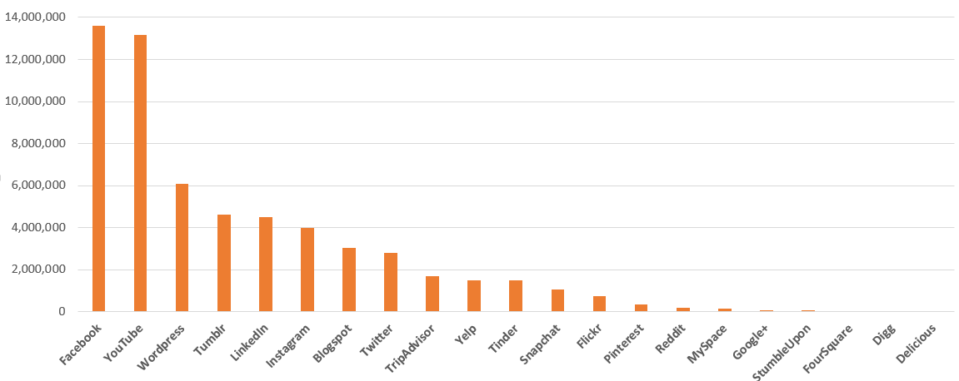
Social media usage in Australia – October
Statistics compiled by SocialMediaNews.com.au for October 2014. Stats courtesy: Vivid Social Research Division. Figures correct as of 31/10/14

Slide 9
John Sheridan - AGIMO
I think it's important to recognise that every day relatively junior government staff engage with the public on the telephone, across the counter, in the street, in a whole range of ways. They do that without creating enormous difficulties for the department.

Slide 10
John Sheridan - AGIMO
Indeed on the whole they cope with difficult situations in a very responsible way, and generate excellent results for the department. My concept here is why shouldn't we trust them therefore, to do the same online?
New Media: An Australian Government Perspective

Slide 11
Australian Government
123 Facebook pages
195 Twitter accounts
59 YouTube channels
23 Flickr accounts

Slide 12
Why isn’t social media accessible?

Slide 13
Testing
#TestAllTheThings

Slide 14
Accessibility problems with Facebook
Timeline layout has logical reading order but cannot be navigated
No alternative text on photos and pictures by default
CAPTCHA during signup
Facebook changes frequently

Slide 15
Accessibility problems with YouTube
All videos auto-play
Registration uses CAPTCHA
Lack of keyboard controls
Automatic captioning is inaccurate
Limited support for audio descriptions
Notes:
Last week, the FCC voted to require captions on online videos starting in 2016. - See more at: http://fedscoop.com/social-media-accessibility/#sthash.7to54PiF.dpuf

Slide 16
Accessibility problems with Twitter
Registration completed via CAPTCHA
Text resizing is not possible
Many links (replying, favouriting and deleting a tweet) available only to the mouse user

Slide 17
Five steps to making social media accessible

Slide 18
Step One: Contact details
Make your contact information available on your social media account page
List a primary phone number and email address where a user can reach your agency with questions, or provide a link to your agency website that lists the appropriate contact information

Slide 19
Step Two: Repeat content
Make your social media content available through your web site
Provide options for daily digests
Provide easy points of entry for more information
Post your social media to multiple outlets

Slide 20
Step Three: Provide alternative apps
Provide contact details to social media support / accessibility teams within your organisation
Provide links to the social media accessibility tips and support
Provide links to alternative apps and web sites that create an accessible interface for social media

Slide 21
Step Four: Clear and simple language
Use camel case
Avoid abbreviations
Limit hashtags and add them only to the end
Avoid mis-spellings
Where linking to others’ content on YouTube, warn users of auto-play, lack of transcripts, captions or audio descriptions

Slide 22
Step Five: Test
Consider testing your social media with users with disabilities
Consider testing your social media against WCAG2
Adapted from digital.gov

Slide 23
Facebook
Specific tips to make Facebook accessible

Slide 24
Facebook accessibility
Add captions to images
Link to transcripts for videos
Load videos to YouTube and add captions there

Slide 25
Facebook accessibility
Recommend alternative methods to the desktop interface:
Facely HD
m.facebook.com

Slide 26
YouTube
Specific tips to make YouTube accessible

Slide 27
YouTube accessibility
Warn users of the auto-play
Make sure there is a transcript, captions and audio descriptions for all videos

Slide 28
YouTube accessibility
Recommend alternative methods to the desktop interface:
Accessible Interface to YouTube
Accessible YouTube
The ICANT

Slide 29
YouTube accessibility
Host the videos on your web site in an accessible player:
OzPlayer
PayPal Accessible HTML5 Video player

Slide 30
Twitter
Specific tips to make Twitter accessible

Slide 31
Twitter accessibility
Describe photos and video or provide a link to the description
Consider preceding tweets with [PIC], [AUDIO], [VIDEO]

Slide 32
Twitter accessibility
Recommend alternative methods to the desktop interface:
EasyChirp
Twitterific (mobile app)

Slide 33
Questions
a11yoz.com/ smriskforum

